Slide 1
Thanks For Your Interest In Student Government!
View the following slides to learn more about us, where to find us and how to join us!

Slide 2
What Is SGA?
Our role is to be active participants in the governance of the university, representing student interests, and creating policies concerning student life, services, and interests.
Every Spring the Student Body votes for the President and Vice President
Each College elects Senators to represent them at Senate
Once elected, the President and Vice President appoint Executives
SGA is structured in three branches of government:
Executive Branch, Legislative and Judicial

Slide 3
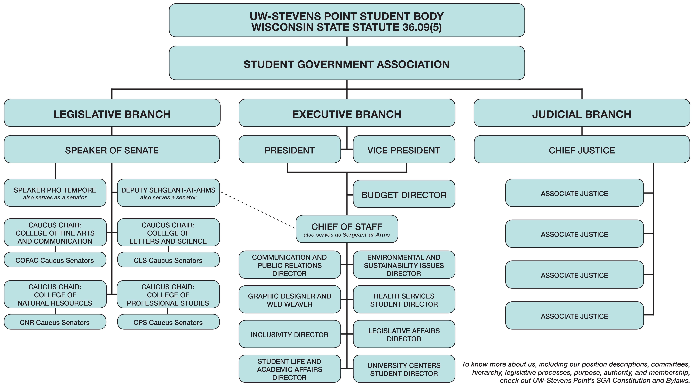
How are we organized?

Slide 4
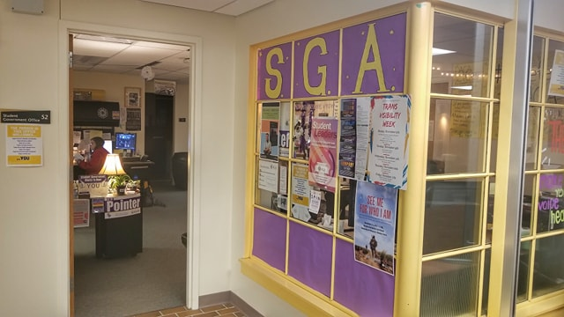
Visit Our Office
Dreyfus University Center, Room 052
Email: SGA@UWSP.edu
Office Phone:(715) 346-4592

Slide 5
Connect With Us On Social Media
Facebok.com/UWSPStudentGov
Instagram.com/UWSP_SGA
Twitter.com/UWSP_SGA

Slide 6
Attend Weekly Senate Meetings
Unless noted, all meetings are held in the DUC Legacy Room. Meetings begin at 6:15 p.m. and end when the agenda has been completed. Our meetings are open to ALL Pointers! You can show up at ANY time!

Slide 7
Questions To Ask Us
What does SGA mean?
How do I become a Senator?
Can I be involved with SGA without being a Senator?
What are the three branches of SGA?
When does Senate meet?
Are Senate meetings open to the public?

Slide 8
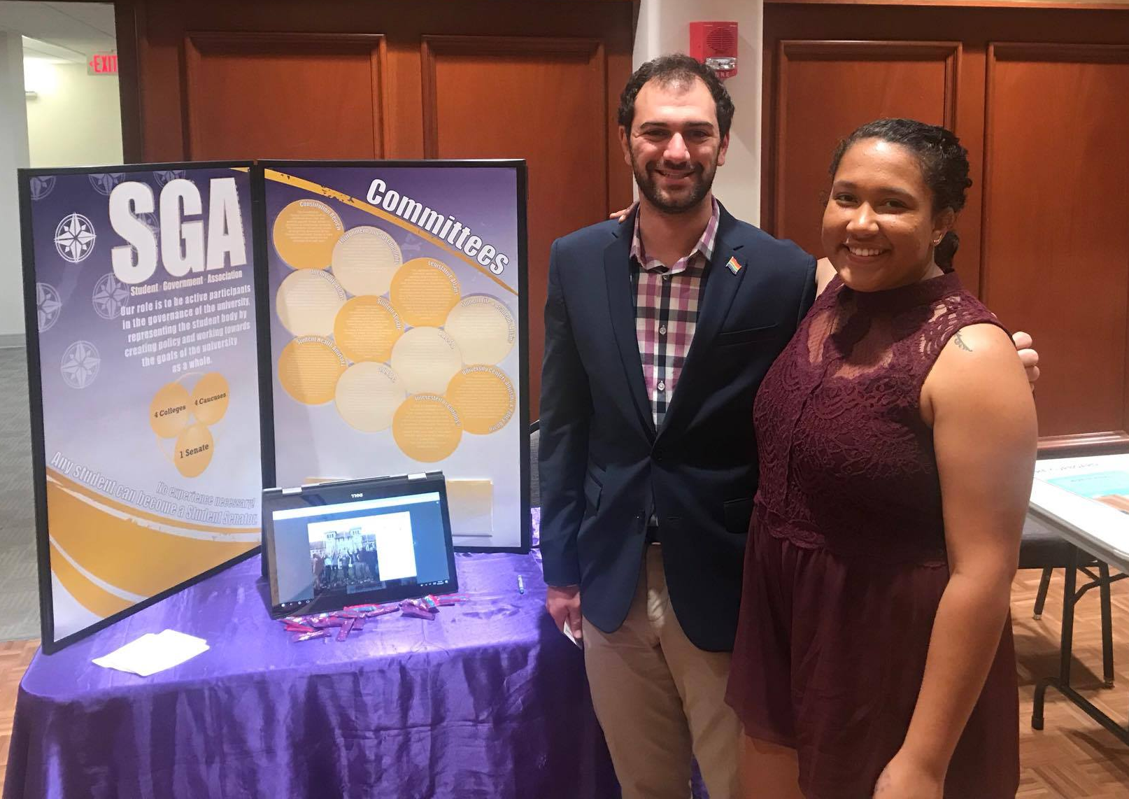
Have Questions?
Email Us: SGA@uwsp.edu
Call Us: (715) 346-4592
Visit our Office, DUC 052
SGA Advisor, Leigh Jentz
Leigh.Jentz@uwsp.edu
Budget Questions?
Email: SGA.Budget.Director@uwsp.edu

