Slide 1
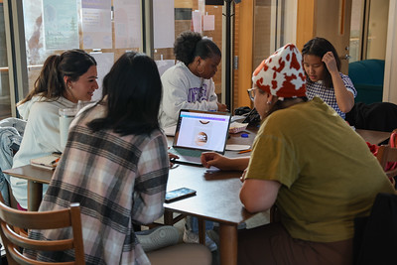
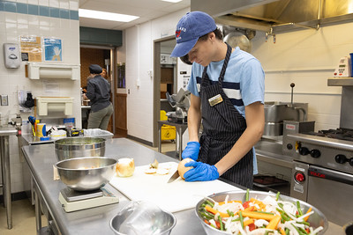

Retention Summit 2025
Understanding Our Students to Positively Impact Retention

Slide 2


Slide 3

Chancellor’s Welcome

Slide 4
Summit Outcomes
More thoroughly understand our students, their basic needs, and the current retention environment.
Identify and engage with the resources available to help units take retention-supportive actions.
Understand the number and percent of students each unit must retain to reach university retention goals.

Slide 5
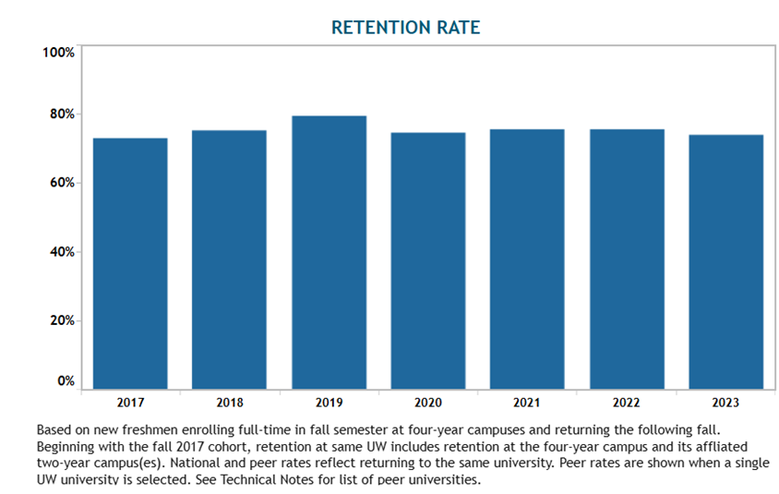
Where we stand
72.9%
75.2%
79.3%
74.6%
75.3%
75.4%
73.8%
Data from https://www.wisconsin.edu/accountability/progress-and-completion/, accessible through OIRE website: Compliance and External Reporting > UW System Accountability and Education Reports & Statistics > Progress & Completion.

Slide 6
Where we’re going
Fall 2023 73.8%
Fall 2024
75.5%
Fall 2027
80%
Rates by entering cohort
Notes:
Going to share data about the number of students your unit will need shortly to meet this goal.

Slide 7
What we heard
Faculty and staff are concerned with:
Student engagement and behavior
Academic performance and expectations
Technology and attention
Mental health and well being
Changes to the education system and curriculum
Notes:
Faculty and staff are concerned with

Slide 8
What the data tells us - preparedness
 | 2017 | 2018 | 2019 | 2020 | 2021 | 2022 | 2023 | 2024
Average high-school GPA of incoming cohort | 3.26 | 3.28 | 3.30 | 3.26 | 3.27 | 3.30 | 3.28 | 3.29
Percentage of cohort in developmental math (Math 90 & 95 combined) | 29% (n=432) | 33% (n=471) | 37% (n=550) | 41% (n=718) | 25% (n=444) | 29% (n=492) | 27% (n=497) | 22% (n=406)
Percentage of cohort earning at least one D, F, or W in the first semester | 32% (n=477) | 35% (n=494) | 36% (n=544) | 33% (n=579) | 40% (n=718) | 36% (n=622) | 38% (n=693) | 31% (n=576)
Notes:
NOTE: I had hoped to provide data for a ten-year period, but 2017 was as far back as I could reach with confidence, in terms of providing information about developmental math and DFWs. Also note that numbers include branch campuses, when applicable; refer ONLY to those students with a known HS GPA to facilitate comparisons across HS GPA, or "preparedness" tiers; and are pulled from OIRE's census snapshot, rather than System's CDR file. For these reasons, the numbers presented here will look different than the numbers available on various public sites. Average HS GPA, developmental math placements, and percentage of FTCs earning at least one D, F, or W grade in the first semester have remained relatively constant since 2017. While the numbers suggest that little has changed, in terms of students' preparedness, a qualitative look at students' experiences both in high school and in their lives as college students suggest that today's students do come to campus with different expectations, skills, knowledge, mindsets, and needs than past cohorts of students. The next few slides as well as our breakout sessions will provide additional insight. OBSERVATION: students from all HS GPA tiers are consistently placed in developmental math, but the four lowest tiers (lower than 3.5) are consistently overrepresented in developmental math. The same pattern holds true for students who earn at least one D, F, or W grade in their first semester.

Slide 9
What the data tells us
Basic Needs and Mental Health
35% of our students receive counseling.
Anxiety: 35%
Depression: 23%
ADHD: 19%
Autism: 9%
Mental health tops the Students of Concern reports.
43% experienced at least one of the following: food insecurity, housing insecurity, or homelessness.
29% experienced limited or uncertain availability of food in the prior 30 days.
29% experienced one or more challenges that prevented them from having a safe, affordable, and consistent place to live in the previous year.
9% did not have a fixed, regular, and adequate place to live at some point during the previous year (unhoused).
Notes:
67% of respondents were 18-20
23% 21-25
i.e. most of the students struggling are in campus housing, campus meal plans (i.e. homeless if withdraw or over summer)

Slide 10
What the data tells us
Retention of Students Who Find Their Purpose
Students who enter undecided or undeclared and change their major are retained at a higher rate and have a higher GPA than those undecided/undeclared students who do not change the major.
Students in high DFW courses that earn at least one DFW and change their major are retained at a higher rate and have a higher GPA than similar students who do not change their major
Generally: Those who discern their major and stick with it are more successful and are retained at higher rates.
Notes:
Current retention for undeclared is in the 60s. Major changers of any type retain in the high 70s, and erases equity gaps

Slide 11
Where our students are at
Skills gap, not a fundamental intelligence gap
K-12 has shifted firmly to a support model, and college is still an access model.
The new traditional student is balancing work, family, and their mental health along with college.

Slide 12

What we can control

Slide 13

What we can control
Stop “should”-ing on our students: design for who we have.

Slide 14

What we can control
We can shift our approaches and actions together
Notes:
Our actions are what’s in our control –we can shift our approaches

Slide 15
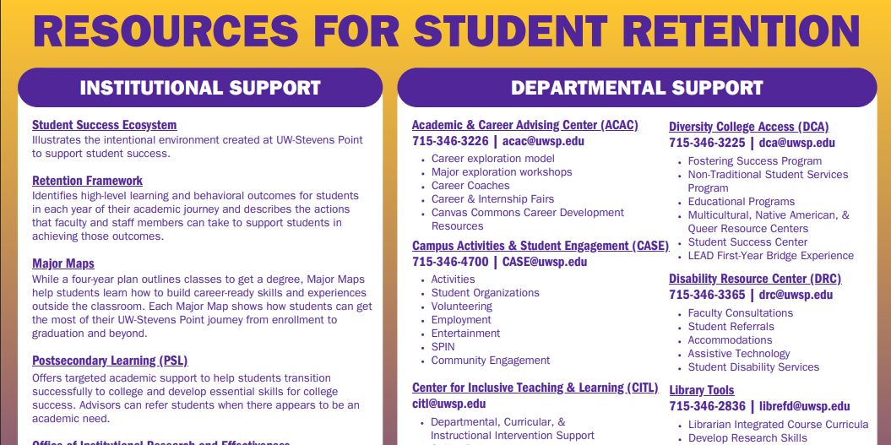
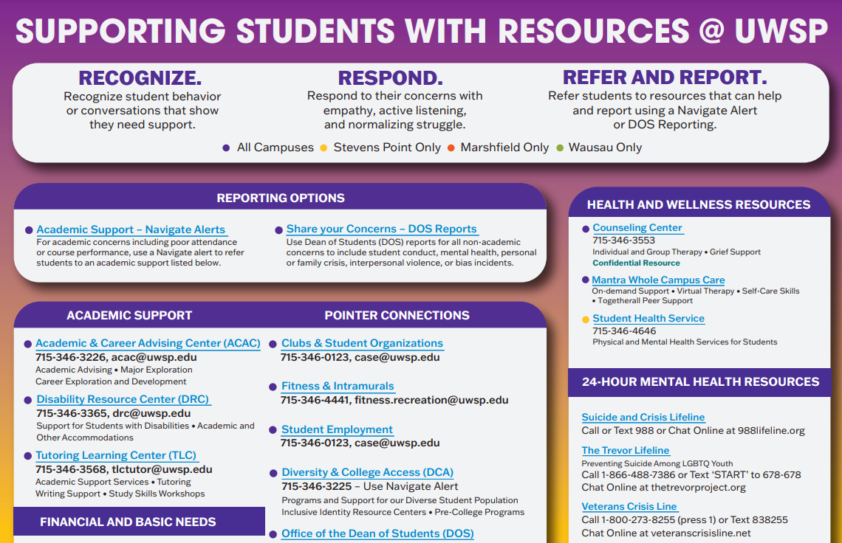
Tools We Have
Notes:
See handout
Has QR codes
Queue Sarah to hand out goals document

Slide 16
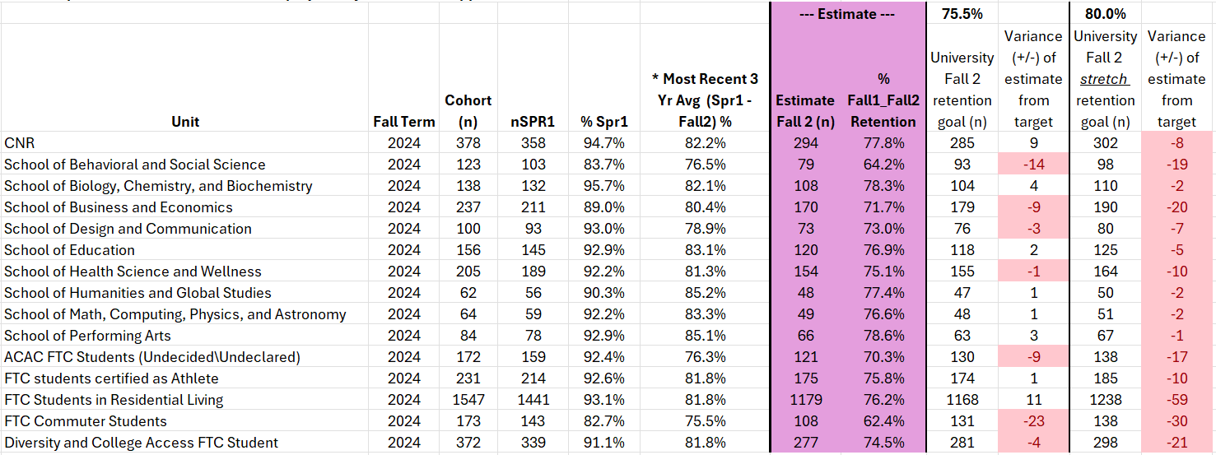
Retention Goals
Notes:
Goal was to 80%

Slide 17
Interactive Time
Activity #1: Unit Framework Assessment
Breakouts with Tools and Resources
Activity #2: Department Action Steps

Slide 18
Activity #1:
Unit Framework Assessment
Choose one of the five elements of the student experience from the UWSP Retention Framework
From the outcomes listed, identify 2-4 actions your unit currently takes to support first year student retention
Which activities have the biggest impact? Considering what you just heard, what changes will you make?

Slide 19
Break-outs

Slide 20
Activity #2
Department Action Steps
What 1-2 actions do you plan to take or continue to impact first year retention this semester?
What 1-2 actions do you plan to take or to impact first year retention for incoming students in fall 2025?
How will you talk with your unit about the impact of these actions?
What resources can the univeristy provide to support you in implementing or continuing to use the actions you’ve described?

Slide 21
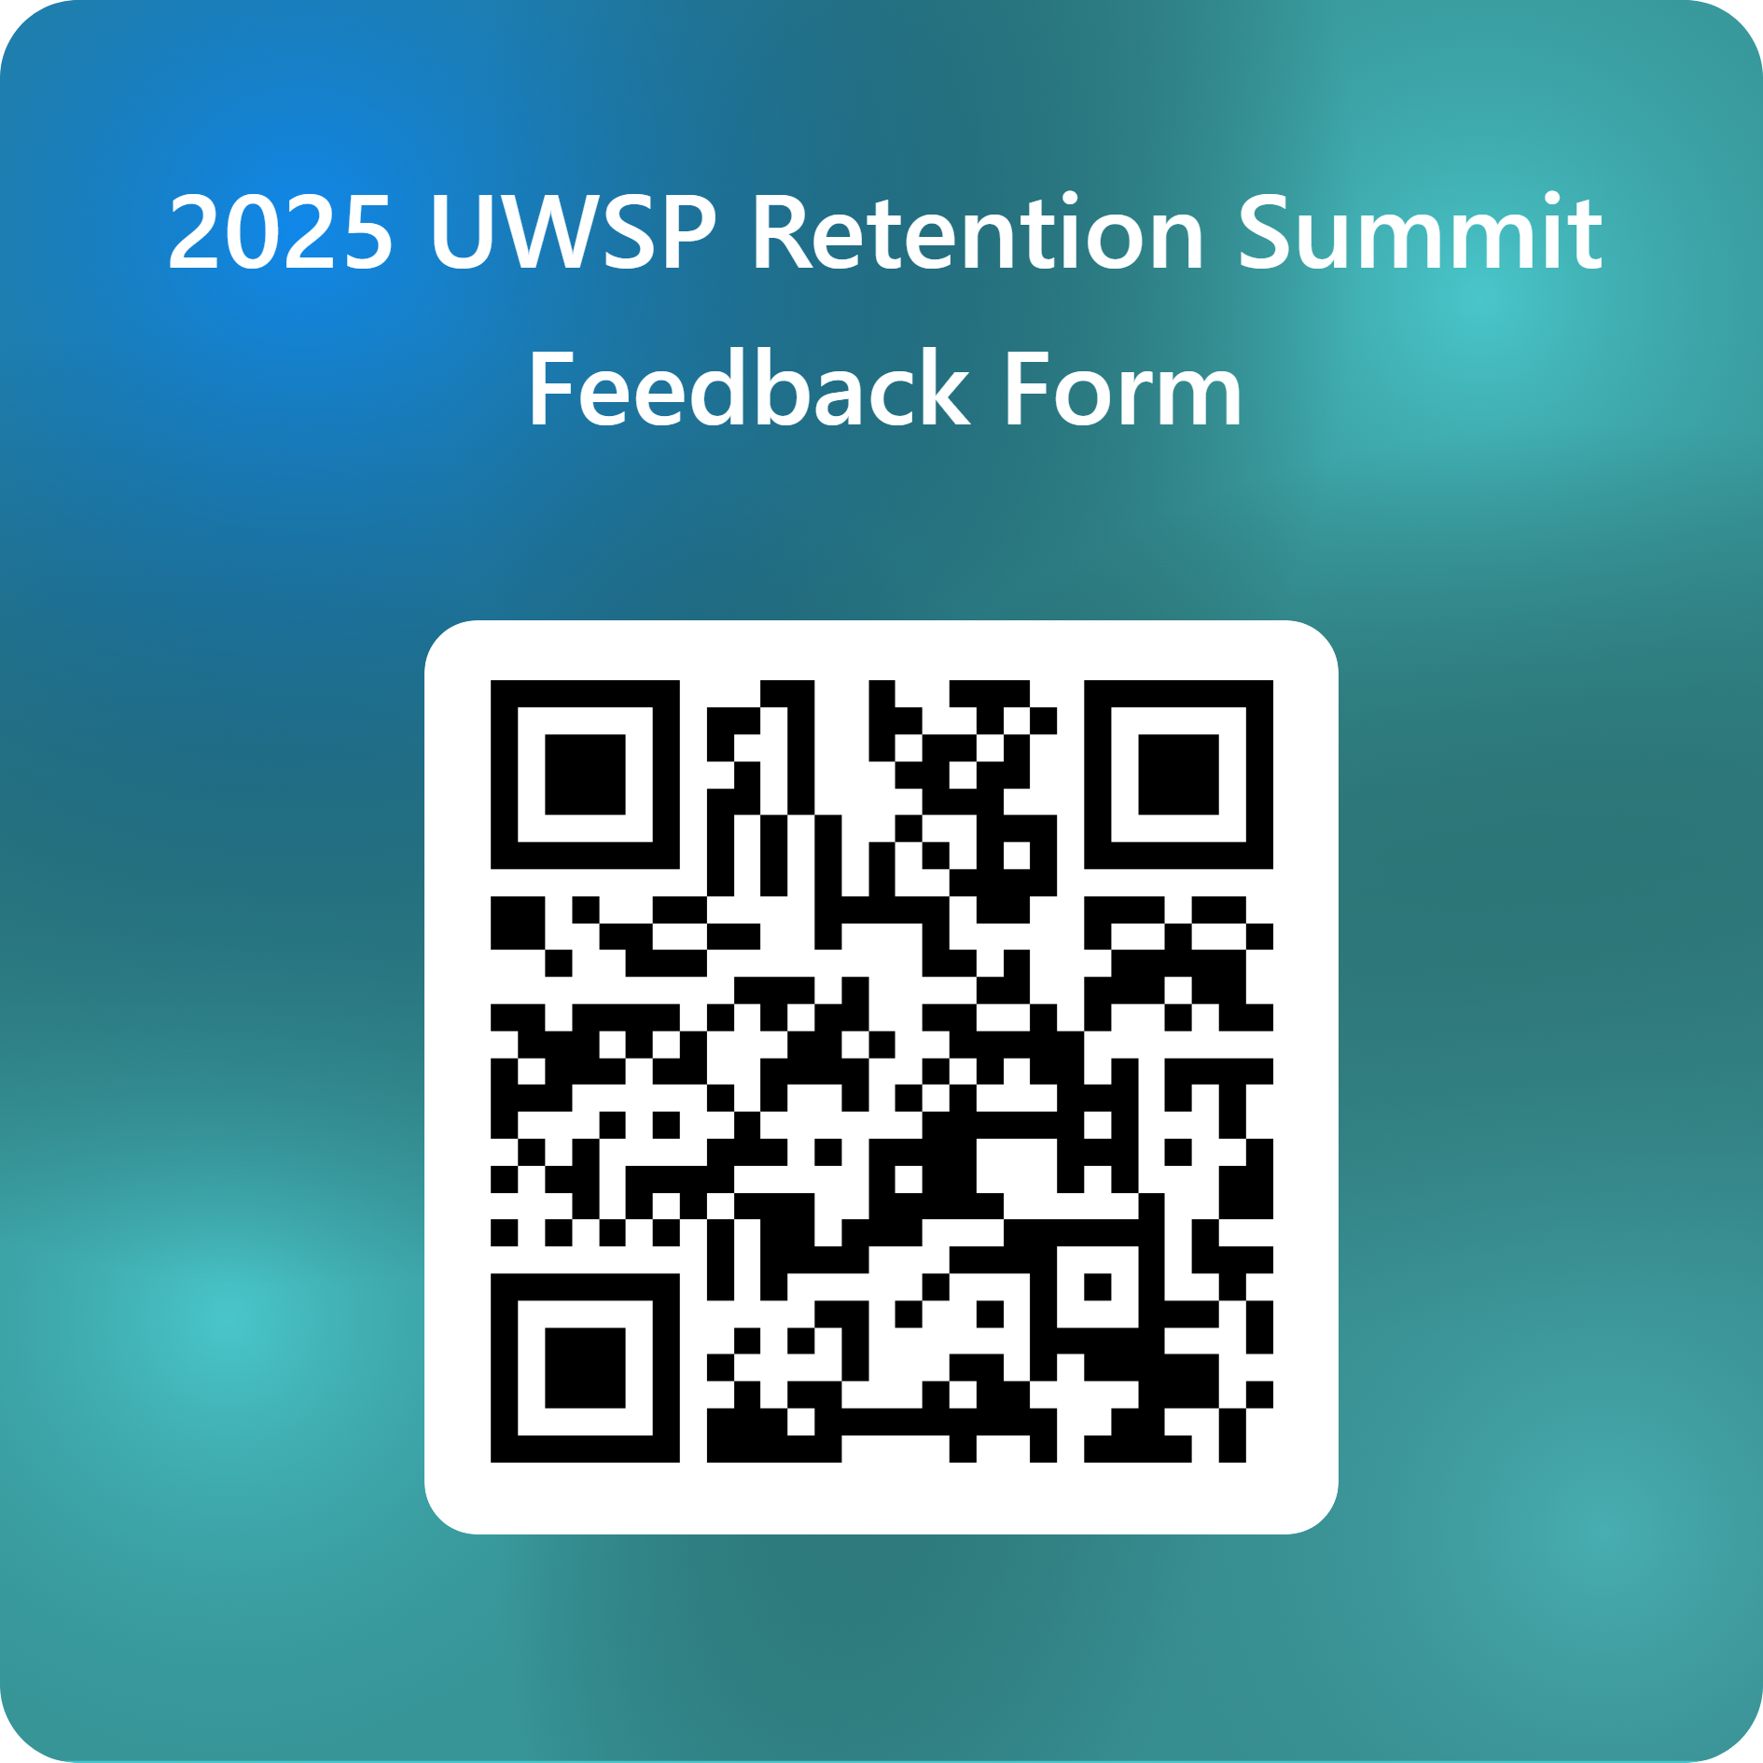
Exit Survey
We value your feedback on today's event! Please take a few moments to complete the feedback form linked below.
2025 UWSP Retention Summit

