Slide 2
Helping Students Navigate Changes in Their Purpose in the First Year
Retention Summit 2025
Laura Bell, Annette Hackbarth-Onson, Brittany Kaminski, Justin Willis

Slide 3
Discover Your Purpose Brand and Brand Positioning
Engaged with BVK marketing firm out of Milwaukee – conducted stakeholder interviews and surveyed prospective student tour groups through Admissions and Recruitment
We believe there is an interesting, and potentially compelling, story around the Liberal Arts education provided by Stevens Point that could form the basis of the UWSP positioning.
We understand that today’s students are looking for further education that makes them “job ready” but feel that when a liberal arts education serves as the basis of whatever a student’s major is, it makes them uniquely qualified to problem-solve in whatever field they pursue.
We feel that can be compelling to employers, who benefit from graduates who have both hands-on and problem-solving skills, as well as to the students themselves, for whom opportunities open up.
But, in a world where the liberal arts are diminishing in appeal, the way in which this is reflected in brand positioning and communications will be critical.

Slide 4
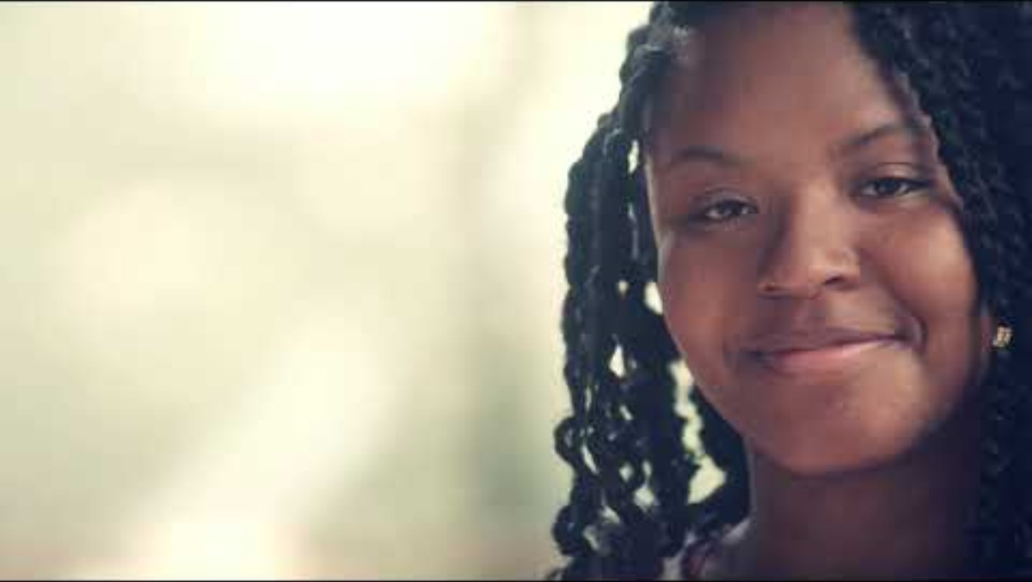
Brand Anthem Video

Slide 5
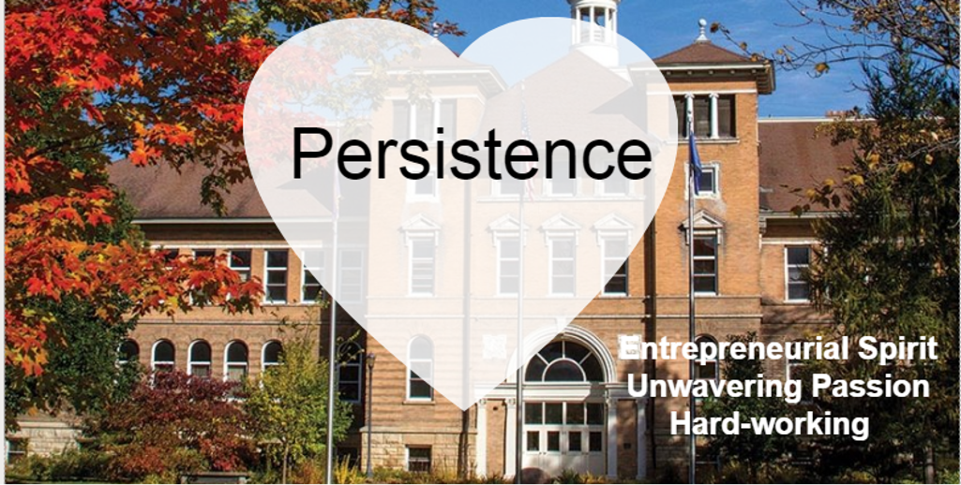

Slide 6
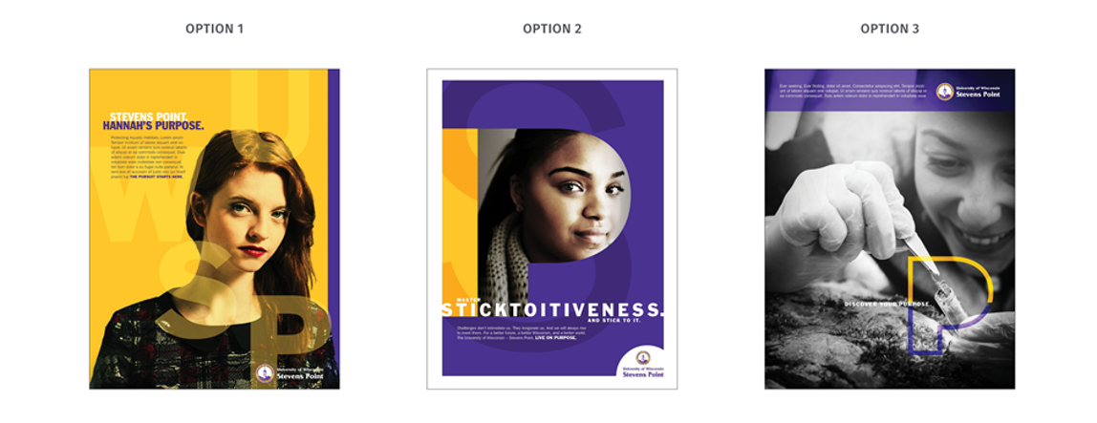

Slide 7
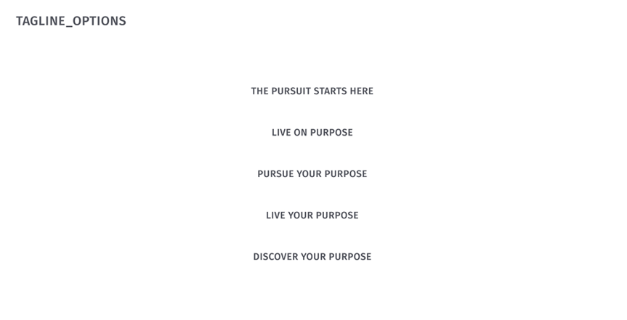

Slide 8
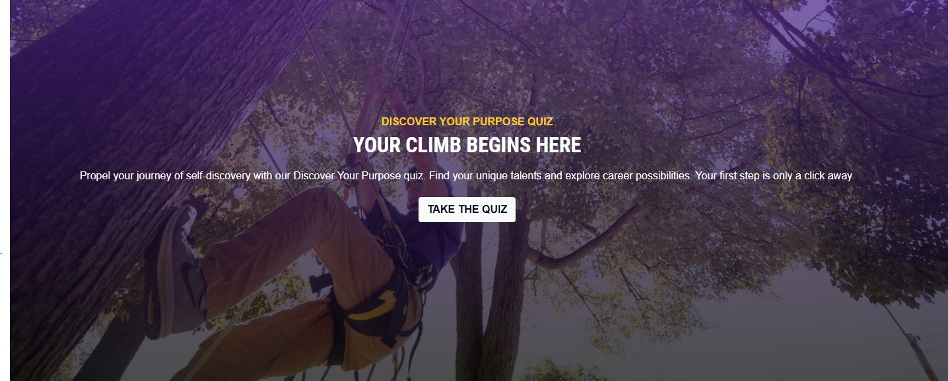
Discover Your Purpose Quiz
Homepage - University of Wisconsin-Stevens Point (uwsp.edu)

Slide 9
How is the DYP Quiz used?
Strategic Slate Distribution (High School Grades 10-12)
Managed by Enrollment Communications Coordinator (Stacy Brokish)
Purpose: Student engagement and Marketing UWSP
High School Engagement
Shared during high school visits with students
Featured topic during discussions with high school counselors
Fall Go Wisconsin Counselor Workshops (Annually)
6 locations across Wisconsin
Additional workshops in Minnesota and Illinois
Campus Visit Integration
Featured in daily campus tour presentations
Supports prospective student exploration

Slide 10
Knowledge Economy: Key skills for the future
1. Critical Thinking*
2. Problem Solving*
Newly emerging skills on this list:
3. Resilience
4. Stress Tolerance
5. Flexibility
6. Active Learning
Others
7. Creativity
8. Leadership and social influence
9. Technology use/monitoring
10. Technology design/programming
Top 10 skills of 2025 (World Economic Forum)​
*The top 2 skills have remained employers' highest priorities since 2016 and are projected to maintain this ranking

Slide 11
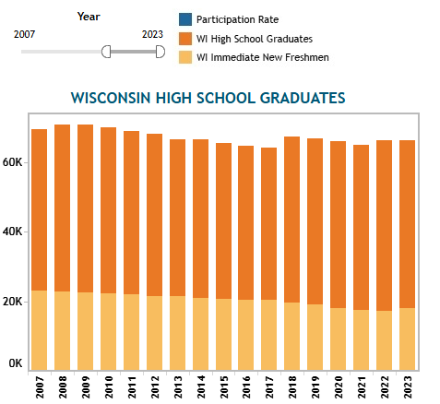
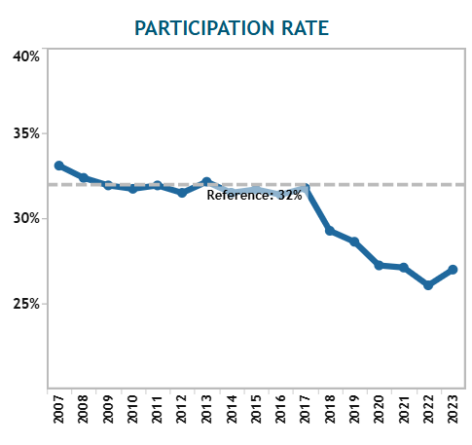
Wisconsin High School Graduates (OPAR)

Slide 12
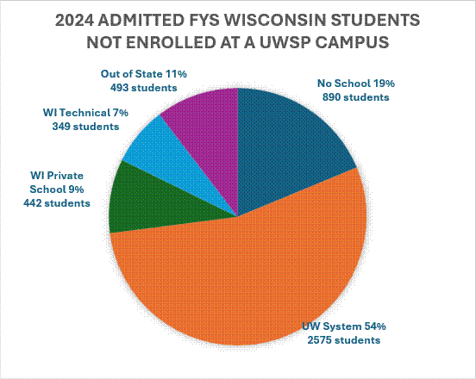
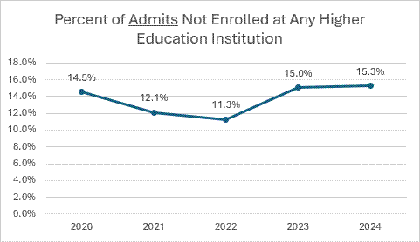
Higher Education Non-consumption

Slide 13
What are Student MindsetsTM – Encoura
Prospective Student MindsetsTM allow for persona-based marketing and recruiting around 3 themes: SOCIAL-, ACADEMIC EXPERIENCE-, CAREER-MINDED students. ​
These “Mindsets” get at students’ desired outcomes of college, perceived importance of college experiences, and key decision criteria at time of application only.​
The fundamental purpose is to understand how college-bound high school students approach their college-going decision. ​
There are products that provide similar information for enrolled students.

Slide 14
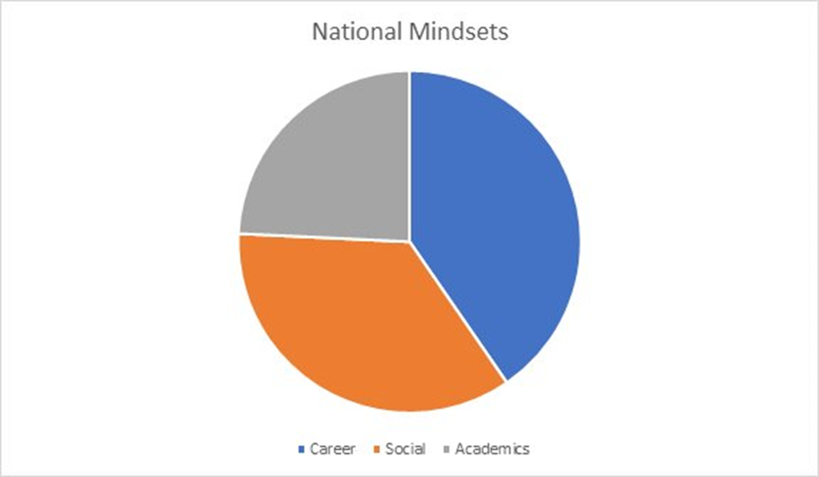
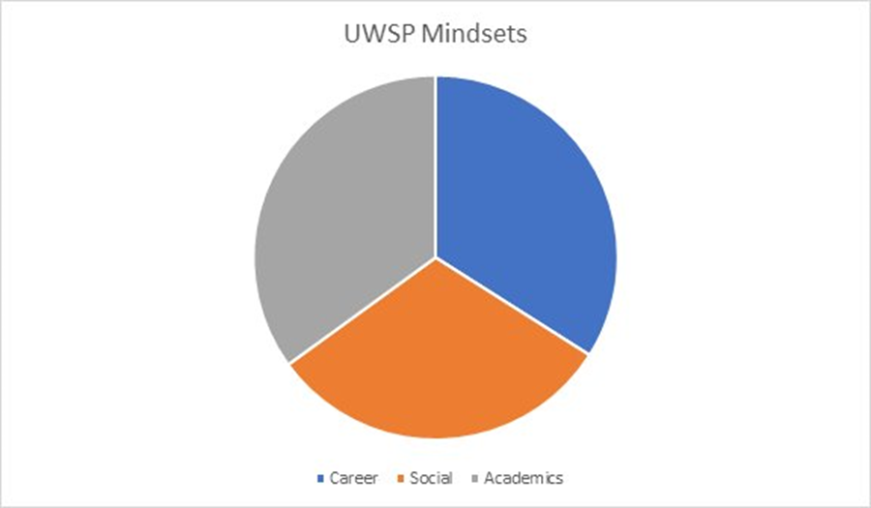
Why do students choose UWSP? First-year anonymous survey results (2023)

Slide 15
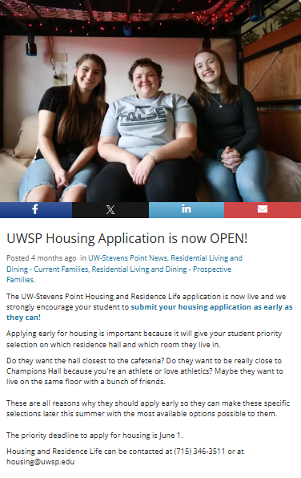
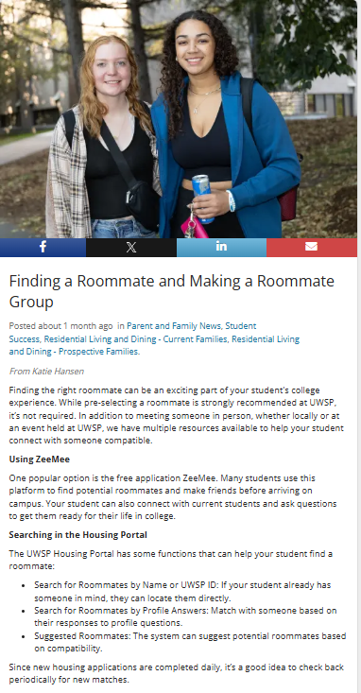
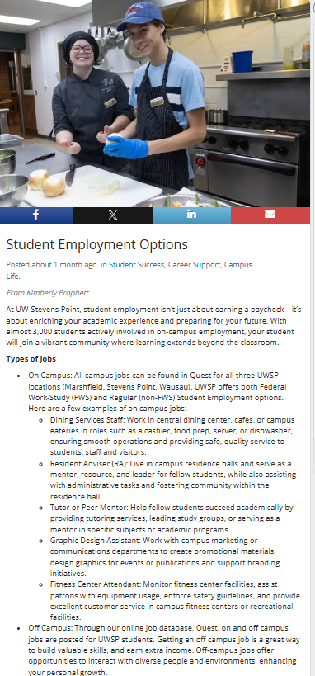
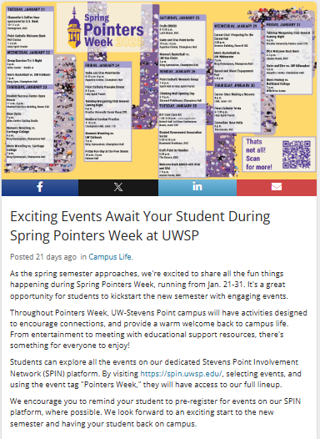
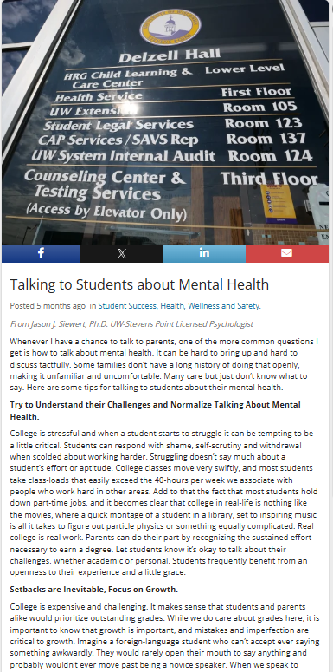
CampusESP and Social Media Messaging Social Focused Content
Housing Katie Hansen 534 Clicks
Housing Katie Hansen 485 Clicks
University Centers Kimberly Prophett 144 Clicks
University Centers Kimberly Prophett 220 Clicks
Dean of Students Troy Seppelt 50 Clicks

Slide 16
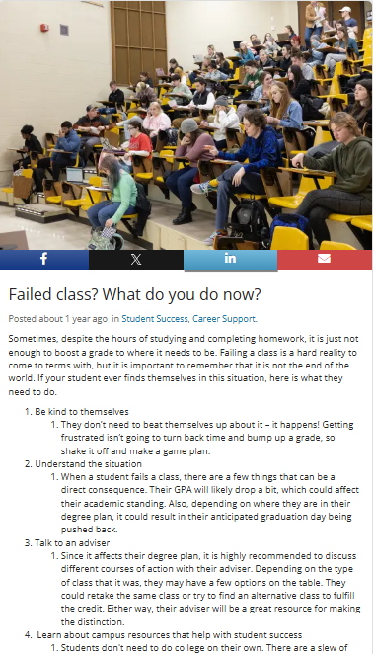
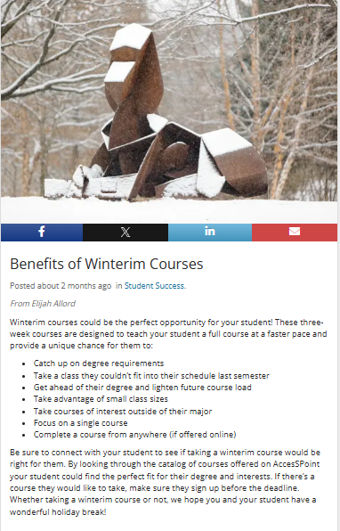
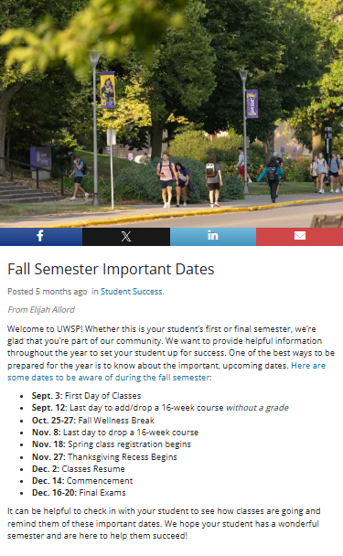
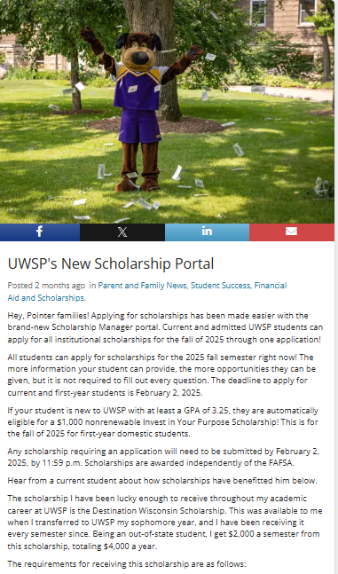
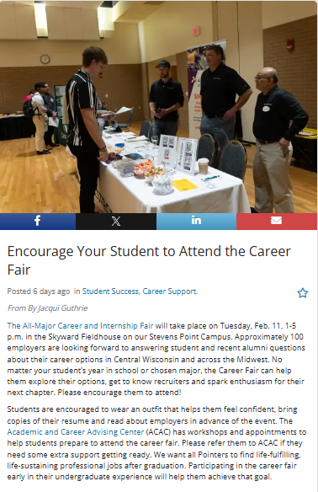
CampusESP and Social Media Messaging Academic and Career Focused Content
University College Elijah Allord 216 Clicks
University College Elijah Allord 71 Clicks
UCM Kylie King 598 Clicks
UCM Abby Maliszewski 1,823 Clicks
University College Jacqui Guthrie 51 Clicks

Slide 17
Future Content Creation for Retention
FAQs from departments – what are students asking you/what problems are they having? How can you frame those questions into posts for CampusESP or social media? Other students more than likely have the same question.
Need more academic content specifically from program areas Example: Study abroad within the academic program Example: Research with a faculty member Example: Events like research symposiums, mental health walk, behind the scenes with dance, music, or musical theatre
*Short information with bullets performs the best!

Slide 18
Retention of Students That Find Their Purpose
We have three cohorts of data that demonstrate that changing the major may be particularly beneficial for two groups of students
Students who enter undecided or undeclared and change their major are retained at a higher rate and have a higher GPA than those undecided/undeclared students that do not change the major.
Students in high DFW courses that earn at least one DFW and change their major are retained at a higher rate and have a higher GPA than similar students that do not change their major
Generally: Those who figure out their major and stick with it, are more successful and are retained at higher rates.
Notes:
OIRE and Office of Student Retention data with higher DFW rates in 2020 and 2021 cohorts and made this discovery. (Side finding)
Fall 2023 cohort reinforces understanding that students that are undeclared benefit from changing the major

Slide 19
Academic Advising
Semester 1 Transition
Semester 2 Exploration
Semester 3 Engage
Semester 4+ Academic Department + ACAC Career Coaches

Slide 20
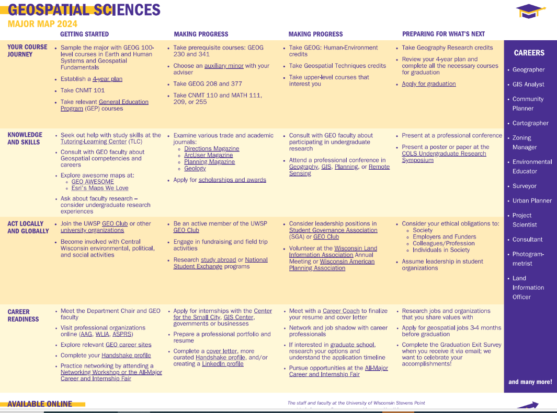
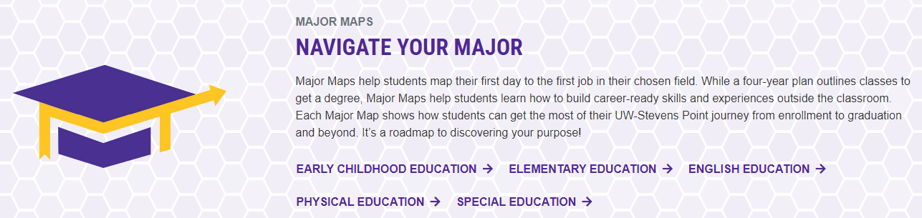
Major Maps
Designed to help students understand the “hidden” curriculum.
Used in tandem with graduation plans.

Slide 21
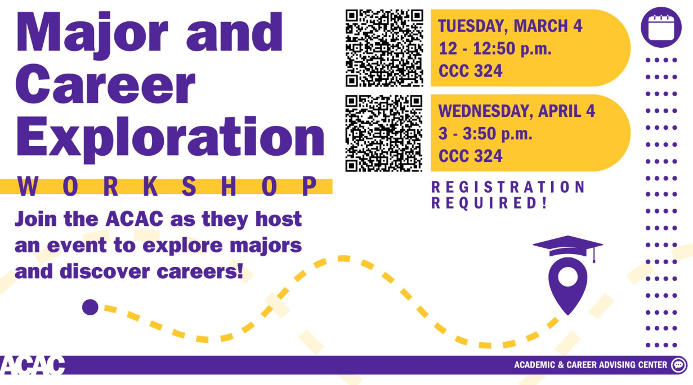

Slide 22
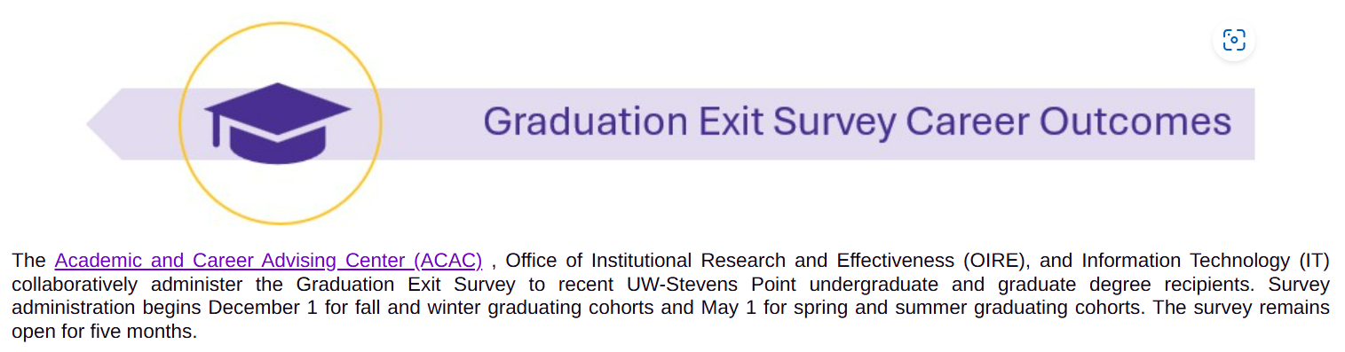
Dashboard - Rich resource of student information- OIRE Website
Employment and continuing education
Majors
Employers
Employment locations
Outcomes are different – not all majors designed to relate to a specific career but contribute to the knowledge economy and skills for the future.
Allows us to celebrate the story.
Done yearly – encourage participation!

Slide 23
Key Takeaways: How can you help students navigate changes in their first year?
Possibilities:
Retaining students is a full campus collaboration and starts with the prospective student and continues into graduation.
Ask questions along the way–what are individual student motivations? What do students most want to accomplish? What matters most to them?
Continue to share information about majors and careers. (Pointers Week, events and activities, Parent Portal, Major Maps, Student Planner)
Invite speakers to visit on topics related to college major and career
Consider ways to help students find their fit within an academic program or major even if it means changing a major.
Utilize campus resources and expertise. Wealth of information everywhere
It takes a Village!

