Slide 1
Supervisor ePerformance Overview Non-Instructional Staff
Nora Boomer, MA, PHR, SHRM-CP
Human Resources Manager
Notes:
This resource is for supervisors who are using the PeopleSoft (HRS) ePerformance module to document, complete, and/or submit their staff member(s)’s performance reviews.
R:\Staff\Organizational Development\Performance Management\ePerformance\ePerm Trainings

Slide 2
Resources
Performance Management
HR Email Sent 8/15/23
HR Email Sent 10/6/23
Notes:
2021 Employee ePerformance Guide 2021: https://www3.uwsp.edu/hr/Documents/Employee%20ePerformance%20Guide%20-%20Goals%20Model.Review%20Completed%20Already.pdf

Slide 3
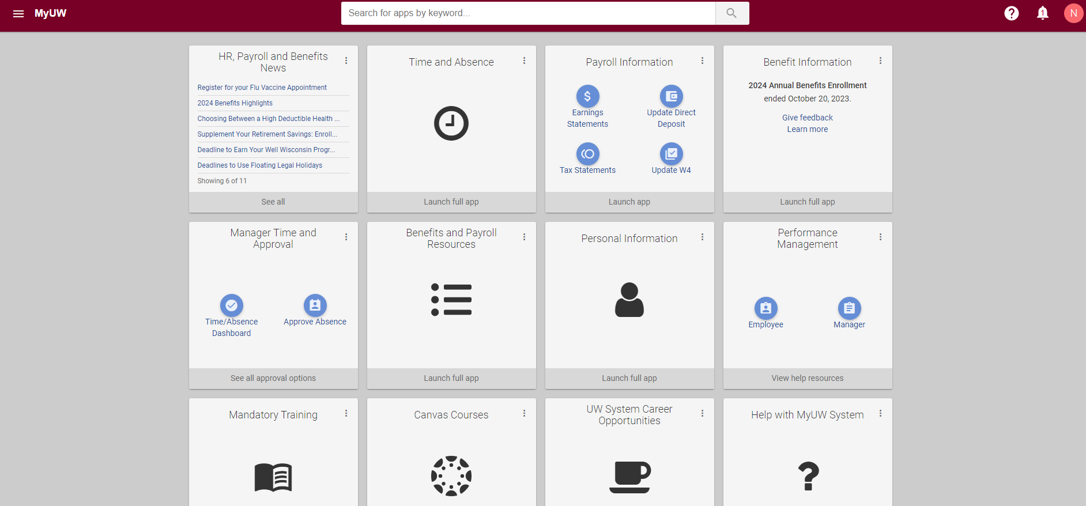
Notes:
MyUW
Performance Management Tab
Click on Manager Icon

Slide 4
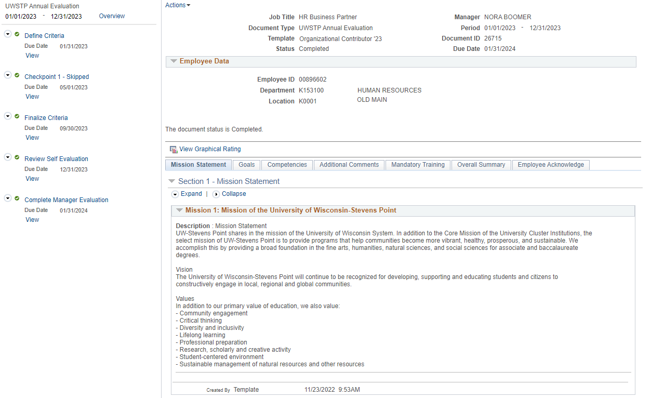
Notes:
Example View
The 5 stages to the left
7 tabs along the top of the review in the middle of the page
Choose only one review model (goals or competencies)
Red/Orange dots mean incomplete stage
Green Checkmark means complete stage

Slide 5
General Performance Review Timeline
Our current system operates on a calendar year
Limitations if wanting to use otherwise
Training materials drafted on calendar year
System generated updates based on calendar timeline
Overall timeline: January 1st to December 31st
Complete all steps by December 31, 2023
Notes:
Overall timeline:
The ePerformance review completion deadline in the system is through January 31, 2024. You are encouraged to submit all performance reviews by December 31, 2023. because in January 2024, the 2024 ePerformance documents will become live. To minimize confusion and issues with using the wrong “documents”, its best to complete the 2023 review by December 31, 2023.

Slide 6
ePerformance Steps
Flowcharts: Electronic Performance Management in HRS
Five steps:
Define Criteria: https://uwservice.wisconsin.edu/docs/publications/pm-define_criteria_mgr.pdf
Checkpoint: https://uwservice.wisconsin.edu/docs/publications/checkpoint_mgr.pdf
Finalize Criteria: https://uwservice.wisconsin.edu/docs/publications/finalize_criteria_mgr.pdf
Self Evaluation: https://uwservice.wisconsin.edu/docs/publications/self_evaluation_ee.pdf
Manager Evaluation: https://uwservice.wisconsin.edu/docs/publications/manager_evaluation.pdf
Weighting
Seeing employee’s saved draft information – Be careful not to erase
Reopen a step: Reopen a Completed Step
Notes:
To generally understand the overall process and workflow of ePerformance, review the Flowcharts: Electronic Performance Management in HRS. In 2021 UWSP did not use “Finalize Criteria” or “Checkpoint” steps.
Five steps:
Define Criteria
Checkpoint
Finalize Criteria
Self Evaluation
Manager Evaluation
These steps will be explained later in more detail.
Weighting
The system uses weighting to support calculation of an employee’s final performance rating. Weighting is determined at the beginning of the process, during the define criteria stage.
Since we have two options for performance reviews, either Goals or Competencies, the model you use will want to have a summary weighting of 100% and the model not used will need to have the summary section be 0% or blank.
Within the model used, goals or competencies, each goal or competency will have a weight.
Seeing the employee’s saved draft information:
The system will also allow you to see saved draft information for any stage that is currently being worked on by the employee. At each step of completion, the system notifies the employee or manager to confirm the other has completed a step. Notifications are provided via email. It’s critical for you as the manager to not work on a step until you receive confirmation from the system that the employee has submitted a step to you. In some steps you will completely erase the employee’s work/information in the ePerformance system if you go to a step before the employee is complete with the previous step.
Reopen a Completed Step:
Certain steps can be reopened if an employee has completed it but you as the supervisor want them to make updates. Follow the UWS tip sheet for how to reopen certain completed steps.

Slide 7
Overview of the 5 Steps
Define Criteria: 1/31/23
Staff complete the Define Criteria step (or together with you) by January 31st
You review and confirm/approve the step by January 31st each year.
Checkpoint 1: 5/1/2023
Optional mid-year review
Can bypass if choose
Both have a review/save action in this step
Finalize Criteria: 9/30/2023
Optional re-evaluation of goals or competencies
Can bypass if choose
Both have a review/save action in this step
Review Self Evaluation: 12/31/23
System due date (this date is a “fail safe date”– do not have staff wait until this date to submit!)
Staff should strive to complete their Self Evaluation step by end of November/Early December.
You review the self-evaluation, draft the manager evaluation, and have the performance review conversation by December 22, 2023.
Complete Manager Evaluation: 1/31/2024
System due date by January 31, 2024 (“fail safe date”)
Submit the manger evaluation after the performance review conversation with the employee, by December 31, 2023
Notes:
Define Criteria Step Deadline:
The deadline for staff and you as the manager to complete and finalize the Define Criteria step is January 31st of each year.
Checkpoint 1 Deadline:
Finalize Criteria Deadline:
Self Evaluation Deadline:
The system deadline for staff to complete their Self Evaluation step completely is December 31st. This is a “fail safe” date in case there are tech issues or if something goes awry and the performance review needs to be reset. Staff should strive to complete their Self Evaluation step by late November/Early December. You should review the self-evaluation step, draft the manger evaluation step, and have the performance review conversation no later than December 22, 2023.
Manager Evaluation:
Your last step is to submit the manager evaluation in the ePerformance system. You want to do this step after you have had the performance review discussion as best practice to support the effectiveness of the performance review conversation. This step should be completed no later than December 31st.

Slide 8
System Reminder Emails
Review the Automated Emails tip sheet
Reminders are sent to both parties (Manager and employee) even if only one of them needs to complete their portion of a step
Reminders of a future step will be sent even if previous steps are not completed
Notes:
System reminder emails:
Review the Automated Emails tip sheet to support your understanding of when reminder emails are sent from the ePerformance system. Managers and employees will receive a reminder email about an incomplete step even if they themselves have completed the step, but the other person still needs to take action.

Slide 9
Define Criteria Foundation
Watch Video: Performance Management - Manager
Review the Define Criteria for managers tip sheet
Review the applicable Employee ePerformance Guide(s) located on the UWSP Performance Management webpage
Notes:
The first step in the ePerformance documents is Define Criteria. To fully ensure you have an understanding of this step, watch the Video: Performance Management - Manager and review the Define Criteria for managers tip sheet. This will give you a good foundation of the system.
You are also encouraged to review the applicable Employee ePerformance Guide(s) located on the UWSP Performance Management webpage. This will help you do your own review, understand what staff were expected to do based on the situation applicable to them, and troubleshoot or make edits for an employee’s review.

Slide 10
Complete Define Criteria for Goals
Ensure the summary weight is 100%
Make 1 competency 100% weight and the other competencies 0% weight. This allows minimal admin later.
Make the Competencies Summary Section Weight 0%
Ensure the goal(s) entered align with your expectations and the instructions of the applicable Define Criteria – Manager
Edit as needed or Release to the Employee if you want them to make updates Define Criteria - Employee
Approve the step
Notes:
Use the information on this slide if you use the Goals Model for the performance review.
HR>Performance Management>ePerformance Resources for Leadership
https://www3.uwsp.edu/hr/Documents/Employee%20ePerformance%20Guide%20-%20Goals%20Model%20Weighting.pdf

Slide 11
Complete Define Criteria for Competencies
Ensure the summary weight is 100%
Ensure the Goals summary weight is 0%
Ensure the weighting of each competency meets your expectations and equals 100%
Edit as needed or Release to the Employee if you want them to make updates Employee Define Criteria
Approve the step
Notes:
Use this slide if Competencies are used for the performance review.
10 competencies = Individual Contributor
12 competencies = Leader
Auto populated, unable to change.
https://www3.uwsp.edu/hr/Documents/Employee%20ePerformance%20Guide%20-%20Competency%20Model%20Weighting.pdf
Competency Guide: https://www3.uwsp.edu/hr/Documents/Performance%20Review%20-%20Competency%20Guide.pdf
HR>Misc Resources>Performance Management:>Paper Forms

Slide 12
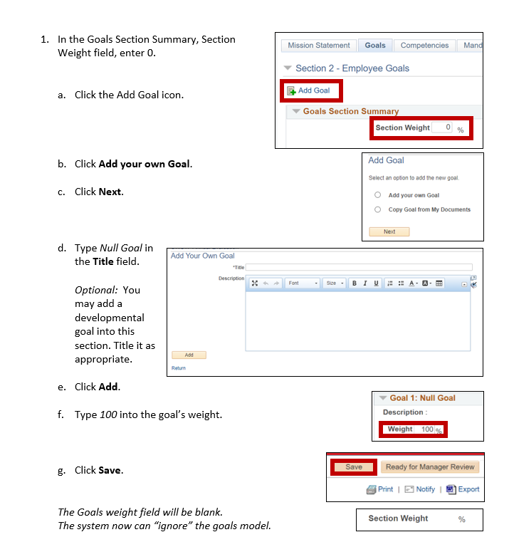

Slide 14
Complete the Self Evaluation Step
Review the employee’s self evaluation
Ensure the system is set up to ignore the model not being used
Send back to employee if changes are needed
Draft your manager evaluation and save
Meet with the employee for the performance review discussion

Slide 15
Meet with your Employee
Schedule for in-Person/Zoom/Teams
Download the review for scheduled meeting
Go over the review acknowledging their self-review compared to your review (scores/comments).
Let them know you’ll send the review electronically for them to acknowledge.
Notes:
I prefer to not send the completed review to the employee ahead of time for them to read. Instead take the time to go through the review in real time allowing for conversation, questions, and clarification. Sometimes reading on their own, they could inadvertently read something the wrong way that could trigger them unnecessarily.

Slide 16
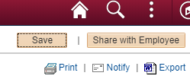
Complete the Manager Evaluation
Finalize/update your manager evaluation
Share with the employee
The employee electronically signs the evaluation
Notes:
After you have met with the employee, complete the Manager Evaluation step. If you have updates based on the performance review conversation, make those updates.
Once the evaluation is complete, share.

Slide 17
Additional Resources for ePeformance
Review employee completions of Mandatory Training: Mandatory Training Tab
ePerformance FAQs
In rare situations you may need to acknowledge a performance review on the employee’s behalf: Acknowledge / Sign Evaluation on Behalf of Employee
UWSP Performance Management
Email HR at hr@uwsp.edu
Notes:
Use the additional resources available on this slide to support further needs

