Slide 1
Financial Aid the Basics
Planning for College

Slide 2
topics
How do I apply for financial aid?
What does it cost to go to college?
Loans, grants, scholarships and work study
Make plans now
Q & A

Slide 3
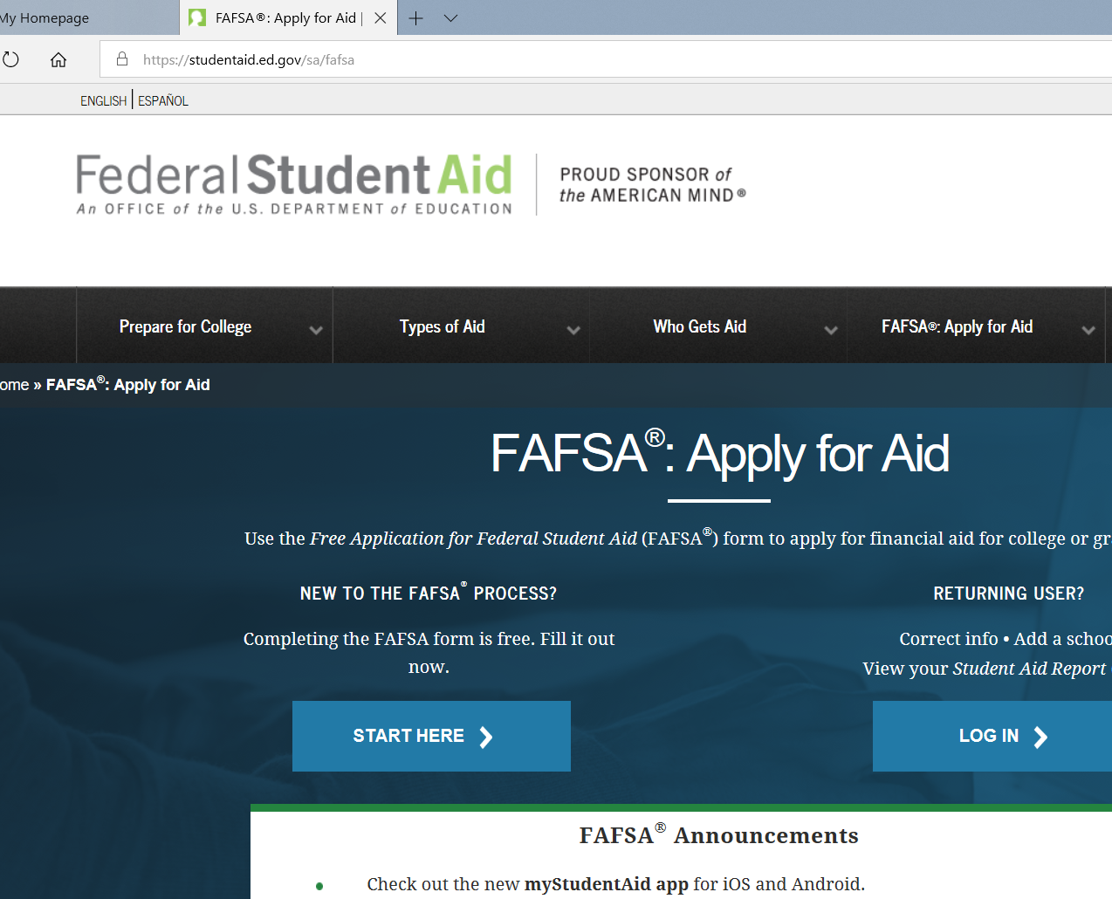
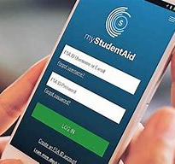
How do I apply for financial aid?
It all begins with the Free Application for Federal Student Aid (FAFSA):
Use the phone app
Website: fafsa.ed.gov
Or paper form (significantly longer response rate, 6-11 weeks)
Helpful resources:
FAFSA4caster.ed.gov
College Goal Wisconsin

Slide 4
What does it cost to go to college?
Tuition
Non-tuition-related fees (registration fee, graduation fee, lab fee, etc.)
Textbooks (buy, rent, access online)
Supplies (computer, printer, etc.)
Housing
Transportation
Food and/or meal plans
Living expenses

Slide 5
Tuition costs
https://uwhelp.wisconsin.edu/pay-for-college/tuition-costs/

Slide 6
What is the Net price?
The Net price is the amount that a student pays to attend an institution in a single academic year AFTER subtracting scholarships and grants the student receives. Scholarships and grants are forms of financial aid that a student does not have to pay back.
https://collegecost.ed.gov/netpricecenter.aspx

Slide 7
What’s the net price?

Slide 8
Scholarships, Grants, loans and work study
$cholarships: FREE MONEY
Grants: typically, do not need to be repaid
Loans: need to be repaid
Work study: money you earn while enrolled in college (must be eligible for it as determined by the FAFSA)

Slide 9
Scholarships
Get involved
Volunteer
Start researching early
Meet deadlines
Know your resources for finding scholarship opportunities:
Financial aid office at college/or career school
High school counselor
FastWeb.com
Careeronestop.org
Bigfuture.collegeboard.org
Avoid scams and never pay for a scholarship search

Slide 10
Grants
Gift-assistance
In most cases, do not need to be repaid
Eligibility determined through the Free Application for Federal Student Aid (FAFSA)
Examples include: Pell, Federal Supplemental Educational Opportunity Grant, and the Wisconsin State Grant

Slide 11
loans
Form of financial aid that must be repaid, with interest
Know what you owe as you go (NSLDS.gov)
Keep track of how much you borrow
Understand the terms of your loan and keep copies of your loan documents
Be aware of repayment plans
Estimate payments: https://studentloans.gov/myDirectLoan/repaymentEstimator.action?_ga=2.193345646.255285496.1542043205-640967052.1532022757
Only borrow what you need
Stick to a budget: https://studentaid.ed.gov/sa/prepare-for-college/budgeting#why

Slide 12
Work study
Provides part-time employment for students while enrolled in school
Available to students with financial need as determined from the Free Application for Federal Student Aid (FAFSA)
Earnings limited to amount awarded through Financial Aid
Locate jobs on campus but some may be available off campus as well (check with college/career school for employment opportunities)
This Photo by Unknown Author is licensed under CC BY-NC-ND

Slide 13
Plan for college now
https://studentaid.ed.gov/sa/sites/default/files/college-prep-checklist.pdf
Build good financial habits and save for college early on
Parents can be a financial educator; help their child to understand the financial responsibility of a college education; start those conversations now
Parents can help their college-bound child with the financial aid process
Get to know your high school counselor and learn how they can help
Develop a plan
Know your resources; learn from the experts

Slide 14
Know your resources
https://studentaid.ed.gov/sa/ (Federal Student Aid)
Your college/career school’s Financial Aid Office/websites/FAQs
https://studentaid.ed.gov/sa/fafsa (Free Application for Federal Student Aid)
https://studentloans.gov/myDirectLoan/index.action (StudenLoans.gov)
Scholarship searches: https://www.fastweb.com/ (FastWeb), https://bigfuture.collegeboard.org/scholarship-search (BigFutre – CollegeBoard), https://www.careeronestop.org/toolkit/training/find-scholarships.aspx (Careeronestop)
Your high school counselor
http://collegegoalwi.org/ College Goal Wisconsin
GradReady (free financial literacy tool) https://gradready.com/gradready/sponsor/uwsp
https://uwhelp.wisconsin.edu/counselors/navigating-financial-aid/uw-system-tuition-chart/
https://collegecost.ed.gov/netpricecenter.aspx (Net Price Calculator)
https://studentloans.gov/myDirectLoan/repaymentEstimator.action?_ga=2.193345646.255285496.1542043205-640967052.1532022757 (Repayment Estimator)
https://studentaid.ed.gov/sa/prepare-for-college/budgeting#why (Budgeting)
https://studentaid.ed.gov/sa/sites/default/files/college-prep-checklist.pdf (Prep checklist)
This Photo by Unknown Author is licensed under CC BY-NC-ND

Slide 15
Office of Financial Aid & Scholarships 103 Student Services center stevens point, WI 54481 finaid@uwsp.edu 715-346-4771 https://www.uwsp.edu/finaid/Pages/default.aspx
This Photo by Unknown Author is licensed under CC BY-SA-NC

