Slide 1
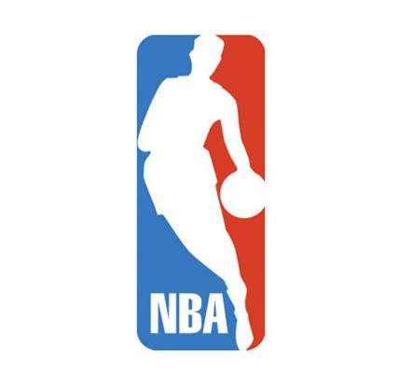
NBA: Analyzing Trends in NBA Officiating
Peter Wu
Lynbrook High School

Slide 2
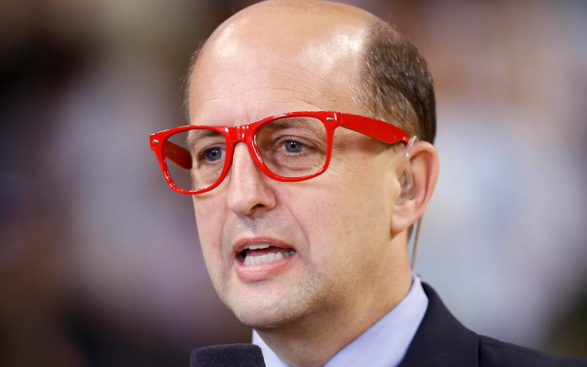
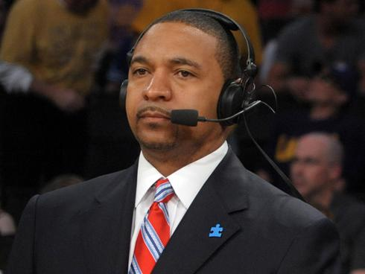
Officiating Today
During the 2017 NBA Finals between the Golden State Warriors and Cleveland Cavaliers…
“Everybody complains on every call.” –Jeff Van Gundy
Aggressiveness misconstrued
Correct calls not made on every play
“As a player or as a coach, that’s all you want in the game” -Mark Jackson on consistency in officiating”

Slide 3
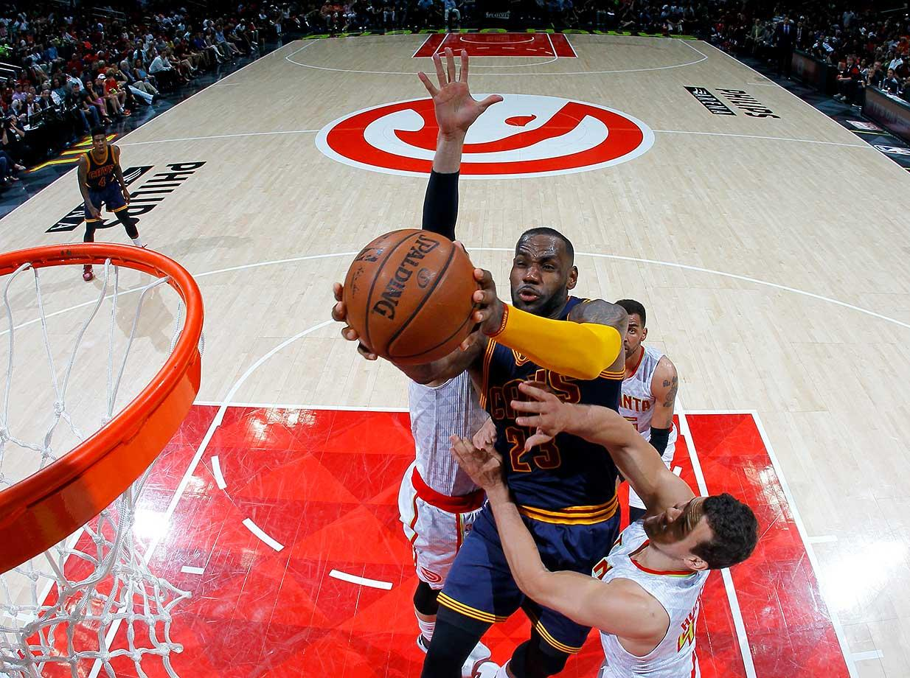
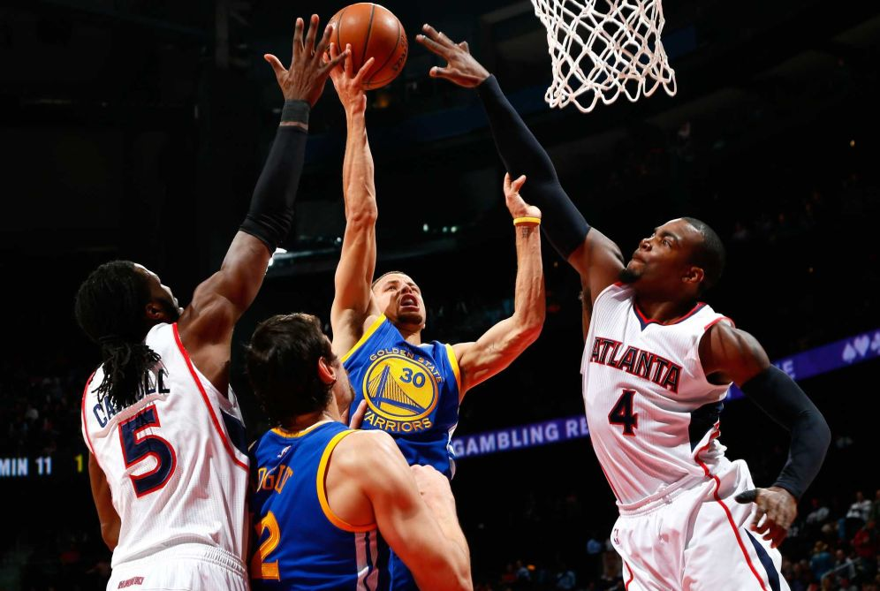
All Fouls Created Equal…?

Slide 4
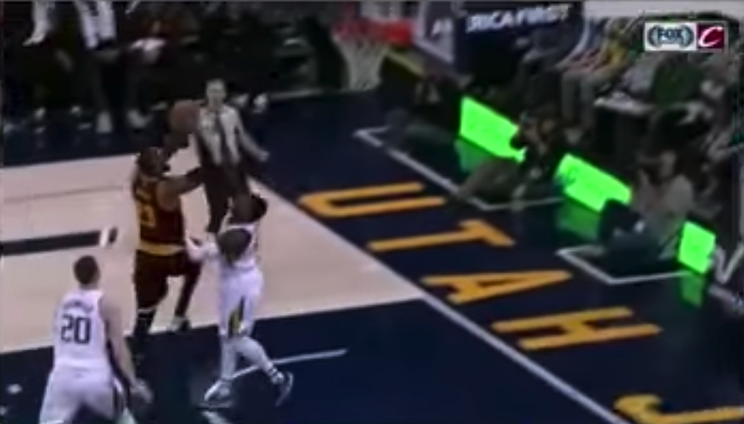
Shelvin Mack vs. LeBron James
Quin Snyder instructs Mack to foul James to prevent a transition bucket
Mack puts his hands on LeBron’s knee and thigh, but because LeBron is so strong and bulky, Mack never really “impedes” LeBron’s progress.
INC: Mack Committing, James Disadvantaged

Slide 5
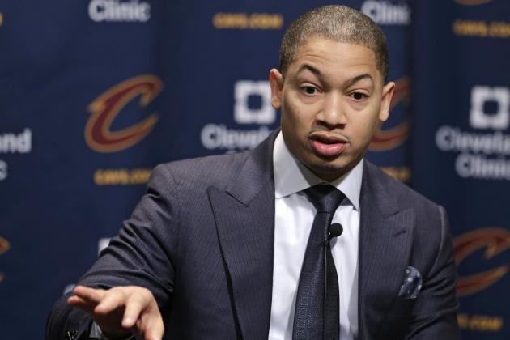
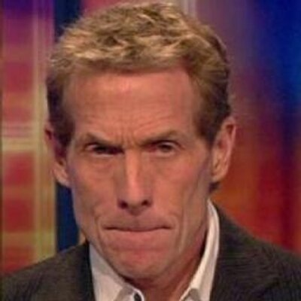
Observations of LeBron’s refereeing
“He's so strong and so physical, when he goes to the basket, guys are bouncing off of him. Those are still fouls, but he doesn't get that call because he's so big and so strong and so physical.” –Tyronn Lue [on NBA’s refereeing of LeBron]
“I’ve often called it the Shaq syndrome that LeBron suffers from. He’s actually too good for his own good. He’s too big, and too strong, and too powerful, and too quick. And he doesn’t get reffed fairly.” –Skip Bayless, UNDISPUTED

Slide 6
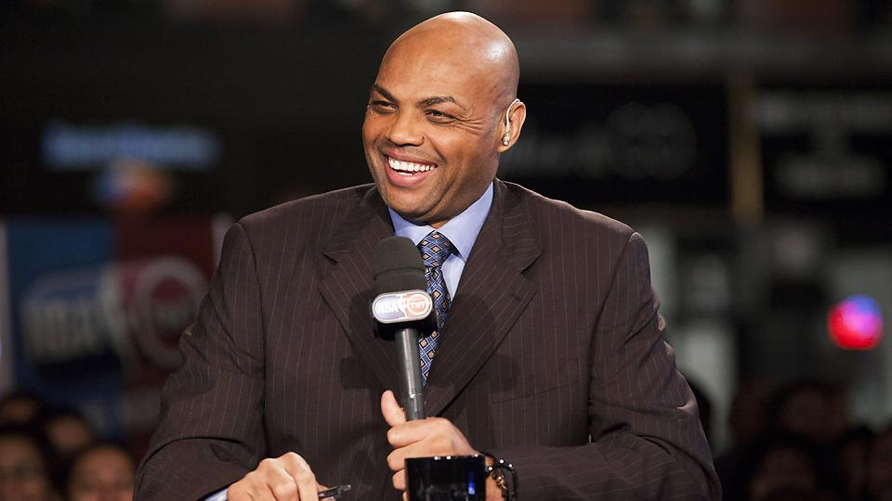
Evolution of the Personal Foul
Prior to the 2004-2005 NBA Season, players were allowed to keep their hands on the opposing players, but were not allowed to touch their hands, shoulders, arms, and legs
NBA tried to prohibit the hand-checking practice during the 1978-79 season so long as it didn’t “impede a player’s forward progress”
After the 2004-2005 NBA Season, a hand-checking rule was implemented and any contact between the defensive and offensive player that impeded the offensive player’s movement (speed, quickness, balance, rhythm) was a foul
“NBA is watered down, worst I’ve ever seen it” –Charles Barkley, on The Dan Patrick Show

Slide 7
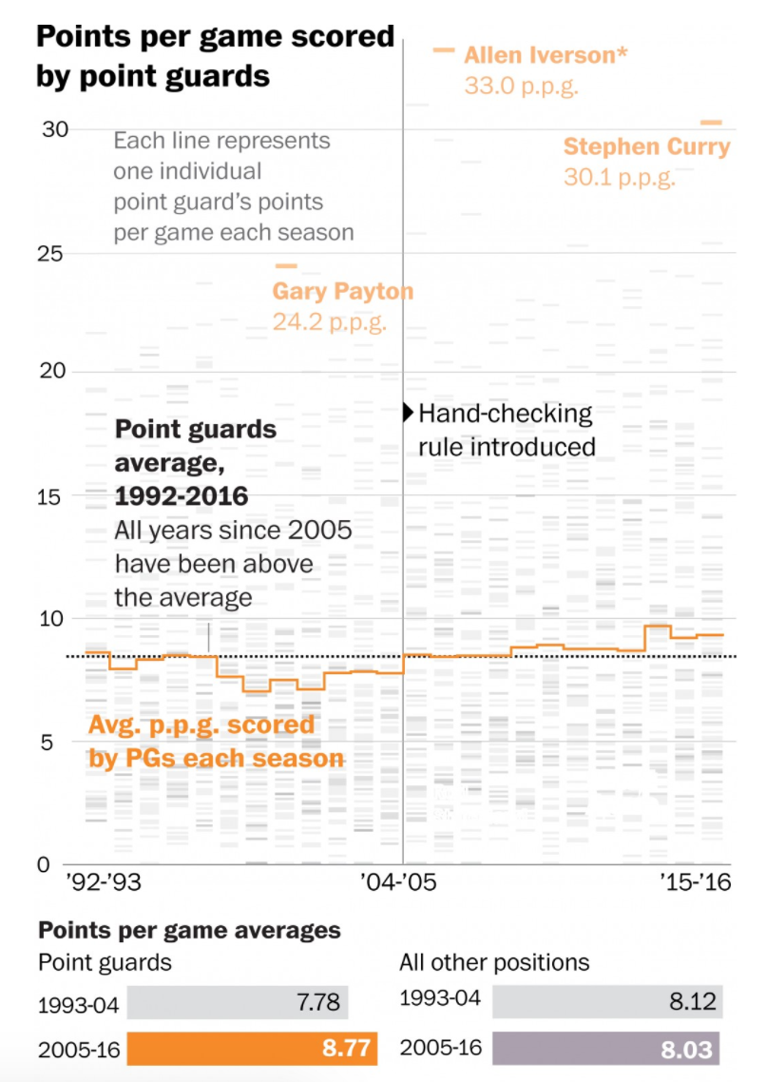
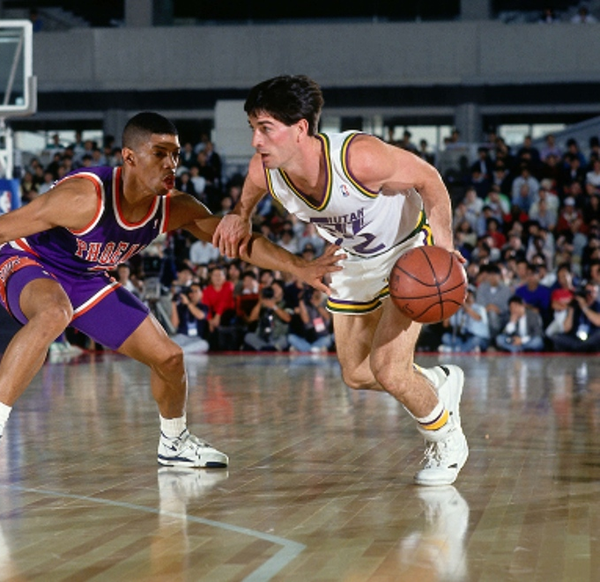
Source: The Washington Post

Slide 8
The Current Definition of the Personal Foul
The 2015-2016 Official NBA Rulebook states that “a player shall not hold, push, charge into, impede the progress of an opponent by extending a hand, arm, leg or knee or by bending the body into a position that is not normal”
What specifically does “impeding the progress” of a player mean?
As impeding the progress of more bulkier player is harder than impeding the progress of a smaller player, is there a statistically significant difference between how smaller players are officiated?
This talk will attempt to analyze the current state of refereeing, and discuss ways the NBA can improve its officiating

Slide 9
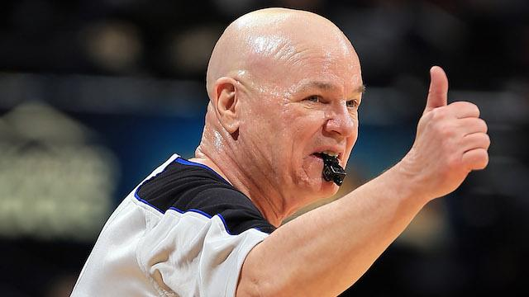
Motivation to Increase Transparency
Occasionally, league acknowledged missed calls via media press release
NBA wanted to find a way to “build a greater awareness and understanding of the rules and processes that govern our game”
Fans wanted to see accountability and consistency in the games
Officials are correct roughly 90% of the time
Not everyone was receptive of this development, as we will see later

Slide 10
How do we study officiating?
Attempting to increase transparency of its officiating, the NBA releases mini Last Two Minute Reports for games that are within five points with two or less minutes to play
Play-by-play basis
Correct Call, Incorrect Call, Incorrect No-Call, Correct No-Call
Provides us with a framework for analyzing the current state of refereeing in the NBA
Using this data, we answer the question as to whether heavier players are refereed differently than smaller or less bulkier players
We hypothesize that referees will tend to miss calls on heavier, bulkier players more often as their standards for a foul are much higher than smaller, less bulky players

Slide 11
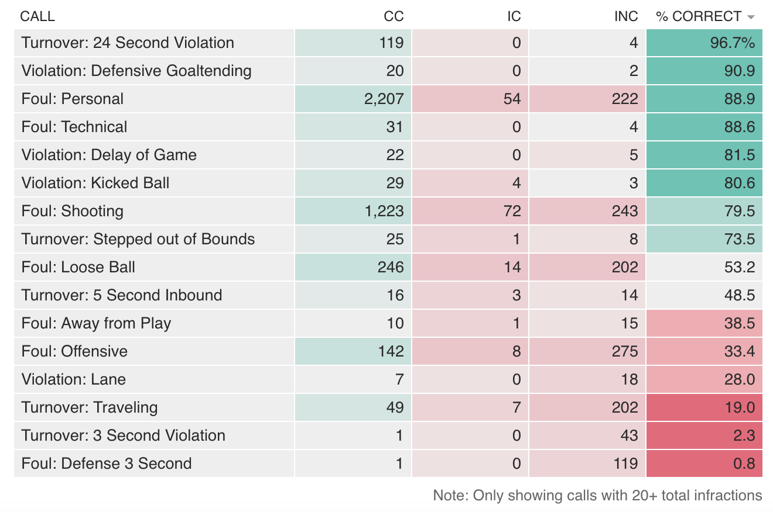
L2M Data
Source: ThePudding

Slide 12
L2M Data Summary
Green = PG, SG, Red = SF, PF, C
Committing Player | Frequency | Position
Marcin Gortat | 177 | C
Al Horford | 169 | C
Draymond Green | 148 | PF
Steven Adams | 144 | C
Karl-Anthony Towns | 142 | C
James Harden | 137 | PG-SG
Brook Lopez | 134 | C
DeAndre Jordan | 123 | C
Cody Zeller | 122 | PF-C
Disadvantaged Player | Frequency | Position
James Harden | 227 | PG-SG
Russell Westbrook | 194 | PG
DeMar DeRozan | 191 | SF
Isaiah Thomas | 185 | PG
Damian Lillard | 179 | PG
LeBron James | 179 | SF
John Wall | 174 | PG
Demarcus Cousins | 173 | C
Kemba Walker | 169 | PG

Slide 13
Model Framework
In our analysis, we focus mainly on the disadvantaged players
We will base our model on what the correct call should have been
Correct Call vs. Incorrect No-Call
On plays where calls should have been made, are certain players not getting the calls they should be getting?
Correct No-Call vs. Incorrect Call
On plays where calls should not have been made, are certain players getting calls they should not be getting?
We use logistic regression to fit weight and personal fouls drawn to the above regressions
To what extent does a player’s weight and aggressiveness (which we measure by fouls drawn) affect a referee’s officiating of a player?

Slide 14
Correct Call vs. Incorrect No-Call
Since most of the focus of LeBron’s arguments about the officiating were when he was on offense, comparing fouls by the disadvantaged player enables us to assess the validity of his claims
Of the fouls that should have been called, do referees miss calls on heavier or more aggressive players significantly more often than other players?
Again, consider everything from a disadvantaged player’s point of view

Slide 15
Correct Call vs. Incorrect No-Call
 | Estimate | Standard Error | z-value | Pr(>|z|)
Intercept | -2.601 | 0.321 | -8.100 | 5.51e-16
Weight | 0.0060 | 0.00145 | 4.161 | 3.17e-05
PF Drawn | -0.00076 | 0.00029 | -2.598 | 0.0094
There is reasonable evidence to suggest that weight and personal fouls drawn affect whether a player gets more incorrect no-calls than correct calls.

Slide 16
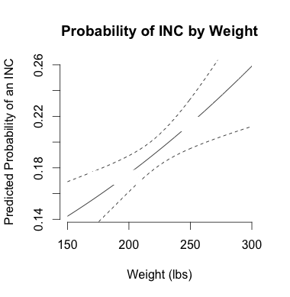
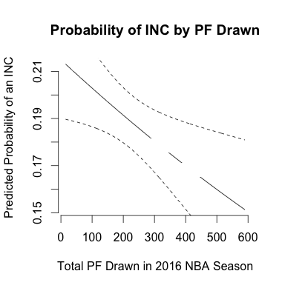
Predicted Probability Graphs (CC vs. INC)
LeBron James
Stephen Curry
Stephen Curry
LeBron James

Slide 17
Correct No-Call vs. Incorrect Call
Of the calls where there should have been no call, do referees tend to give more calls to heavier or more aggressive players that should not have been called?
In much the same way that LeBron argues that bulkier players like him do not get the same treatment as him, does he sometime get “the benefit of the doubt” significantly more often?
Enables us to see which types of players referees are missing calls on more

Slide 18
Correct No-Call vs. Incorrect Call
 | Estimate | Standard Error | z-value | Pr(>|z|)
Intercept | -4.191 | 0.716 | -5.856 | 4.73e-09
Weight | -0.0010 | 0.0033 | -0.303 | 0.762
PF Drawn | 0.0019 | 0.00060 | 3.090 | 0.002
There is reasonable evidence to suggest that personal fouls drawn affect whether a player gets more calls they should not have gotten.

Slide 19
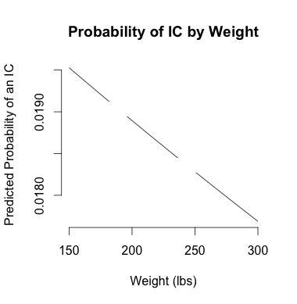
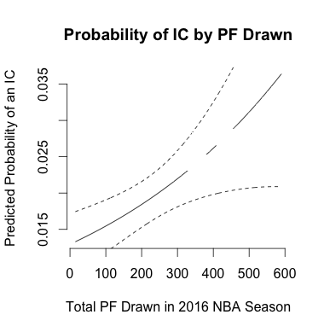
Predicted Probability Graphs (CNC vs. IC)
Stephen Curry
LeBron James
Stephen Curry
LeBron James

Slide 20
Conclusion
Evidence of heavier and more aggressive players being officiated differently in the last two minutes of a game
Should we be looking for the “solution”?
Fluid, continuous game → consistency
Referees already get 90% calls in last two minutes of game
What will the future of officiating look like?
Flagrant fouls based solely on intent or result?
Interpreting calls within the context of a game?

Slide 21
Acknowledgments
Thank you to Chris Pickard and Scott Powers for giving excellent advice and encouraging me throughout my project, and to everyone from Stanford Sports Analytics Club

Slide 22
References
http://www.espn.com/nba/story/_/id/18449636/lebron-james-cleveland-cavaliers-frustrated-recent-officiating
https://www.si.com/nba/2016/05/11/charles-barkley-watered-down-comments-tnt
https://turnernbahangtime.files.wordpress.com/2015/11/official-nba-rule-book-2015-16.pdf
http://official.nba.com/
http://fansided.com/2016/08/25/introducing-foul-drawn-percentage/
http://www.washingtonpost.com/sf/sports/wp/2016/04/15/its-a-point-guards-game/?utm_term=.e70f980e3915
https://pudding.cool/2017/02/two-minute-report/

