Slide 1
Basketball Analytics Spatial Tracking
July 13, 2017
Stephen Shea, Ph.D.
Chair of Mathematics
Saint Anselm College

Slide 2
Spatial Tracking
Locations of the players and ball multiple times a second

Slide 3
Spatial Tracking
Locations of the players and ball multiple times a second

Slide 4
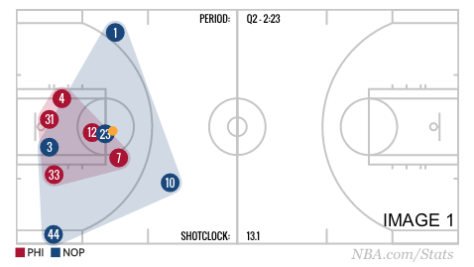
Spatial Tracking
Locations of the players and ball multiple times a second

Slide 5
Spatial Tracking
Locations of the players and ball multiple times a second
What can we do with it?

Slide 6
Four Pillars of Basketball Analytics

Slide 7
Four Pillars of Basketball Analytics
Efficiency
Context

Slide 8
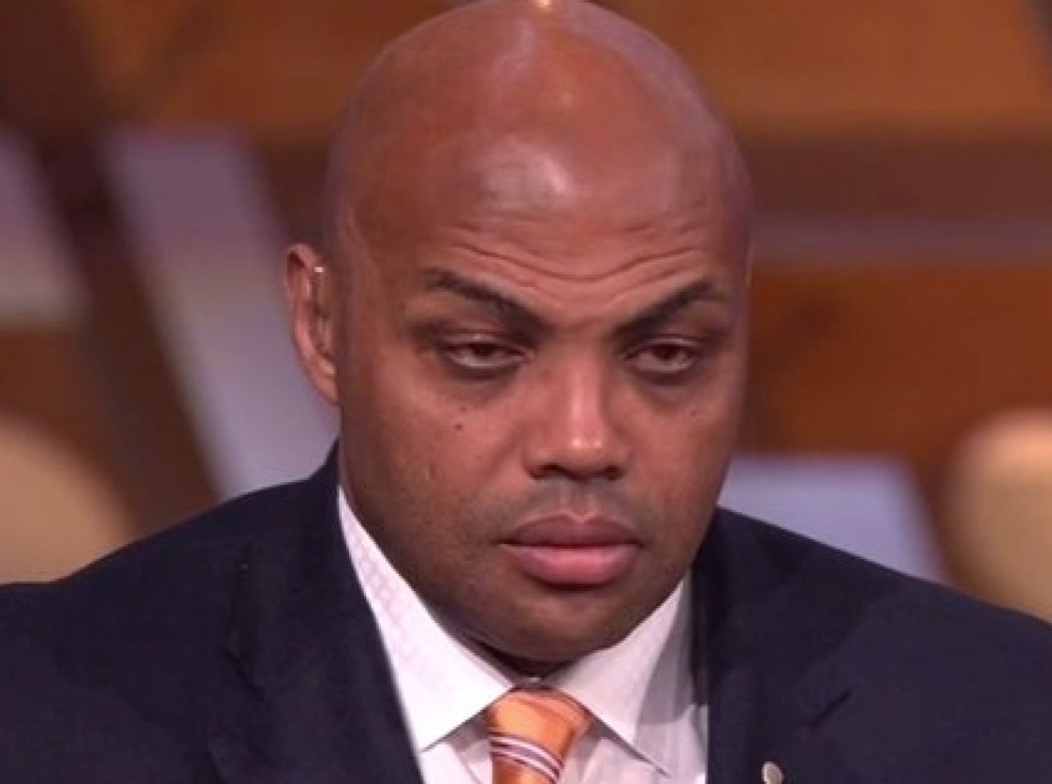
Four Pillars of Basketball Analytics
Efficiency
Context
Russell Westbrook
Charles Barkley

Slide 9
Barkley’s TNT Rant
February 10, 2015
“Analytics is crap”

Slide 10
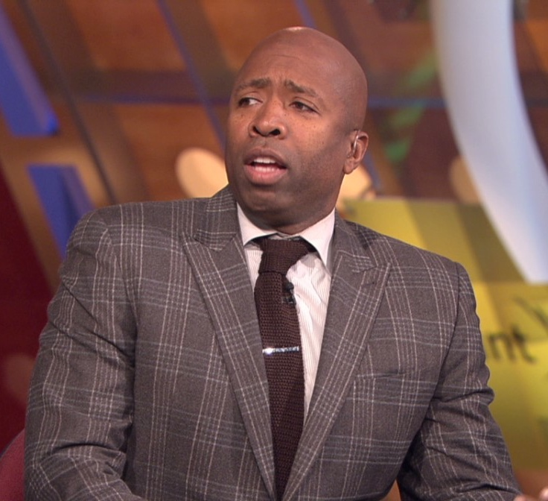
Kenny Smith

Slide 11
Kenny Smith
“My first 5 years in the league, I took 82 3s.”

Slide 12
Kenny Smith
“My first 5 years in the league, I took 82 3s.”
“After the 5th year, I took 82 in probably 40 games when I got to the Rockets.”

Slide 13
Kenny Smith
“My first 5 years in the league, I took 82 3s.”
“After the 5th year, I took 82 in probably 40 games when I got to the Rockets.”
“I became a 3pt shooter because I had a big beast mode in the middle that drew 2 men.”

Slide 14
Kenny Smith
“My first 5 years in the league, I took 82 3s.”
“After the 5th year, I took 82 in probably 40 games when I got to the Rockets.”
“I became a 3pt shooter because I had a big beast mode in the middle that drew 2 men.”
Context!

Slide 15
Kenny Smith
Kenny Smith: Analytics are flawed because they don’t account for context.

Slide 16
Kenny Smith
Kenny Smith: Analytics are flawed because they don’t account for context.
No, we use analytics to understand context!

Slide 17
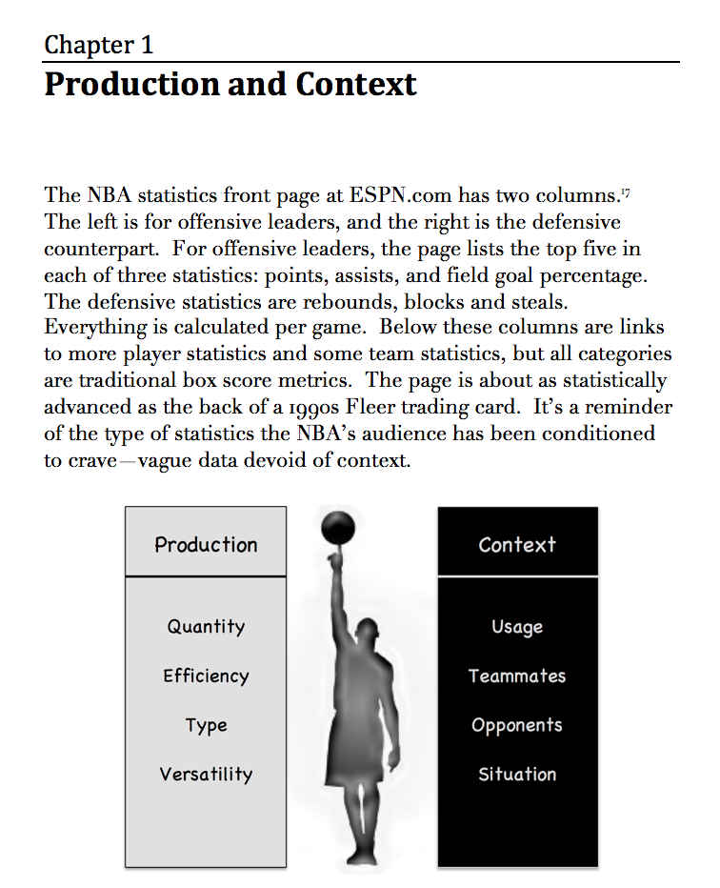
Product Placement

Slide 18
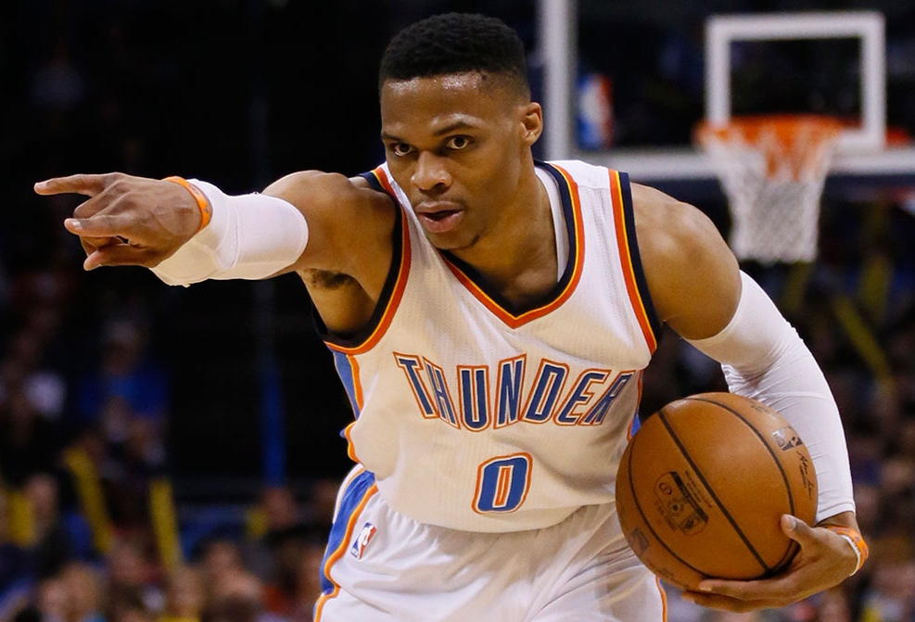
Russell Westbrook

Slide 19
Russell Westbrook
Player | PPG | TS% | PPS
R. Westbrook | 31.6 | .554 | 1.11
J. Harden | 29.1 | .613 | 1.23
K. Leonard | 25.5 | .610 | 1.22
L. James | 26.4 | .619 | 1.24
K. Durant | 25.1 | .651 | 1.20

Slide 20
Russell Westbrook
FG%
3 is more than 2
Player | PPG | TS% | PPS
R. Westbrook | 31.6 | .554 | 1.11
J. Harden | 29.1 | .613 | 1.23
K. Leonard | 25.5 | .610 | 1.22
L. James | 26.4 | .619 | 1.24
K. Durant | 25.1 | .651 | 1.20
eFG%
Free throws
TS%

Slide 21
Russell Westbrook
FG%
efficiency
3 is more than 2
Player | PPG | TS% | PPS
R. Westbrook | 31.6 | .554 | 1.11
J. Harden | 29.1 | .613 | 1.23
K. Leonard | 25.5 | .610 | 1.22
L. James | 26.4 | .619 | 1.24
K. Durant | 25.1 | .651 | 1.20
eFG%
Free throws
TS%

Slide 22
Russell Westbrook
Box Score
Player | PPG | TS% | PPS
R. Westbrook | 31.6 | .554 | 1.11
J. Harden | 29.1 | .613 | 1.23
K. Leonard | 25.5 | .610 | 1.22
L. James | 26.4 | .619 | 1.24
K. Durant | 25.1 | .651 | 1.20
Shot Charts
Spatial Tracking

Slide 23
Russell Westbrook
Box Score
325 long 2s (greater than 16 feet)
Shot Charts
Spatial Tracking

Slide 24
Russell Westbrook
Box Score
325 long 2s (greater than 16 feet)
4 per game (14% of his shots)
Shot Charts
Spatial Tracking

Slide 25
Russell Westbrook
Box Score
325 long 2s (greater than 16 feet)
4 per game (14% of his shots)
0.69 PPS (1.18 PPS otherwise)
Shot Charts
Spatial Tracking

Slide 26
Russell Westbrook Long 2s
Box Score
Could Westbrook have driven to the hoop?
Shot Charts
Spatial Tracking

Slide 27
Russell Westbrook Long 2s
Box Score
Could Westbrook have driven to the hoop?
Averaged 2.7 help defenders in the paint.
League average is 1.7.
Shot Charts
Spatial Tracking

Slide 28
Russell Westbrook Long 2s
Box Score
Could Westbrook have kicked to the corner?
Shot Charts
Spatial Tracking

Slide 29
Russell Westbrook Long 2s
Box Score
Could Westbrook have kicked to the corner?
The most common corner option was Andre Roberson (36% of the time).
Roberson scores 0.71 PPS from the corners.
Shot Charts
Spatial Tracking

Slide 30
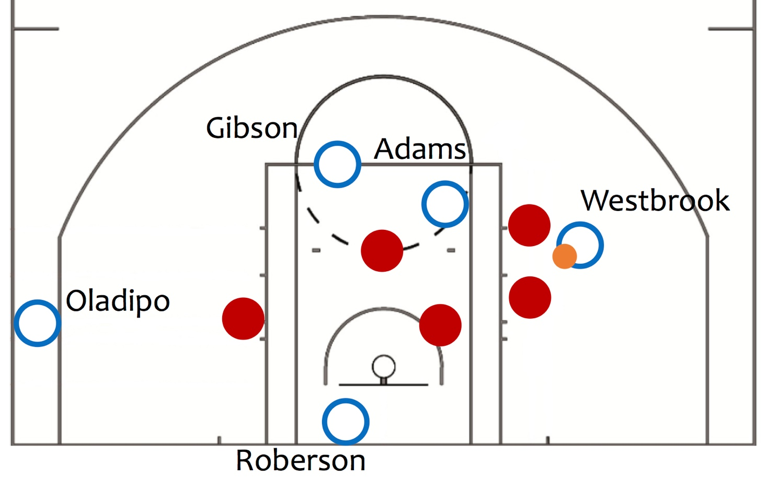
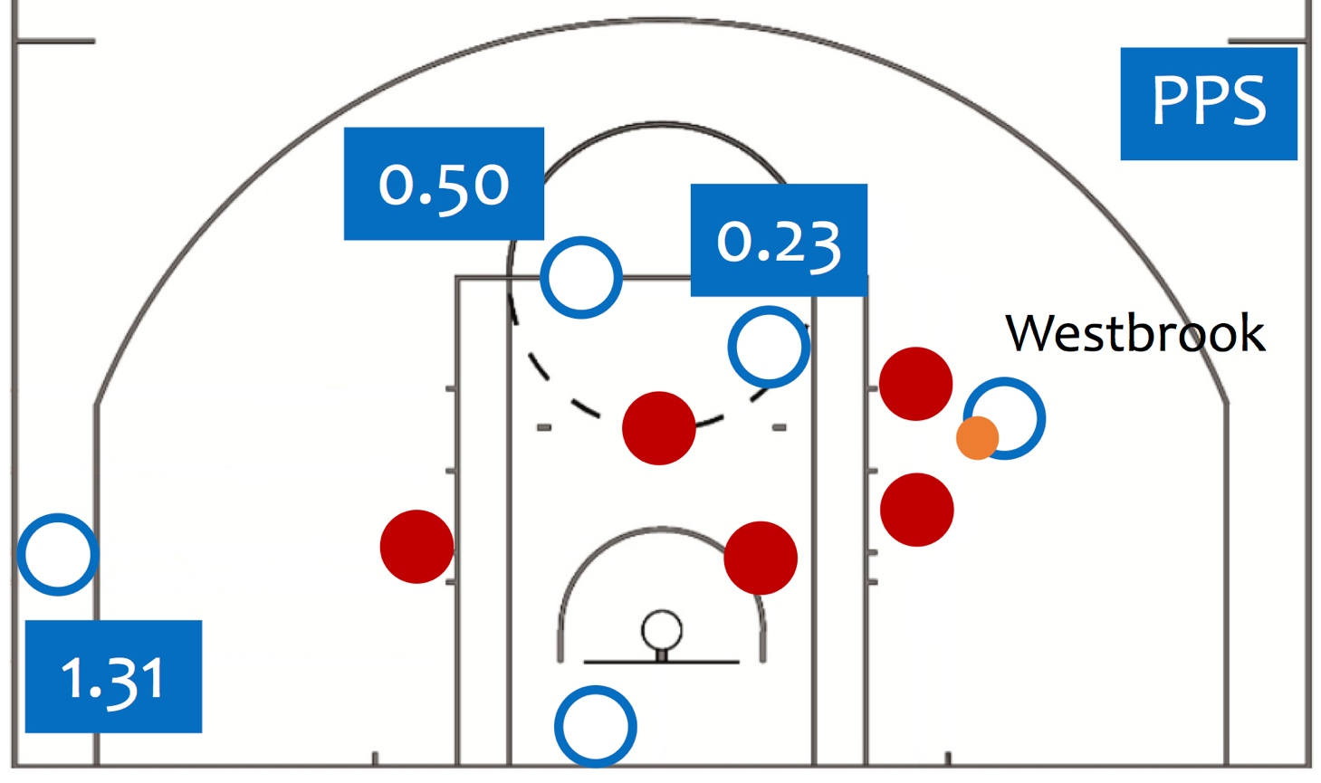
Spatial Tracking Provides Context
Oklahoma City

Slide 31
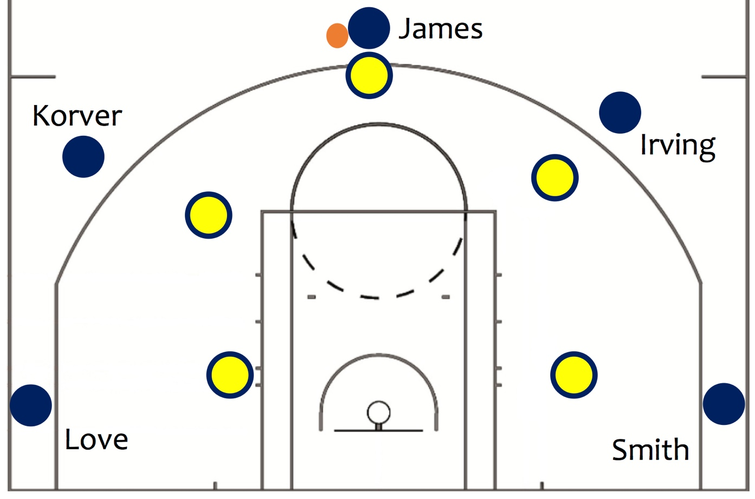
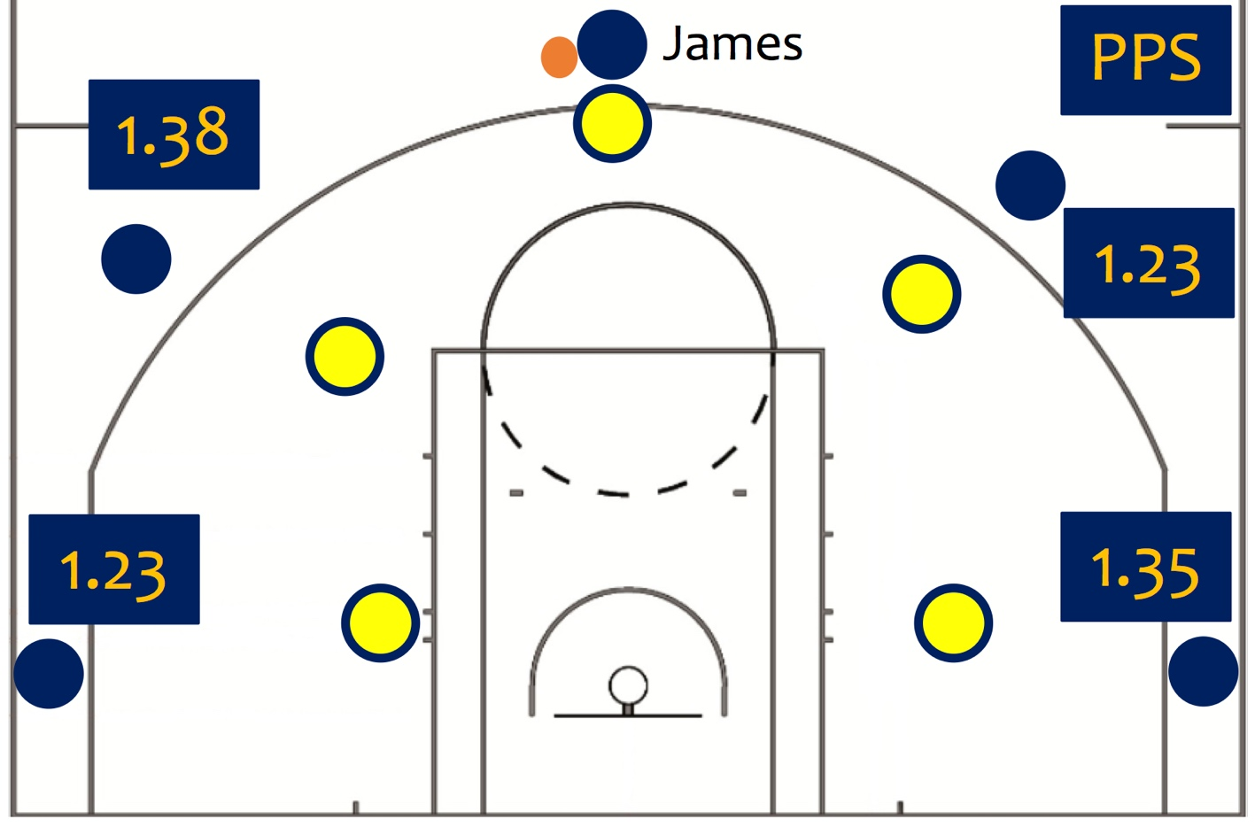
Spatial Tracking Provides Context
Cleveland

Slide 32
Spatial Tracking Provides Context
Oklahoma City
Cleveland

Slide 33
ShotTracker
Spatial tracking
For practices and games
For colleges, high schools, AAU

Slide 34
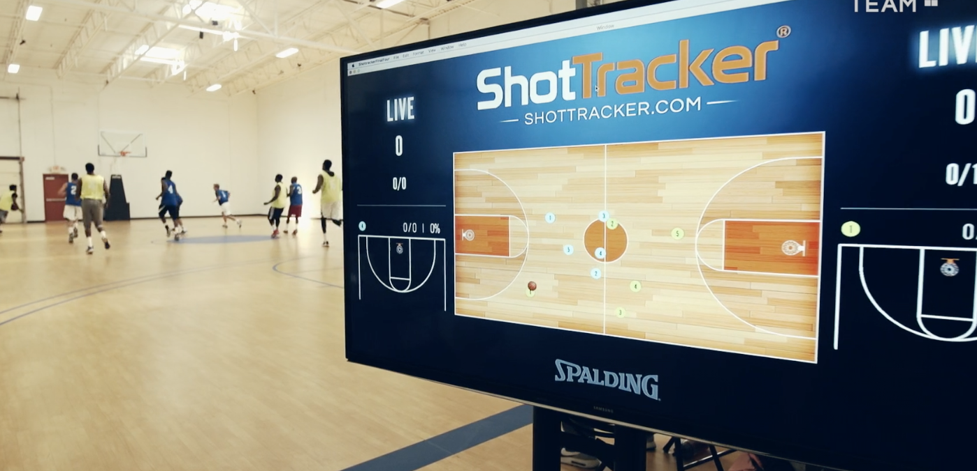
ShotTracker

Slide 35
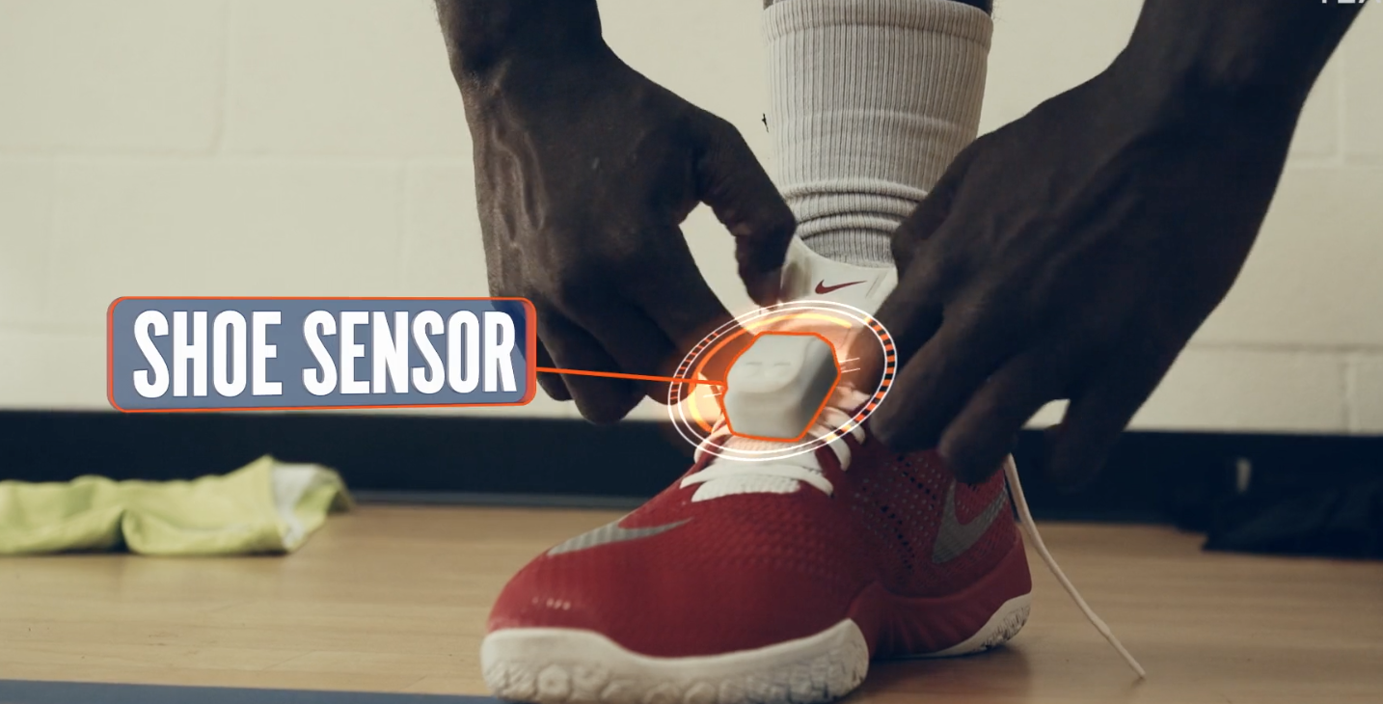
ShotTracker

Slide 36
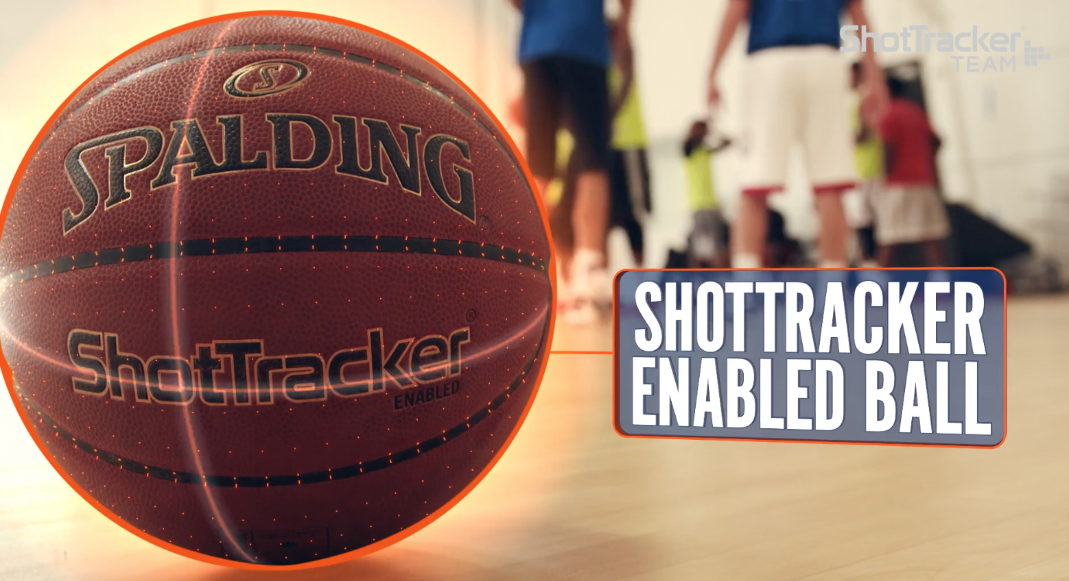
ShotTracker

Slide 37
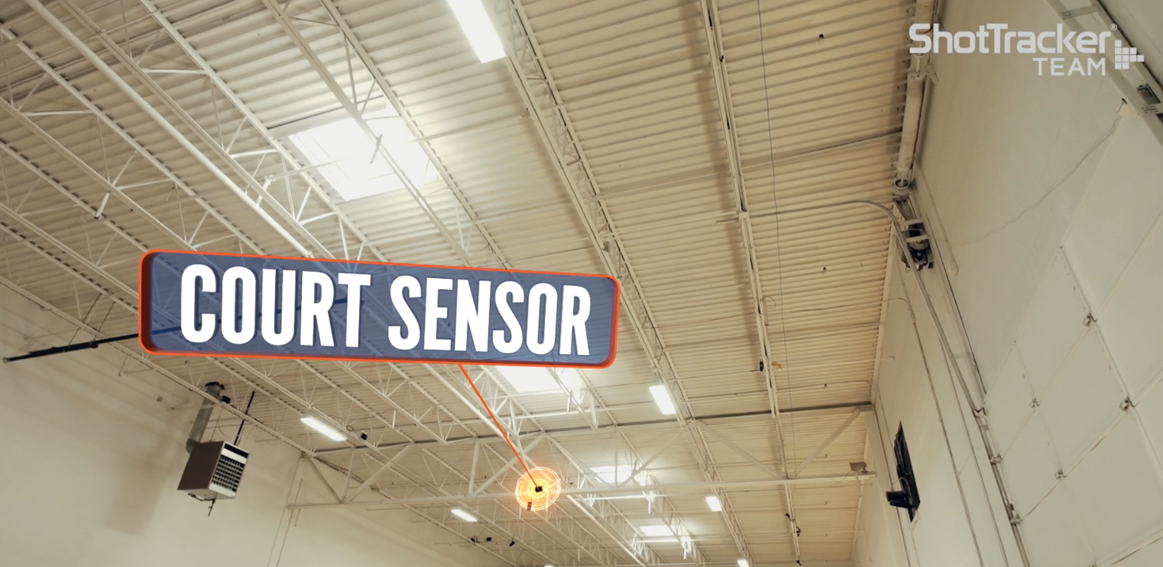
ShotTracker

Slide 38
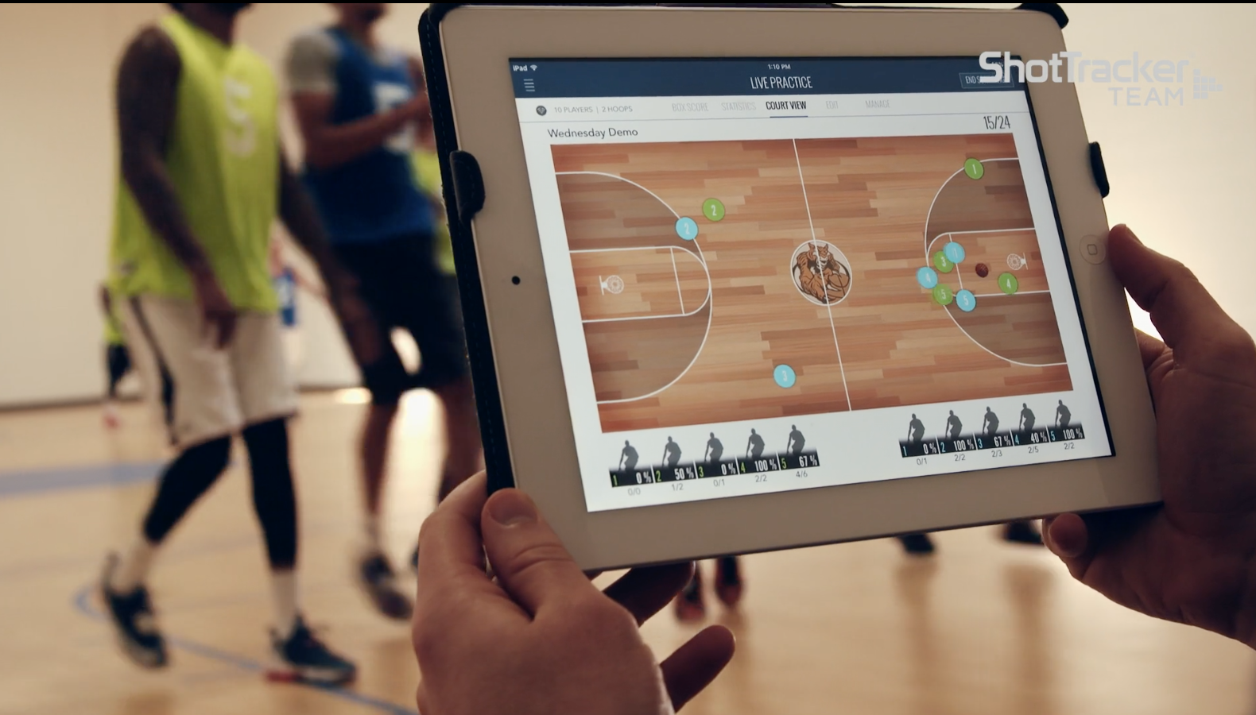
ShotTracker

