Slide 1
Novel Monitoring Parameters in Sports Analytics
Russ Rymut
CEO, Nobo

Slide 2
Who is this guy?
Arterial Blood Gas Monitor
Molecular Medicine in Ambulatory Care
Hydration Monitoring Wearable
Notes:
Before we dive in – let me take 20 seconds to tell you about my background. That way when I drift off into topics I don’t know much about it will make it easier to call bullshit. Which I love.
I’m an engineer by birth, and I’ve spent my entire career developing and launching healthcare technologies at companies like Honeywell Life Care Solutions, GE Healthcare & a Milwaukee startup called PointOne Systems. During that time I’ve worked on a variety of products I thought were pretty cool including the industry’s first bedside blood gas monitor, an IT system that integrated molecular & genetic medicine into the context of the traditional patient record and I’m currently the CEO of Nobo where we’re developing a wearable device that monitors hydration levels of individuals.
So there ya go.
My goal is not to give you lots of answers, but I hope to generate a little thought & hear your thoughts at the end.

Slide 3
A Tale of Three Tales
Biometrics in Patient Monitoring
Biometrics in Athletics
Analytics Driving Action

Slide 4
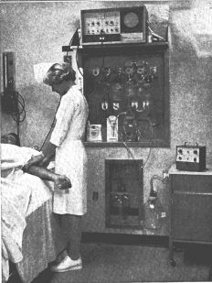
Notes:
Continuous measurement – began w/ Ecg in early 50’s
Soon followed – hardware HR estimate (hardware analytics)
80s – modular parameters, digial arrythmia analysis (more analytics)
Over time – automated collection of BP, temp, resp, pulse ox

Slide 5
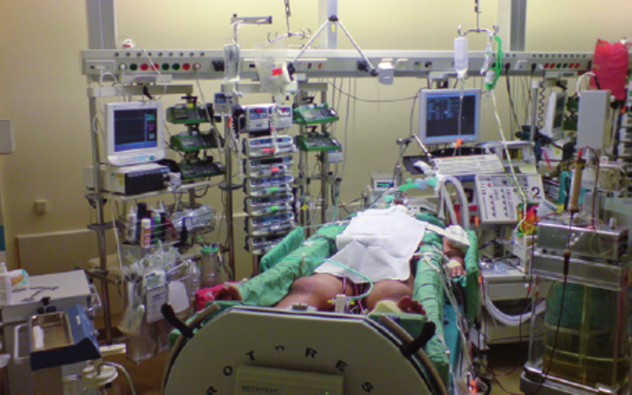
Notes:
Eventually morphed into this – I guess we’ll call it progress.
Imagine how much data is there

Slide 6
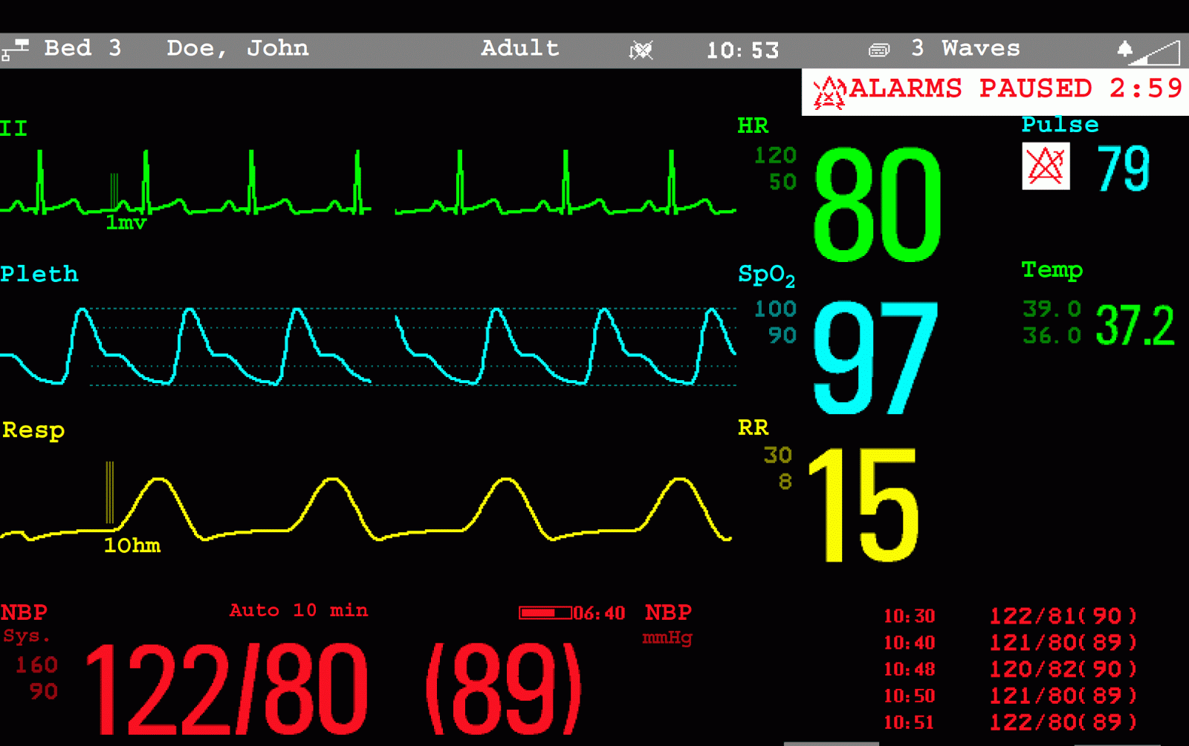
Notes:
Take a closer look at just one of those moniotrs
See HR, arrythmias, blood oxygenation, respiration rate & temperature – all isolated
Same set of parameters that’s been around for at least 20 years – maybe 30
That’s TONS of data related to how well that patient is doing at any given time.
So you might ask how that data is analyzed to determine patient condition

Slide 7
Notes:
Our lovely smiling team of care providers observes each number and each waveform and interprets the total package according to their own clinical experience and expertise.
It’s very much like baseball player evaluation before Moneyball.

Slide 8
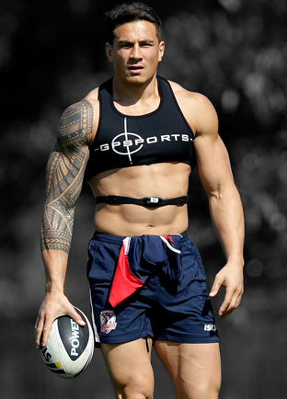
Notes:
Evolution of biometric collection in athletics has been following a similar path
Early 2000s – GPS location tech tracked motion, speed and distance – ecg for athletics
Less sophisticated – Nike+ dongle – steps, distance, pace
Eventually consumer devices – heart rate, galvanic skin response, skin temp, perspiration – useful & interesting
More professional devices – added respiration, HR variability, muscular activity & other things I’m not aware of
Similar to healthcare – we’re measuring lots & lots of stuff

Slide 9
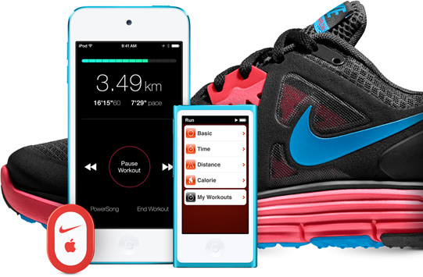
Notes:
Evolution of biometric collection in athletics has been following a similar path
Early 2000s – GPS location tech tracked motion, speed and distance – ecg for athletics
Less sophisticated – Nike+ dongle – steps, distance, pace
Eventually consumer devices – heart rate, galvanic skin response, skin temp, perspiration – useful & interesting
More professional devices – added respiration, HR variability, muscular activity & other things I’m not aware of
Similar to healthcare – we’re measuring lots & lots of stuff

Slide 10
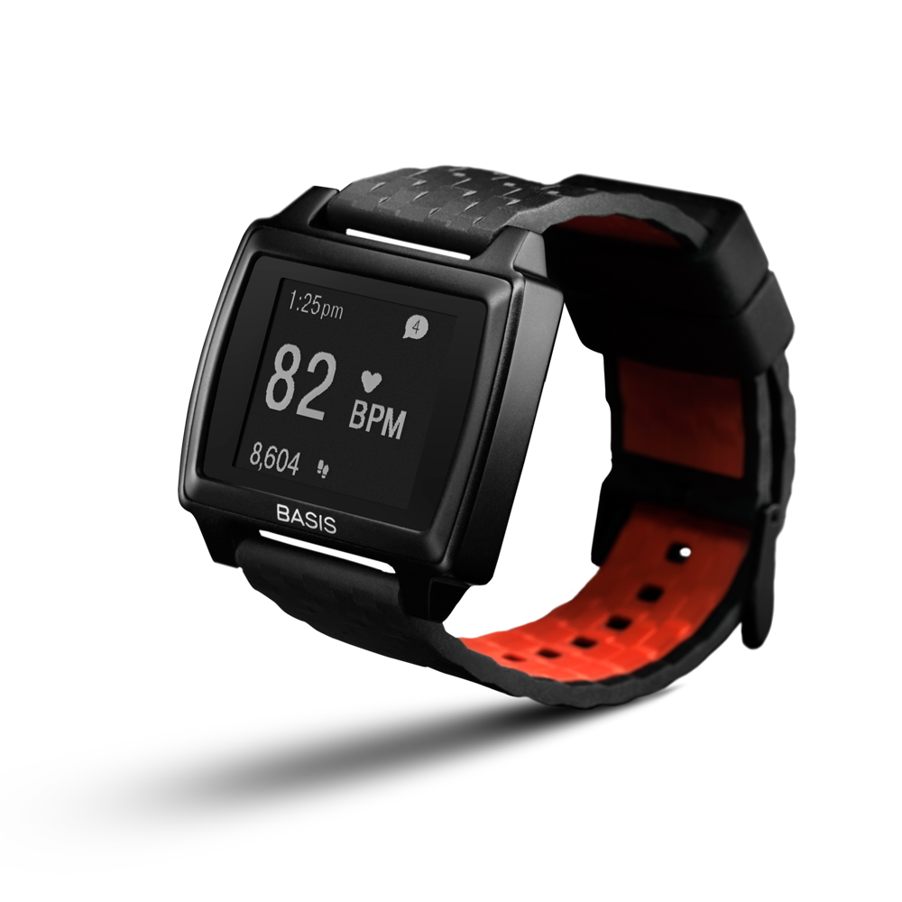
Notes:
Evolution of biometric collection in athletics has been following a similar path
Early 2000s – GPS location tech tracked motion, speed and distance – ecg for athletics
Less sophisticated – Nike+ dongle – steps, distance, pace
Eventually consumer devices – heart rate, galvanic skin response, skin temp, perspiration – useful & interesting
More professional devices – added respiration, HR variability, muscular activity & other things I’m not aware of
Similar to healthcare – we’re measuring lots & lots of stuff

Slide 11
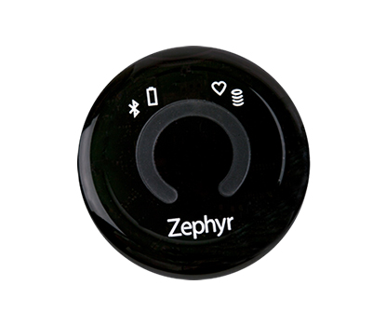
Notes:
Evolution of biometric collection in athletics has been following a similar path
Early 2000s – GPS location tech tracked motion, speed and distance – ecg for athletics
Less sophisticated – Nike+ dongle – steps, distance, pace
Eventually consumer devices – heart rate, galvanic skin response, skin temp, perspiration – useful & interesting
More professional devices – added respiration, HR variability, muscular activity & other things I’m not aware of
Similar to healthcare – we’re measuring lots & lots of stuff

Slide 12
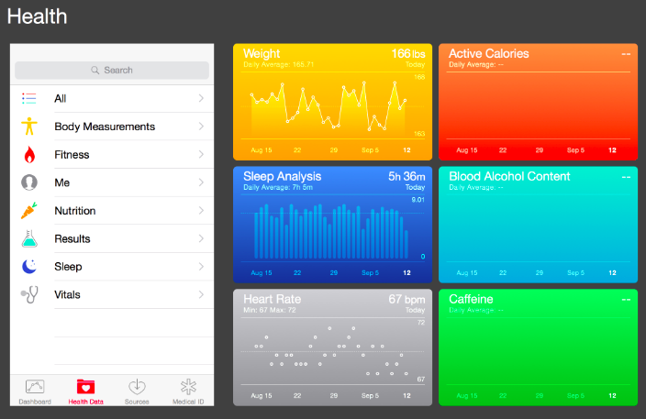
Notes:
But guess what –We still aren’t looking at the person as a whole
And more importantly – none of the data is actionalble.
Graph of heart rate laid against a graph of acceleration.
See temperature, but what’s it’s relationship to muscle activity? Which is affecting which?
And what the hell should athletes, trainers & coaches DO about those relationships?
In other words – where are the analytics coming from?

Slide 13
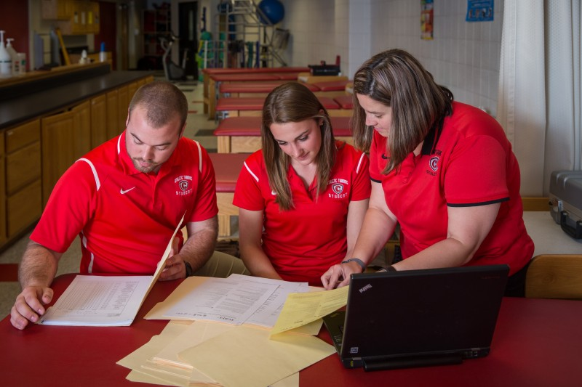
Notes:
It’s our team of lovely smiling athletic trainers looking at data, looking at waveforms and using their experience to determine what do with that information.
Hope that sounds familiar.
HR is known
Use it to determine how hard an athlete is training
What about athlete-to-athlete variations
What about other factors affecting max HR that day?
Is practice configured to maximize team’s performance?
The truth - even with the data and the analytics there’s still subjective interpretation that could be either validated or invalidated by consistent & robust cross parameter analytics.

Slide 14
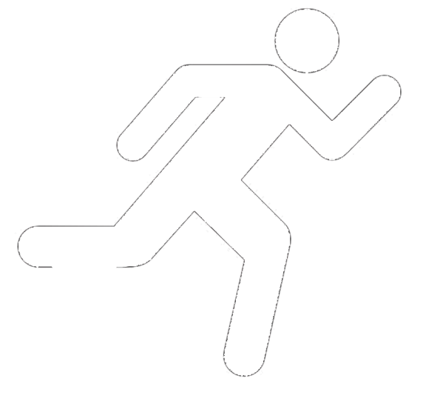
Cross-parameter Analytics
Position
Heart Rate
Temp.
EMG
Notes:
I see it as siloed parameters
Lot’s of interesting data inside each silo
I’ll mention Catapult and their work extracting information from position vs. time
Next layer up – cross parameter analytics – is the key to unlocking secrets of optimum performance

Slide 15
Position
Heart Rate
Temp.
EMG
Notes:
The trouble is (I would argue) that that layer doesn’t currently exist in any robust way.

Slide 16
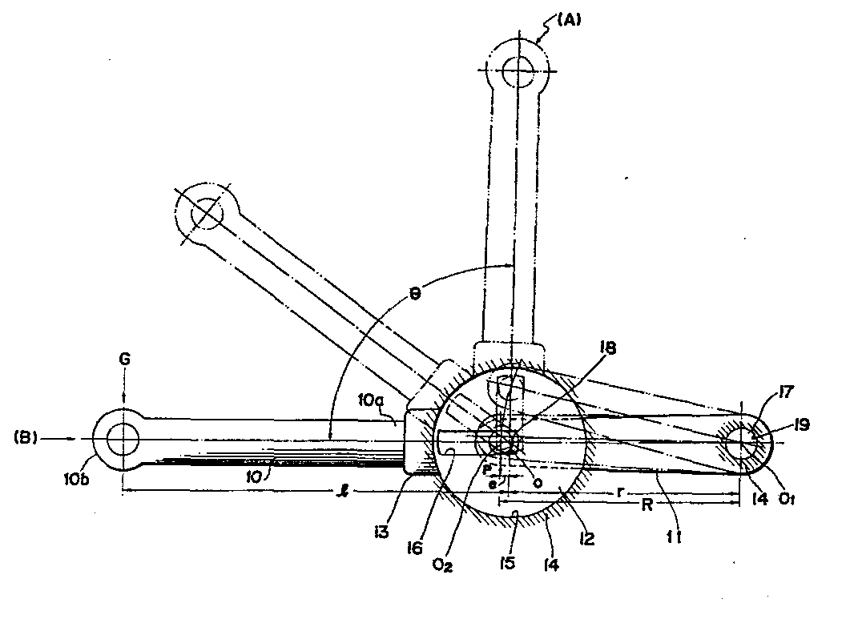
Notes:
And I’ll go even further –cross parameter analytics is a force multiplier for new biometrics
If that analytics is available, each new parameter exponentially increases value, information & actionable recommendations
Don’t ask me defend that mathmatically
Let’s take a look at some of the novel biometrics in athletics
Dream a little about how cross platform analytics will improve knowledge of the athlete & create actionable recommendations

Slide 17
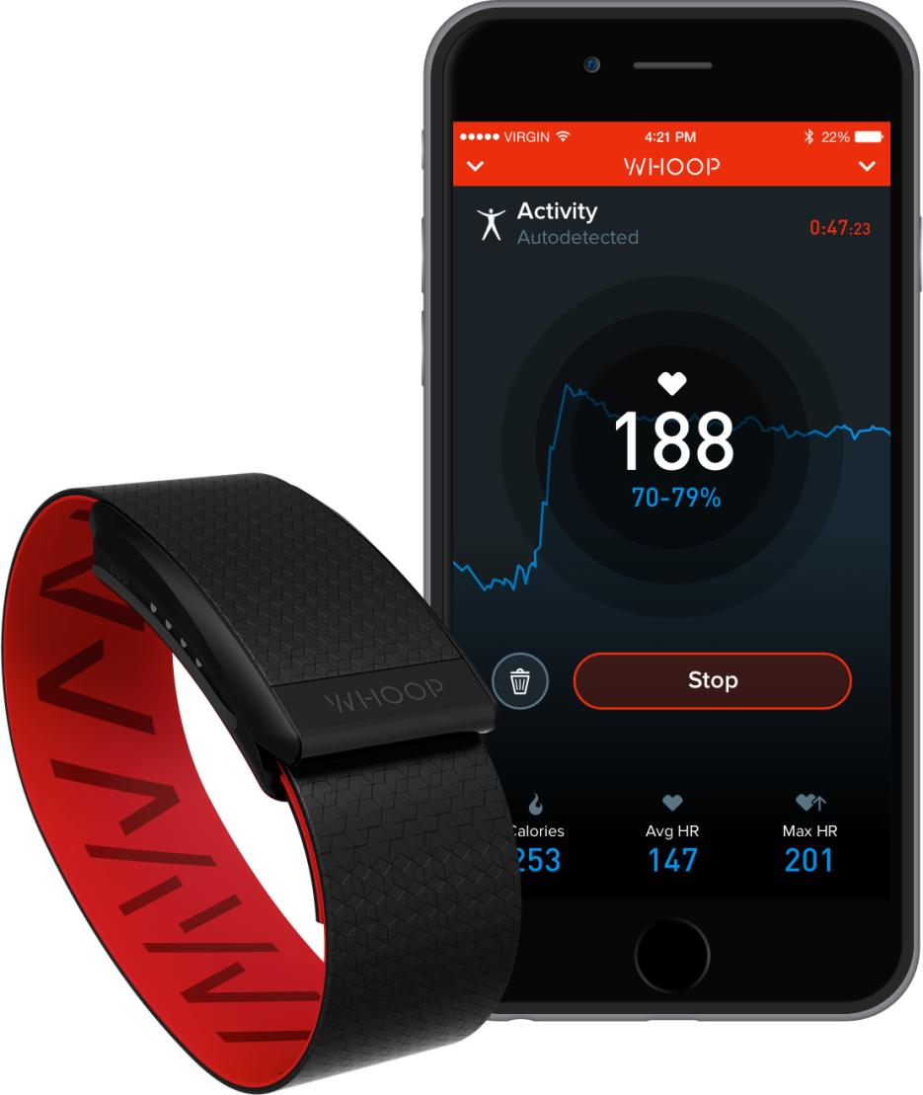
Sleep as a Biometric
Notes:
Whoop – recommends workout intensity based on quality of sleep
That’s a great actionable outcome based on their siloed sleep analysis
What are the effects of sleep quality on maximum heart rate, max acceleration, endurance?
Would understanding those relationships modify the workout intensity recommendations?

Slide 18
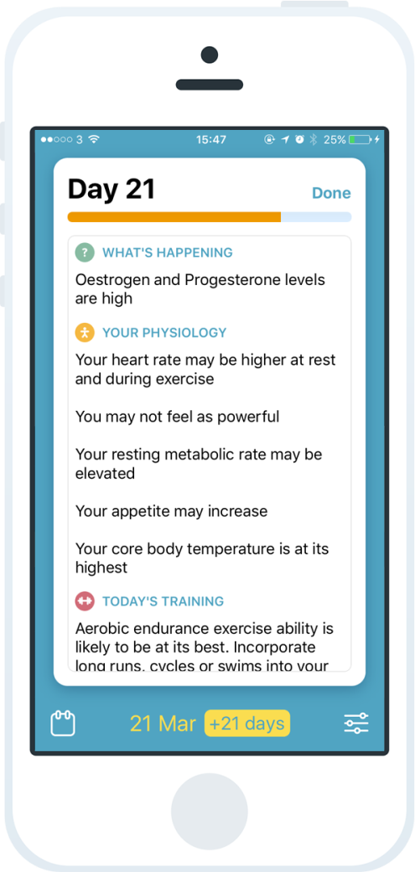
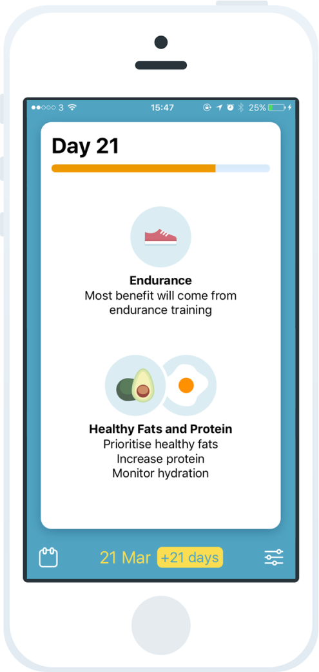
Menstrual Cycle & Performance
Notes:
FitrWoman app by Orreco
Hormone levels
Again provides training recommendations
How do we reconcile those recommendations with the ones generated by the Whoop system?
Only through that cross parameter, recommendation focused analytics that we’ll begin to treat the athlete as a whole person and provide valuable, actionable outputs.

Slide 19
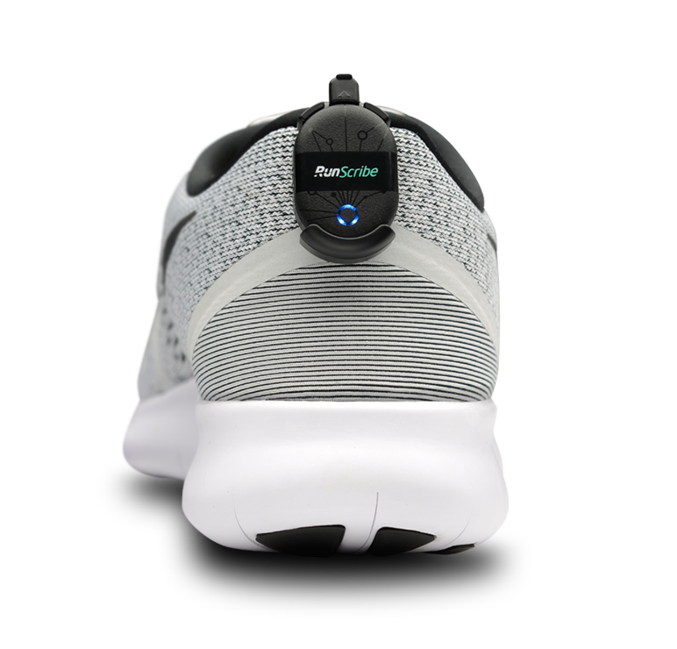
Gait Analysis
Notes:
RunScribe
Beyond step tracking to understand efficiency, motion, symetry and shock of a runner’s gait.
Interesting, but what do we do about it?
Further – how does nutrition affect gait? Or sleep? How does gait change as distance run changes?
All of that would be really interesesting outputs of a cross-parameter analytics layer, but let’s go even further – Are changes in gait predictive of injury? Is it possible to recommend rest instead of training in order to prevent injury?
Or are changes in gait coupled with changes in heart rate indicative of a truly optimized workout?
Should practices be designed with gait, HR and temperature targets?

Slide 20
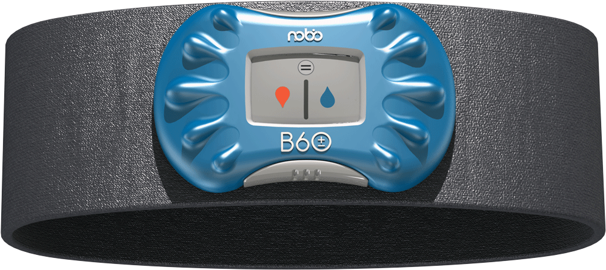
Hydration
Notes:
And of course I need to get a shameless plug in.
Lots of studies show improper hydration has dramatic influence on performance
Also anxious to look at cross parameter affects
Within our silo, Nobo is working to predict hydration needs
Gets more exciting when we look at performance params, ECG, temperature work together to impact performance
How can athletes use that info to optimize nutrition

Slide 21
Let’s Wrap it Up
Good | Really cool analytics that reveals information from a single biometric
Better | Really cool analytics that reveals information from multiple biometrics
Best | Really cool analytics that provides actionable information from all the biometrics
Notes:
Cross parameter analytics is a force multiplier that enable an athlete to be treated as a whole person
I get it – it’s really hard for one company to both create a new biometric and work on cross-parameter analytics.
But that’s where the real value comes from
And I hope that we as the athletic technology community find a way to collaborate and provide the athletic community with tools that help us understand athletes as a whole person and use that information to optimize nutrition, training and competition.

Slide 22
www.nobo.io
Russ Rymut
russ.rymut@nobo.io
414.604.6626
Notes:
And I’ll stop there
Anxious to hear any thoughts, comments, questions or snide remarks

