Slide 1
Zoning as a tool in Groundwater protection
January 4, 2022
Central sands groundwater collaborative
Lynn Markham, land use specialist

Slide 2
Summary
Zoning has strengths and weaknesses related to protecting groundwater
Weaknesses
Limited ability to address existing problematic land uses
Zoning doesn’t determine which crops are grown in ag districts, even though they have different amounts of nitrogen leaching to groundwater
Strengths
Can use wellhead protection ordinances to protect municipal/community wells
Can set minimum lot sizes to space out residential septic systems and protect private well water quality from septic systems
Can list high nitrogen uses as conditional or prohibited uses (e.g. fertilizer plants, landfills, feedlots, cemeteries, golf courses, possibly CAFOs)
Can geographically separate high nitrogen uses from wells - theoretically
Can be changed at any time by elected officials (town-county zoning). Land purchases are more certain long-term protection, and more expensive.

Slide 3
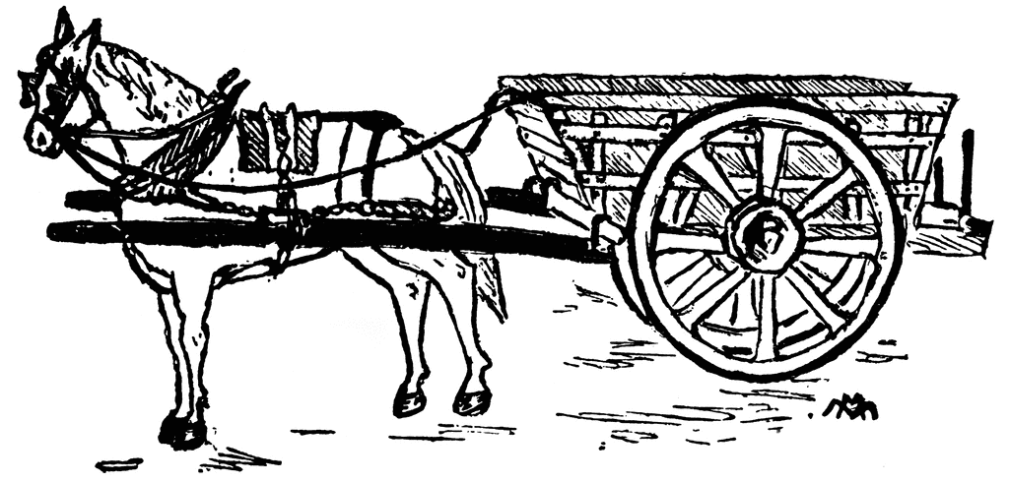
Comprehensive plan = Goals Zoning = Way to achieve goals
Notes:
You can also view it as the comprehensive plan – the horse - guides zoning – the cart.

Slide 4
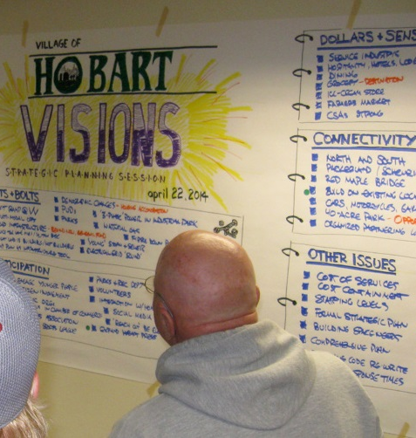
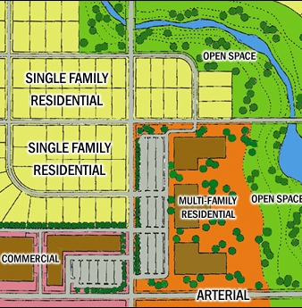
Guiding Document
Comprehensive Plan
Regulatory Tools to Implement the Plan
Zoning Ordinance
Subdivision Ordinance
Notes:
The comprehensive plan is meant to include community goals and be the guiding document. Zoning is one of the regulatory tools available to implement the plan.
http://innov8tiv.com/wp-content/uploads/2014/12/z50.jpg
https://burnett.uwex.edu/files/2010/09/Official_Mapping.pdf

Slide 5
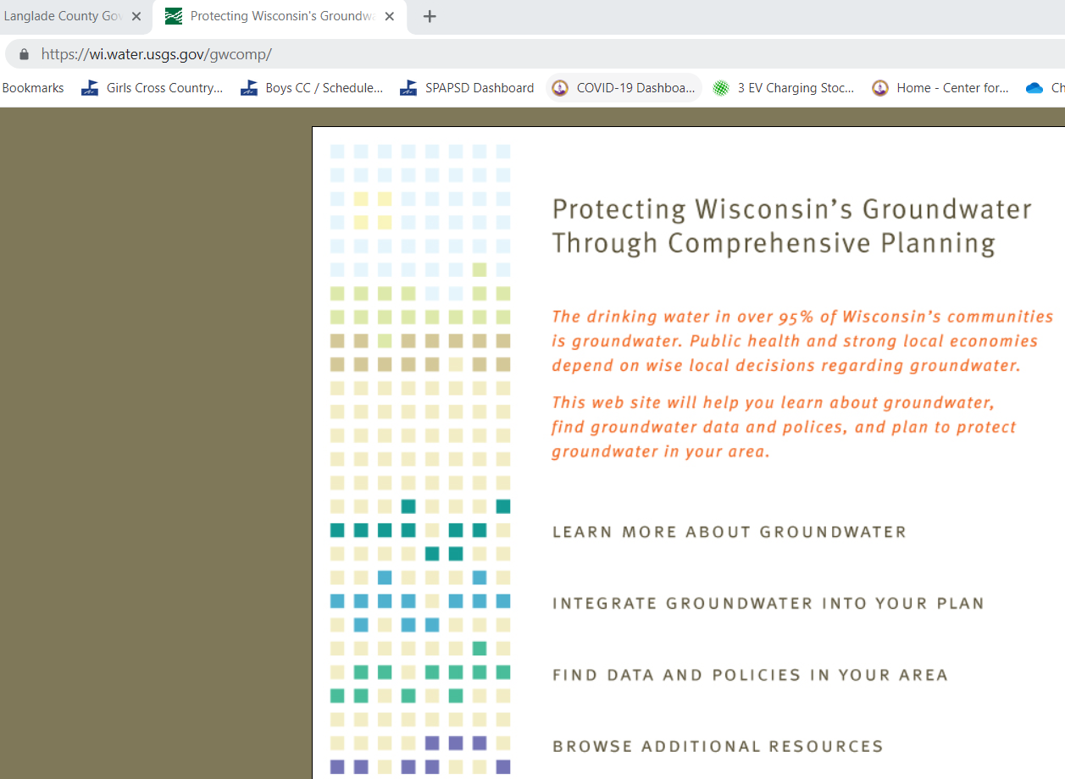
Policy suggestions for updating comp plans.
Note: Data on this website is old. Use Well Water Quality Viewer for data.

Slide 6
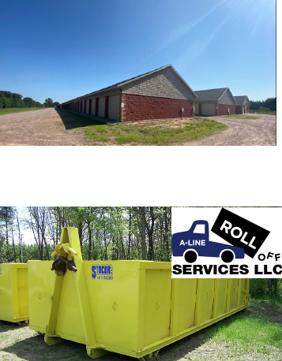
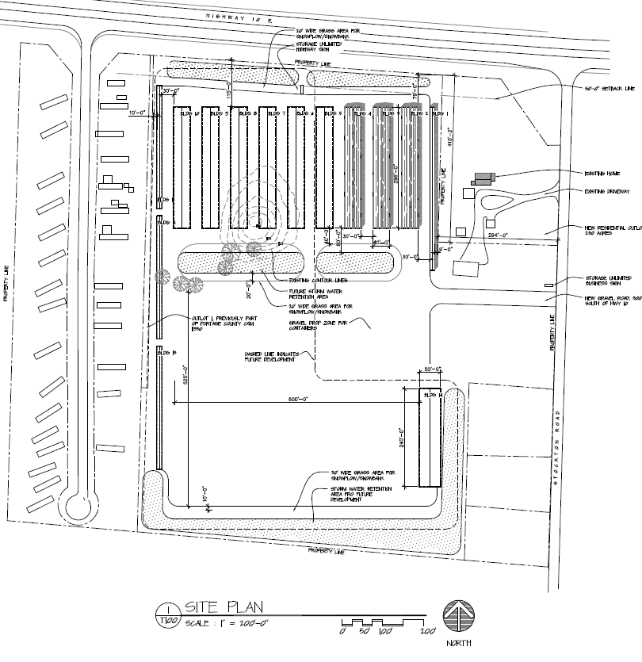
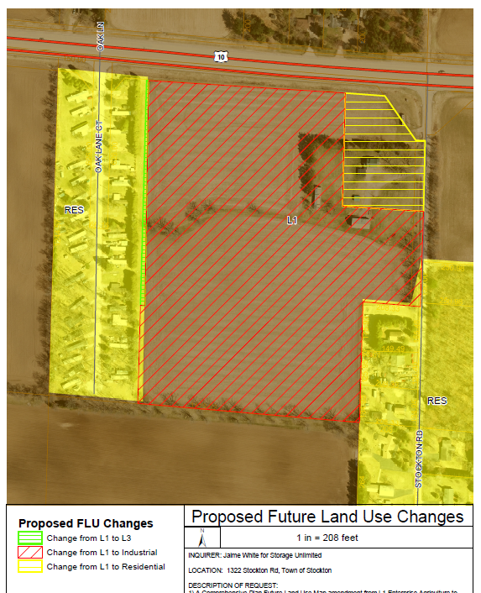
Example of using your plan to protect groundwater
Plans are only valuable if they are used in making decisions
Changes to zoning are required to be consistent with the comprehensive plan
Portage County used their comp plan to guide groundwater protection conditions for a new proposed development that required a change in zoning
Notes:
The 25-acre parcel shown is zoned for A1 Exclusive Agricultural, and has existing residential uses on the west and southeast sides. This parcel is also in Zone C of the Wellhead protection ordinance, and as such, any new unsewered industrial development requires approval of a special exception.
The current A1 zoning does not allow for the proposed use of mini-warehousing along with storage of approximately 40 portable storage containers and 40 dumpster that are rented out.
Questions were
1) The Town of Stockton Comprehensive Plan future land use map designates this parcel for L1
Enterprise Agricultural, so the proposed rezoning is not consistent with that. Should the land use map be amended to change this parcel from from Agriculture to Industrial and Residential land uses?
2) Should this parcel be rezoned to Industrial zone, (plus R1 for the existing home and buildings)?
3) Should a special exception (conditional use) be granted for this industrial use in the wellhead protection zone?
From a county staff letter to the Portage County board of adjustment that would decide on the special exception:
- It is important to consider the land use practices that fall within the wellhead protection zones, as they can impact the municipal water quality, as well as neighboring wells.
- Groundwater in the area of the Stockton Road property is approximately 20 feet below the ground surface,
which is considered to be somewhat shallow and could be prone to groundwater contamination.
When reviewing the proposed land use within the Wellhead Protection District C, three concerns for potential
contamination were identified with recommendations for how to address these concerns;
1) how stormwater from impervious surfaces would be handled. County LWCD would need to approve a stormwater plan that addresses concerns related to stormwater impacts on GW.
2) what if any potential toxic and/or hazardous materials may be allowed in storage units. Propose “no hazardous and/or toxic materials be allowed to be stored in facilities” as a special exception condition.
3) whether the washing of empty dumpsters and/or storage pods would occur on site. Propose “no washing of empty containers or pods should occur on
premises” as a special exception condition.

Slide 7
What do zoning and subdivision regs do?
Sets the development pattern
Density
Land Uses
Building envelope dimensions (setbacks, height, etc.)
Roads
Impacts how our communities look and how they function

Slide 8
How does zoning work?

Slide 9
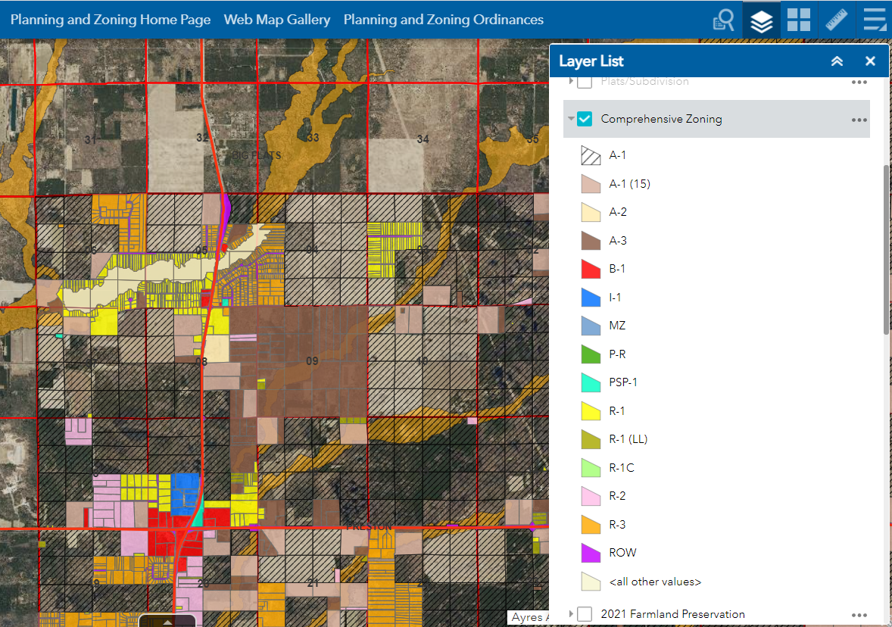
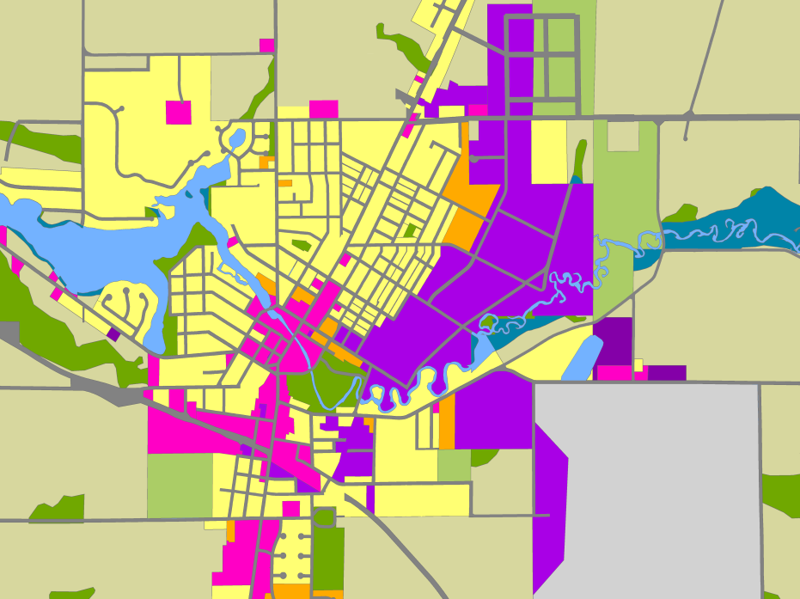
A zoning ordinance contains two parts:
Zoning Map divides the community into districts
Residential
A-1
Industrial
Conservancy
A-3
A-1
Commercial
Airport
Notes:
Adams County comp zoning just north of Adams and Friendship. You see blocks or ag zoned land next to blocks of residential land that is typical. https://adams-county-wi.maps.arcgis.com/apps/webappviewer/index.html?id=75732dd4741b44a5b599ad197db17a1e
Dusty Grant is the Adams County ZA
https://propertybangalore555.wordpress.com/2015/05/15/zoning-regulations-some-terms-and-definitions/

Slide 10
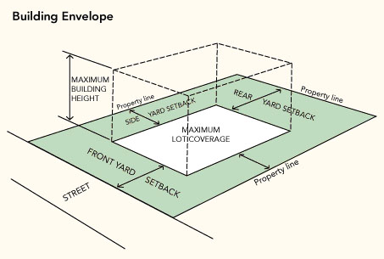
A zoning ordinance contains two parts:
Zoning Text
purposes
uses allowed in each district
dimensional standards i.e. lot size, setbacks, etc.
requirements related to parking, signage, landscaping, etc.
Notes:
https://propertybangalore555.wordpress.com/2015/05/15/zoning-regulations-some-terms-and-definitions/

Slide 11
Uses for each district:
Permitted Use
Use is listed and allowed by right in all parts of the zoning district
Granted by zoning administrator
Conditional Use
Use is listed for the district and may be allowed if suited to the location
Decided by zoning board, plan commission, or governing body
Prohibited Use
Use is not listed for the district or is expressly prohibited
May apply for rezone or use variance, if allowed

Slide 12
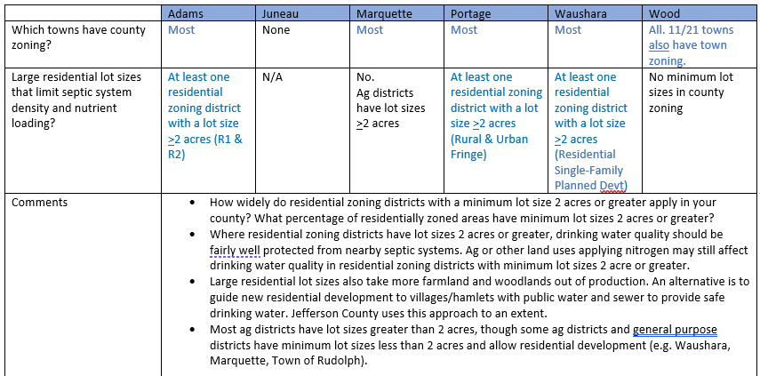
County survey results

Slide 13
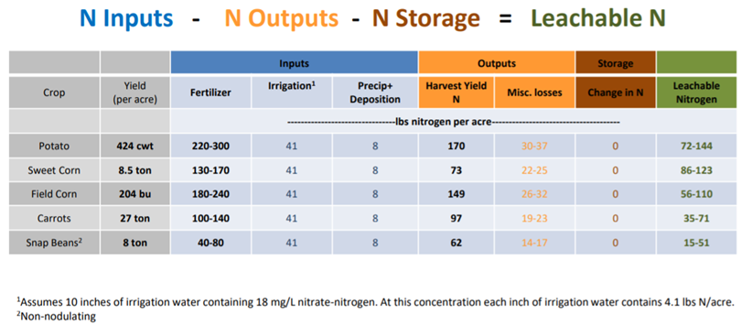
Different crops leach different amounts of Nitrogen to groundwater
Ag zoning districts do not differentiate based on how much nitrogen is leached to groundwater
Sandy soils
Kevin Masarik, Groundwater Specialist
Notes:
Slides from Kevin Masarik
Portage county well water quality 2017, page 15 at https://www.co.portage.wi.us/home/showpublisheddocument/21878/636797679878700000

Slide 14
Comparing Land-use Impacts
Corn¹ (per acre) |  | Prairie¹ (per acre) | Septic ² System
Total Nitrogen Inputs (lb) | 169 | 9 | 20-25
Nitrogen Leaching Loss (lb) | 36 | 0.04 | 16-20
Amount N lost to leaching (%) | 20 | 0.4 | 80-90
Data from Masarik, Economic Optimum Rate on a silt-loam soil, 2003
Data from Tri-State Water Quality Council, 2005 and EPA 625/R-00/008

Slide 15
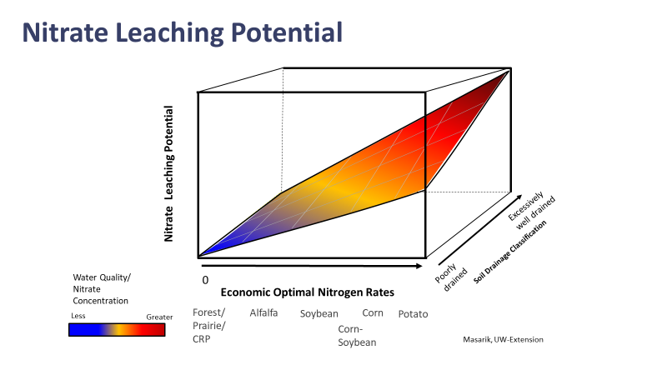
solar
Different crops on the same soil have different rates of nitrate leaching that vary from year to year based on fertilizer inputs, yield, and weather
Nitrate leaching below the same crop can vary depending on soil type and location in the state
Zoning doesn’t determine which crops are grown. LWCD and FSA offices can affect this topic.
Kevin Masarik, Groundwater Specialist, send PowerPoint and video
Notes:
PowerPoint https://nanopdf.com/download/nitrogen-and-groundwater-kevin-masarik_pdf
Video https://www.youtube.com/watch?v=2kN0VmvwLJ8

Slide 16
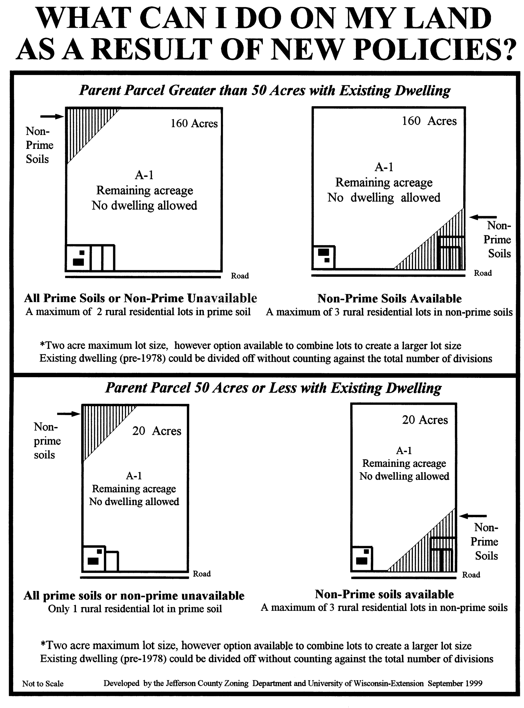
limited residential allowed in a-1 zoning districts
Farmland preservation
Fewer new residential lots in A-1 zoning districts which may have high nitrate levels

Slide 17
Survey results Limiting new residential lots where drinking water is not safe

Slide 18
Can use zoning to make land uses with high nitrogen leaching conditional or prohibited uses
Review the permitted, conditional, and unlisted/prohibited uses listed for each zoning district in your ordinance. Compare your zoning maps with your groundwater susceptibility/soil maps. Do they need to be updated to protect groundwater qualiy?
2017 Act 67 says if a CUP meets standards in ordinance it must be granted
Notes:
Email from Craig Conroy 12/30/21

Slide 19
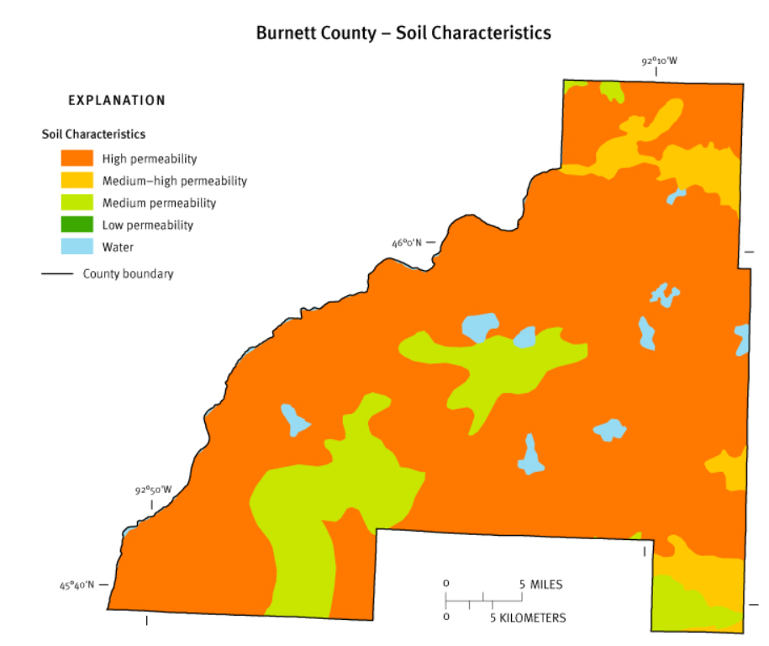
Burnett county plans to use gw susceptibility maps and zoning to limit where new cafos can be located
About 80% of Burnett County is less than 20 feet to the water table and has highly permeable soils
Burnett County has three ag districts
Not much exclusive ag zoning (A1) is located in the sandy soil areas of the county
Land use committee is working on a proposal to allow CAFOs (1000 animal units or more) only in A1, and limit animal units in other ag districts to 250 or 500
Notes:
Email from Craig Conroy 12/30/21

Slide 20
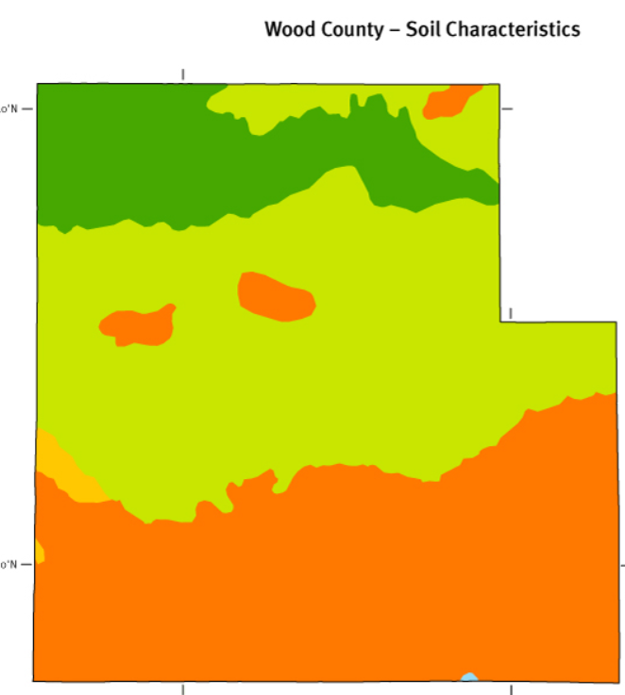
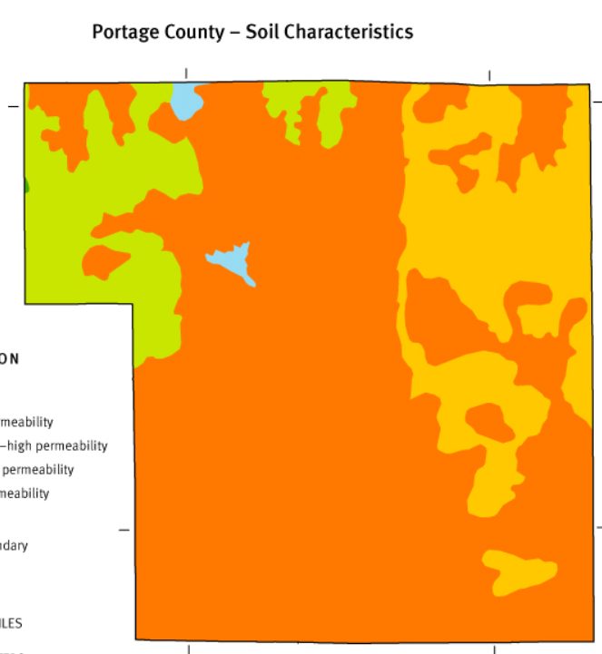
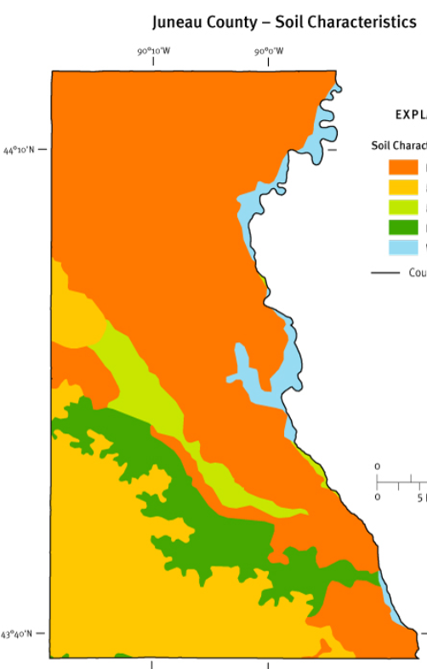
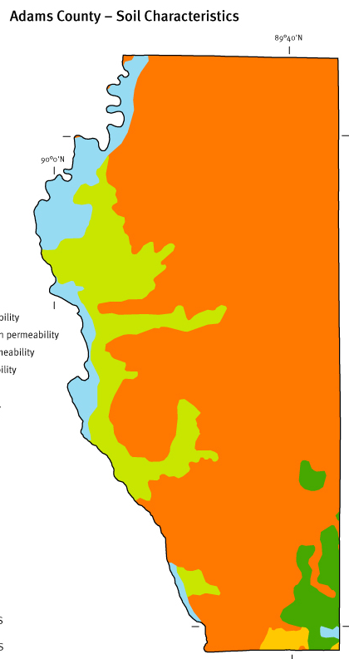
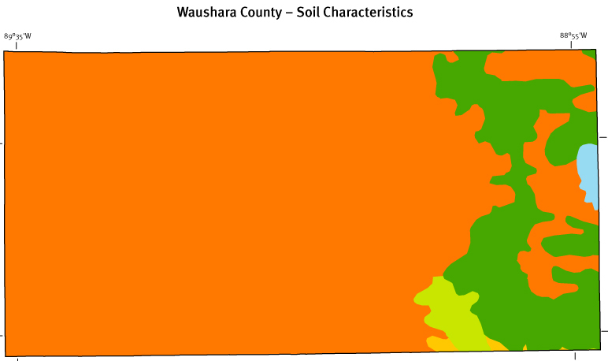
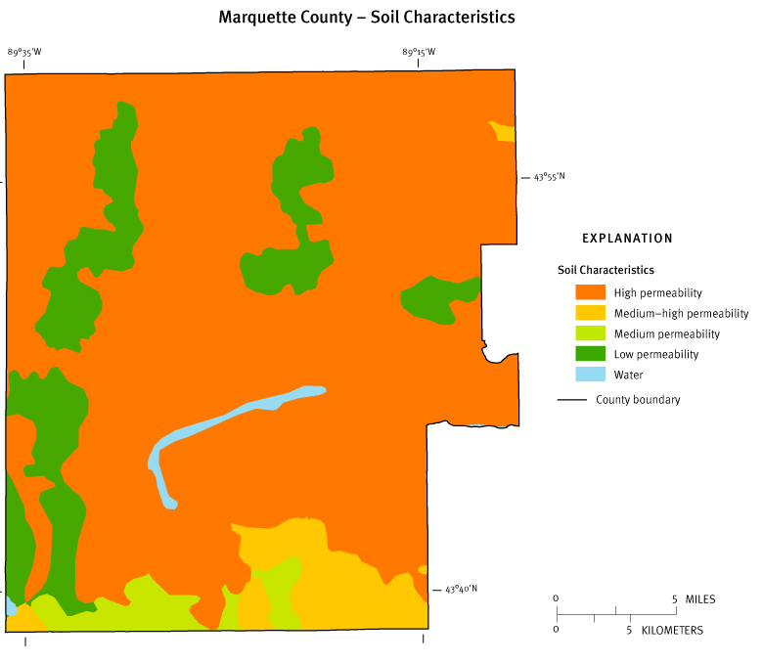
All counties in CSGCC have areas of highly permeable soils, and some areas with lower permeable soils
Areas with lower permeable soils are likely safer places for land uses that are potential sources of GW contamination
Zoning can be used to determine where NEW land uses will be located (e.g. fertilizer plant, manufacturing)

Slide 21
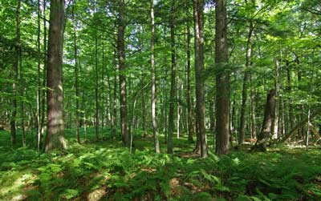
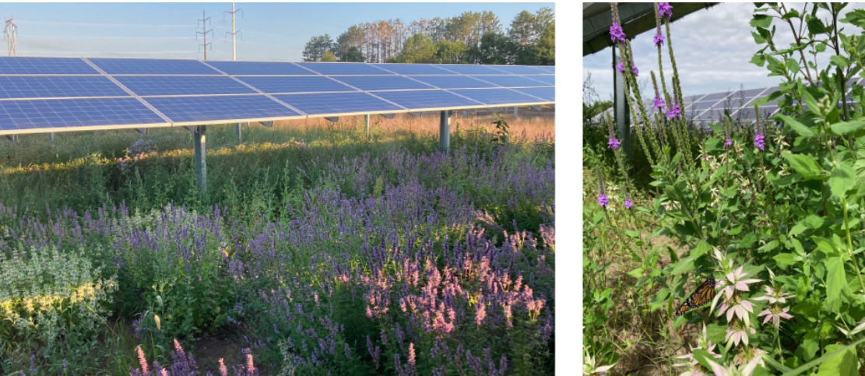
Survey results
Zoning districts that maintain or allow low nitrogen land uses
GW downgradient of these areas may be protected & low nitrate. Map?
Notes:
Solar farm photo from MN at https://fresh-energy.org/case-study-900-acres-of-pollinator-friendly-solar
Woods photo from WI DNR https://dnr.wi.gov/topic/lands/naturalareas/index.asp?SNA=282

Slide 22
Comparing Land-use Impacts
36 lbs | 36 lbs | 36 lbs | 36 lbs
36 lbs | 36 lbs | 36 lbs | 36 lbs
36 lbs | 36 lbs | 36 lbs | 36 lbs
36 lbs | 36 lbs | 36 lbs | 36 lbs
36 lbs | 36 lbs | 36 lbs | 36 lbs
20 lbs
20 acres
20 acres
36 lbs/ac x 20 acres = 720 lbs
16 mg/L
20 lbs/septic system x 1 septic systems = 20 lbs
1/36th the impact on water quality
0.44 mg/L
Assuming 10 inches of recharge -
Masarik, UW-Extension

Slide 23
Comparing Land-use Impacts
36 lbs | 36 lbs | 36 lbs | 36 lbs
36 lbs | 36 lbs | 36 lbs | 36 lbs
36 lbs | 36 lbs | 36 lbs | 36 lbs
36 lbs | 36 lbs | 36 lbs | 36 lbs
36 lbs | 36 lbs | 36 lbs | 36 lbs
20 lbs
20 lbs
20 lbs
20 lbs
20 lbs
20 lbs
20 lbs
20 lbs
20 lbs
20 lbs
20 lbs
20 lbs
20 lbs
20 lbs
20 lbs
20 lbs
20 acres
20 acres
20 lbs
20 lbs
20 lbs
20 lbs
20 lbs
20 lbs
20 lbs
20 lbs
20 lbs
20 lbs
20 lbs
20 lbs
20 lbs
20 lbs
20 lbs
20 lbs
20 lbs 20 lbs 20 lbs 20 lbs
20 lbs/septic system x 36 septic systems = 720 lbs
36 lbs/ac x 20 acres = 720 lbs
Using these numbers: 36 septic systems on 20 acres (0.55 acre lots) needed to achieve same impact to water quality as 20 acres of corn
Masarik, UW-Extension

Slide 24
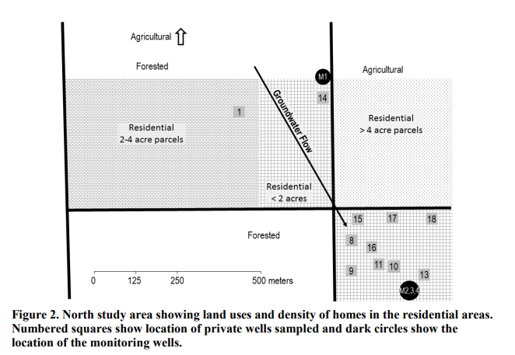
Unsewered residential areas
In a sandy area with unsewered lot sizes less than 2 acres, nitrate levels were:
7 wells 2-10 ppm = blue circles
3 wells over 10 ppm= black circles
1 well less than 2 ppm
Sulfamethoxazole, a human antibiotic = red circles
Let me know if you’d like a copy of this study
Notes:
https://www.uwsp.edu/cnr-ap/watershed/Documents/Eval_chemtracers_suburbanGW.pdf
Town of Hull, Portage County, central sands
Following the groundwater flow direction, it is about 500m (a little more than a quarter mile) from the ag/forested area to the cluster of wells 8-18

Slide 25
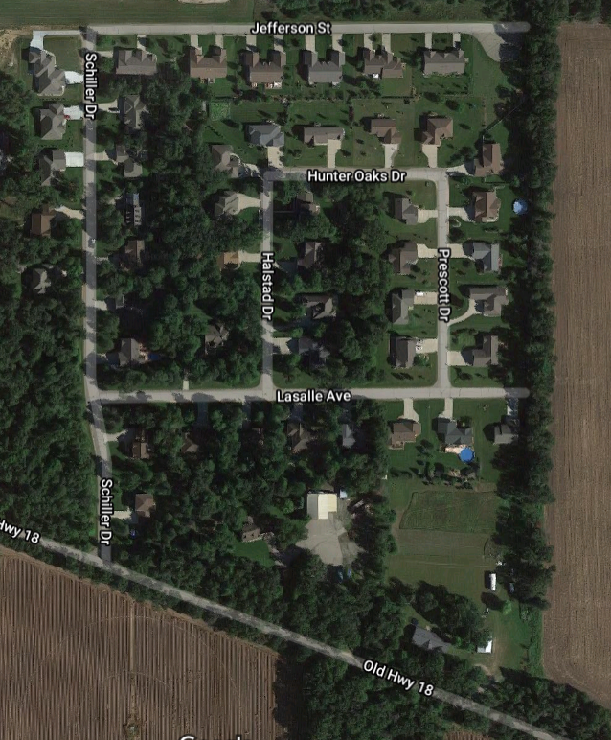
Residential zoning for unsewered development
Zoning can be used to set unsewered minimum residential lot sizes at 2 or more acres to limit well contamination by nitrate and pharmaceuticals from nearby septics

Slide 26
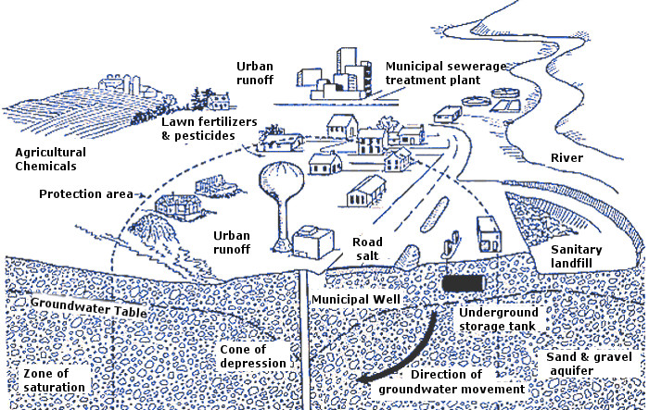
Wellhead protection ordinance

Slide 27
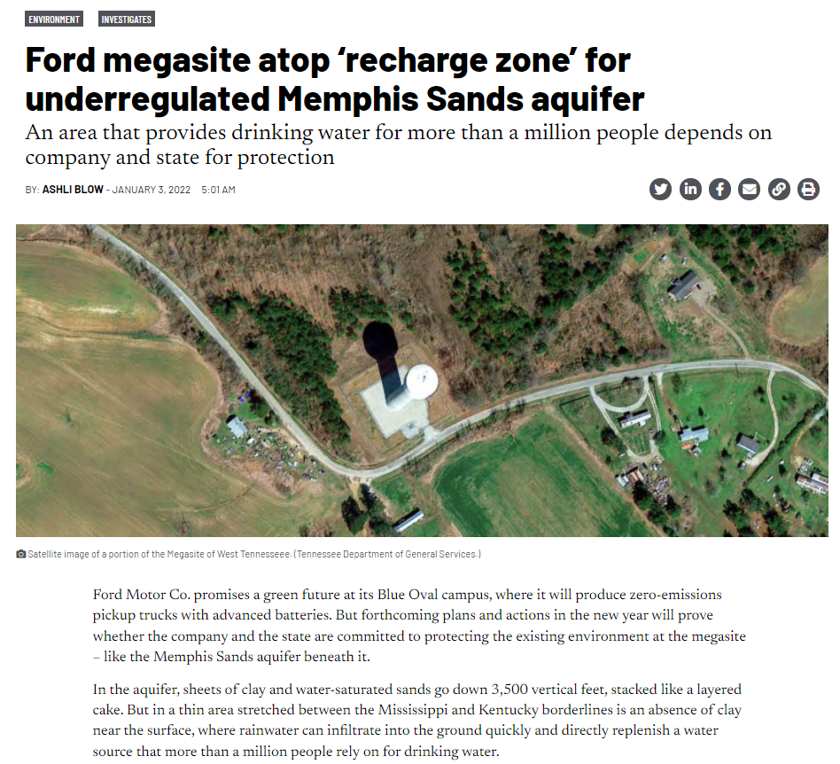
Survey results
Notes:
https://tennesseelookout.com/2022/01/03/ford-megasite-atop-recharge-zone-for-underregulated-memphis-sands-aquifer/
You never know what land uses could be coming your way in the future. This is the value of planning and zoning: to prepare rules ahead of time.
absence of clay near the surface, where rainwater can infiltrate into the ground quickly and directly replenish a water source that more than a million people rely on for drinking water.
Part of this recharge zone is underneath Ford’s megasite that spans nearly six square miles —almost the same size as downtown Memphis.

Slide 28
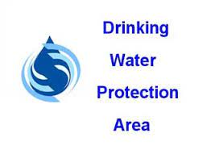
Wellhead Protection Ordinance
Zone A – allows only land uses with low potential to pollute drinking water such as unfertilized parks
Zone B – allows more land uses but not gas stations, fertilizer plants, cemeteries, etc.
Municipalities can save $ by keeping their drinking water safe
Zone A

Slide 29
Other approaches to wellhead protection
Purchase and lease of lands around the wells:
City forested recreation area
Izaak Walton League lodge and shooting range
Boy Scout camp
Conservation easement
ARPA funding?
Notes:
String of pearls (protected lands) to protect the Plover River and the city’s drinking water:
City XC forested recreation area
Izaak Walton’s land for hunting and shooting sports
Boy scout camp with 100 year lease
Conservation easement on 60 acres on Jordan Pond, purchased by city and state stewardship funds
+ conservation zoning to prevent further residential development and septic tanks near river
Largely thanks to Tom Schrader, city parks director

Slide 30
Summary
Zoning has strengths and weaknesses related to protecting groundwater
Weaknesses
Limited ability to address existing problematic land uses (e.g. fertilizer plant with regular spills); can limit building expansions
Zoning doesn’t determine which crops are grown in ag districts, even though they have different amounts of nitrogen leaching to groundwater
Strengths
Can use wellhead protection ordinances to protect municipal/community wells
Can set minimum lot sizes to space out residential septic systems and protect private well water quality from septic systems
Can list high nitrogen uses as conditional or prohibited uses (e.g. fertilizer plants, landfills, feedlots, cemeteries, golf courses, possibly CAFOs)
Can geographically separate high nitrogen uses from wells - theoretically
Can be changed at any time by elected officials (town-county zoning). Land purchases are more certain long-term protection, and more expensive.

