Slide 1
Waterfront properties
Could fish live here?

Slide 2
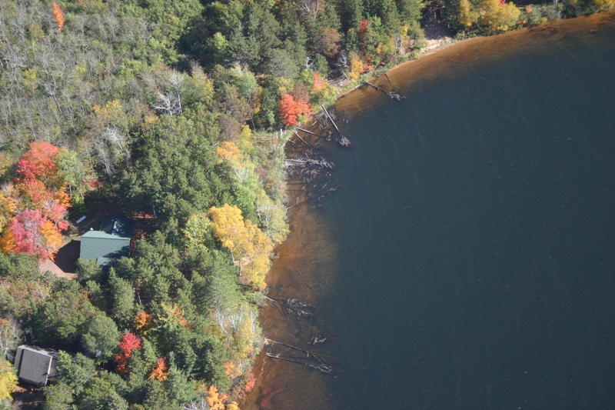
Study results from northern Wisconsin
Where houses have been built along lakes, people have removed almost 9 out of 10 trees from the water
We have many trees to replace in the water by planting trees along shorelines and letting fallen trees be
Notes:
Christensen, D.L., B.R. Herwig, D.E. Schindler, and S.R. Carpenter. 1996. Impacts of lakeshore residential development on coarse woody debris in north temperate lakes. Ecological Applications 6: 1143-1149.

Slide 3
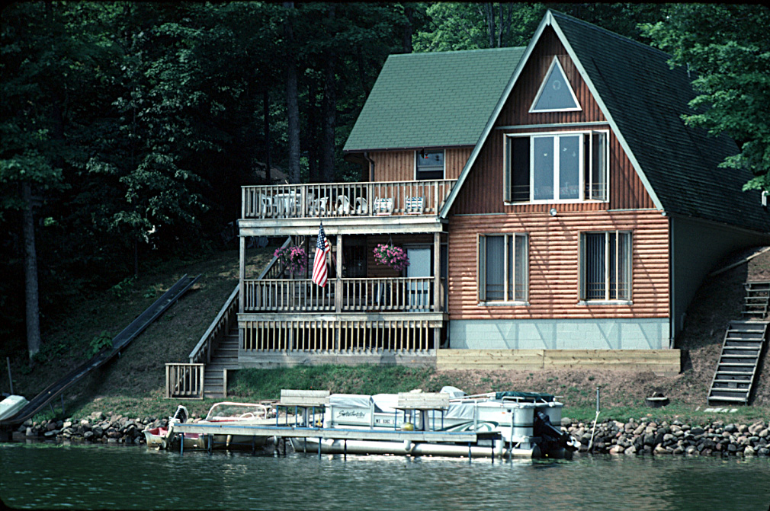
The closer a structure is to the water
…the more it hurts fish
Could you survive as a fish here?
Notes:
The rooftop close to the water creates runoff that can carry soil into the water. Soil contains nutrients that cause algae growth and aquatic plant growth. When algae and plants die and sink to the bottom, their decomposition uses up oxygen, which eliminates fish species that live near the bottom because they need cold or cool water. Soil/sediments also cover fish spawning beds resulting in some fish eggs never hatching. No deep-rooted trees/shrubs/native plants along the shoreline to hold soil in place and filter the fecal bacteria and nutrients out of runoff

Slide 4
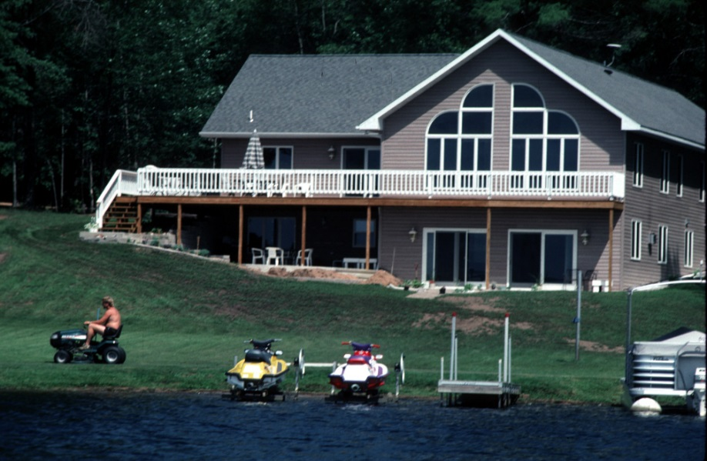
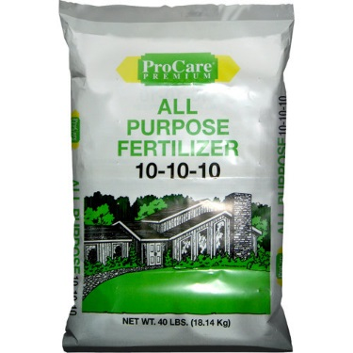
Notes:
This house is set further back, which allows the runoff from the roof more of a chance to soak into the ground. Fertilizer contains nutrients, and when carried into the lake by runoff results in algae growth and aquatic plant growth. When algae and plants die and sink to the bottom, their decomposition uses up oxygen.
If insecticides are applied to the lawn and are carried into the lake by runoff, they can kill aquatic insects that fish rely on for food. Insecticides are sometimes mixed with fertilizers that are applied to lawns, shrubs, roses, etc.
Scientific studies
Van Dijk TC, Van Staalduinen MA, Van der Sluijs JP. 2013. MacroInvertebrate Decline in Surface Water Polluted with Imidacloprid. PLoS ONE 8(5): e62374. doi:10.1371/journal.pone.0062374.
Chen, X.D., Culbert, E., Hebert, V. and Stark, J.D., 2010. Mixture effects of the nonylphenyl polyethoxylate, R-11 and the insecticide, imidacloprid on population growth rate and other parameters of the crustacean, Ceriodaphnia dubia. Ecotoxicology and environmental safety, 73(2), pp.132-137.

Slide 5
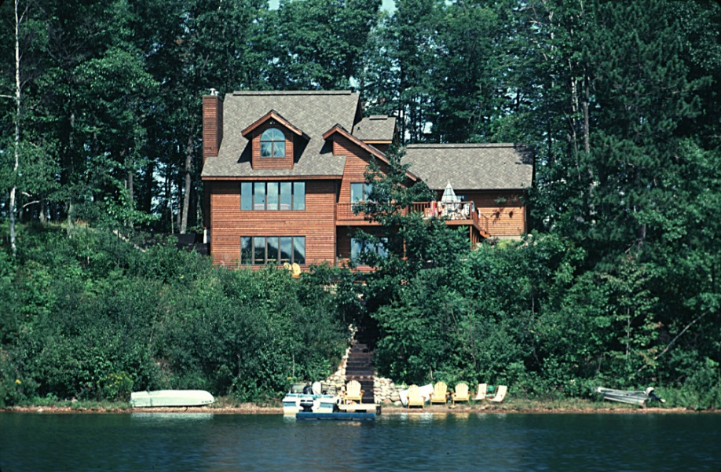
Notes:
This lot is better for fish than the previous ones because there are many trees and shrubs with deep roots that hold soil in place and allow water and nutrients to soak in so they don’t cause algae blooms or low oxygen. Trees and shrubs also provide some shade for the ground and the water, keeping the water cooler. Trees and shrubs will eventually die and some will fall into the lake becoming fish hotels.

Slide 6
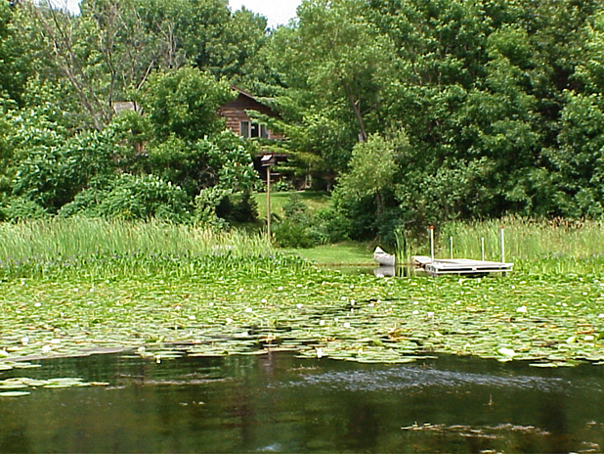
Notes:
It’s a great sign for fish when plants on land and in the water make it difficult to tell where the land ends and the water begins, as shown in this photo. Trees on land shade the water and will become future fish hotels. Water plants like lily pads shade the water, like walking through a cool woods in the summer. The lily pads and other aquatic plants also provide food for fish, and food for the aquatic insects that fish eat.

Slide 7
Notes:
Fish hotel. Notice there is a house set back from the shoreline with many trees along the shoreline. Good for fish.

Slide 8
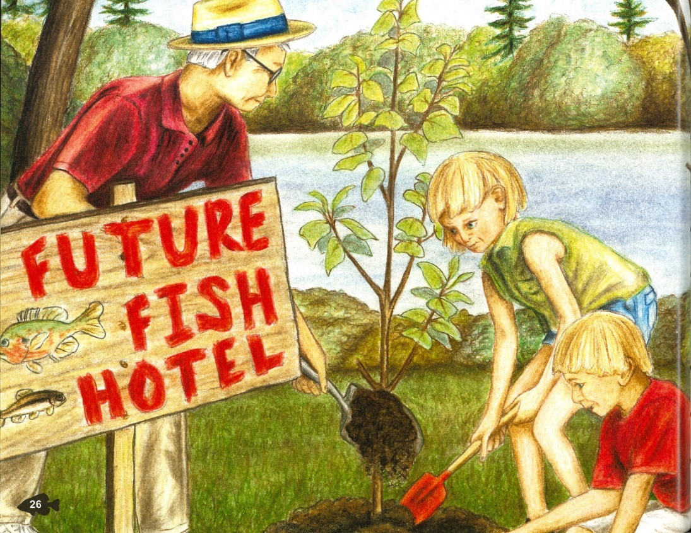
Ways to help fish
Follow shoreland zoning rules
  Set buildings and pavement WAY back from shoreline
  Minimize impervious surfaces
Leave trees, branches and water plants in the lake
Leave or plant trees and deep rooted plants on waterfront lots
Keep fertilizers & pesticides away from shorelines
Less impervious surface

