Slide 1
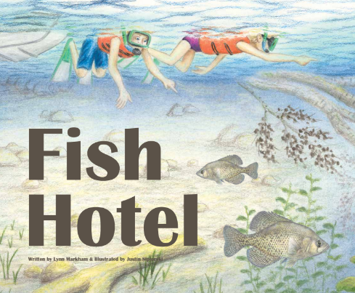
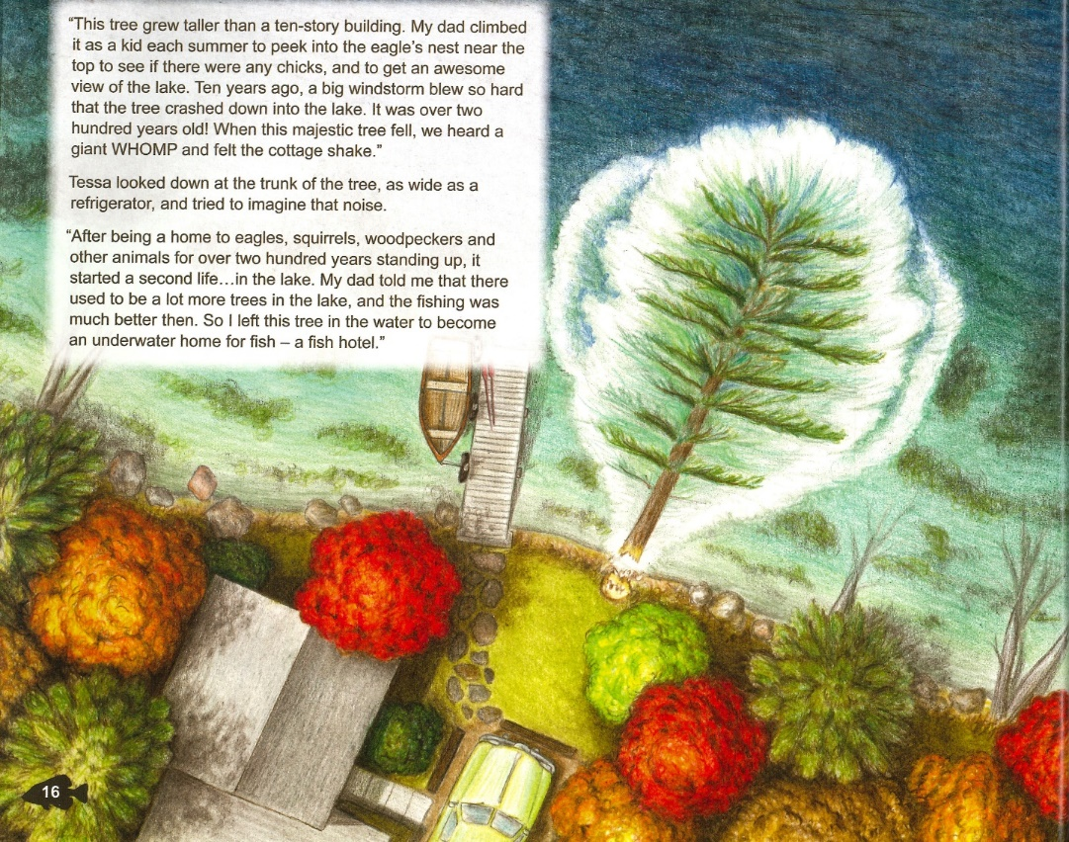
What is a fish hotel?
Notes:
A fish hotel is a tree that fell in the water.
The drawing on the left shows a fallen tree with many fish around it.
The drawing on the right shows a shoreline from a bird’s eye view. A large white pine has fallen into the lake. You can see the stump from the tree along the shoreline.
Ask your students: What do you find when you go to a hotel?
Rooms (shelter, a safe place to stay) and food. Fish hotels provide the same things for fish.

Slide 2
A few questions
Do you like fish? Why?
What do fish need?
Notes:
What do fish need?
Food: plants, water insects, smaller fish
Water: provides oxygen. Cold water has more oxygen than warm water. Fish need clear water so that they can see their prey, or so they can see the predator coming after them. Fish need water free of pollutants like gasoline, oil, manure, fertilizers, pesticides, etc.
Shelter: fallen trees, water plants like lily pads (often called ‘seaweed’, but actually seaweed lives in the sea). Rocks and crevices between rocks and gravel are also shelter. Some small fish also dive into the sand or muck on the lake bottom for protection when predators come after them.
To stress the importance of shelter for all fish, ask your students: How big do you think fish in Wisconsin are when they hatch from their egg?
The answer is less than an inch long, even for muskies and walleye that get very large as adults.
Then ask your students: If you’re a fish that just hatched from its egg, what do you need to survive until tomorrow when you’re in a lake with big fish?
This leads to shelter – a place to hide from the big fish. Fallen trees are an important part of shelter for fish, so are water plants. It’s like hide-and-seek; little fish need good places to hide.

Slide 3
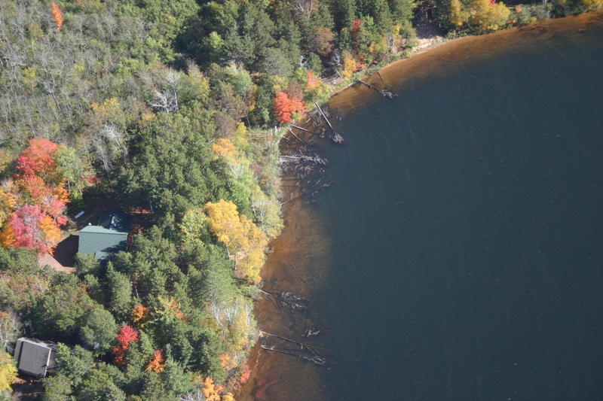
Study results from northern Wisconsin
Where houses have been built along lakes, people have removed almost 9 out of 10 trees from the water
We have many trees to replace in the water by planting trees along shorelines and letting fallen trees be
Notes:
Christensen, D.L., B.R. Herwig, D.E. Schindler, and S.R. Carpenter. 1996. Impacts of lakeshore residential development on coarse woody debris in north temperate lakes. Ecological Applications 6: 1143-1149.

Slide 4
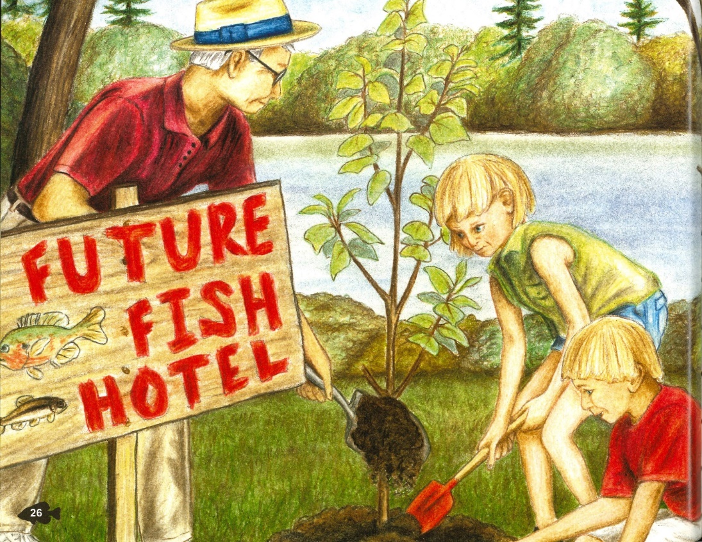
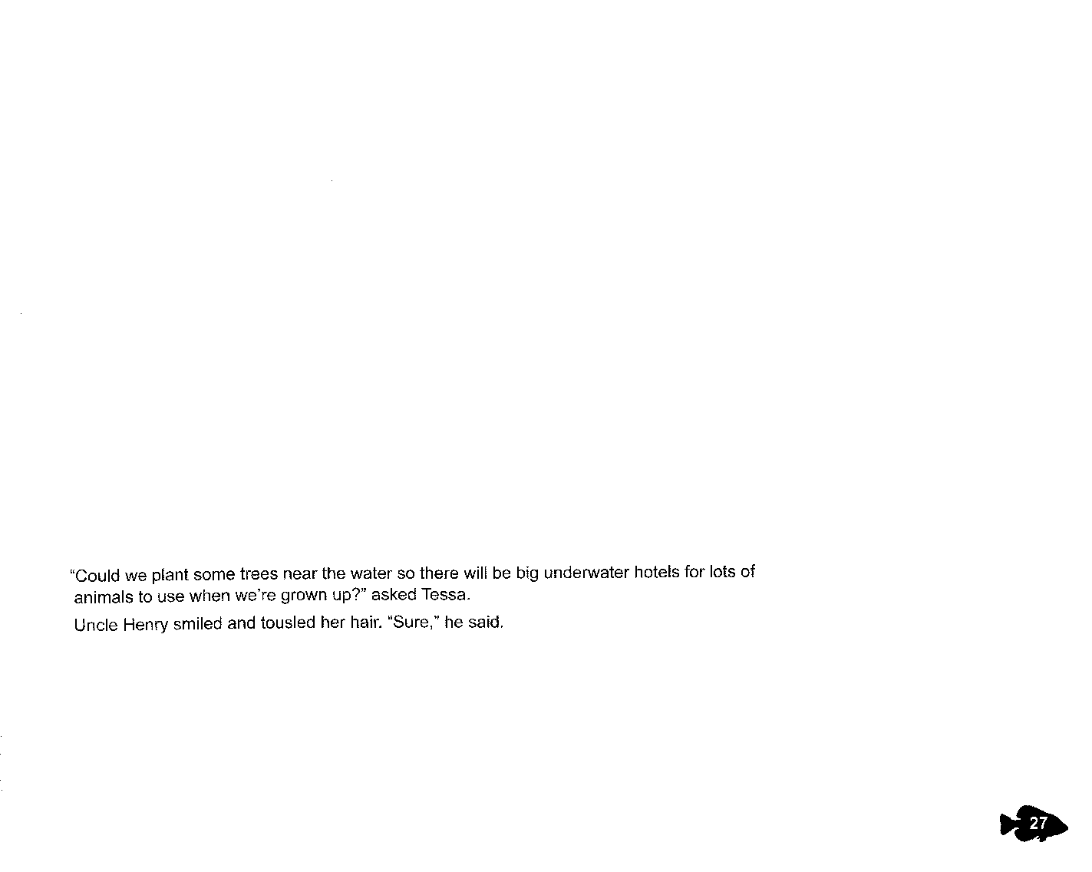
Notes:
To help the fish in their lake the kids planted a tree along the shoreline. They put up a sign showing that the tree was a “Future Fish Hotel” because after growing it would die and fall in the lake.

Slide 5
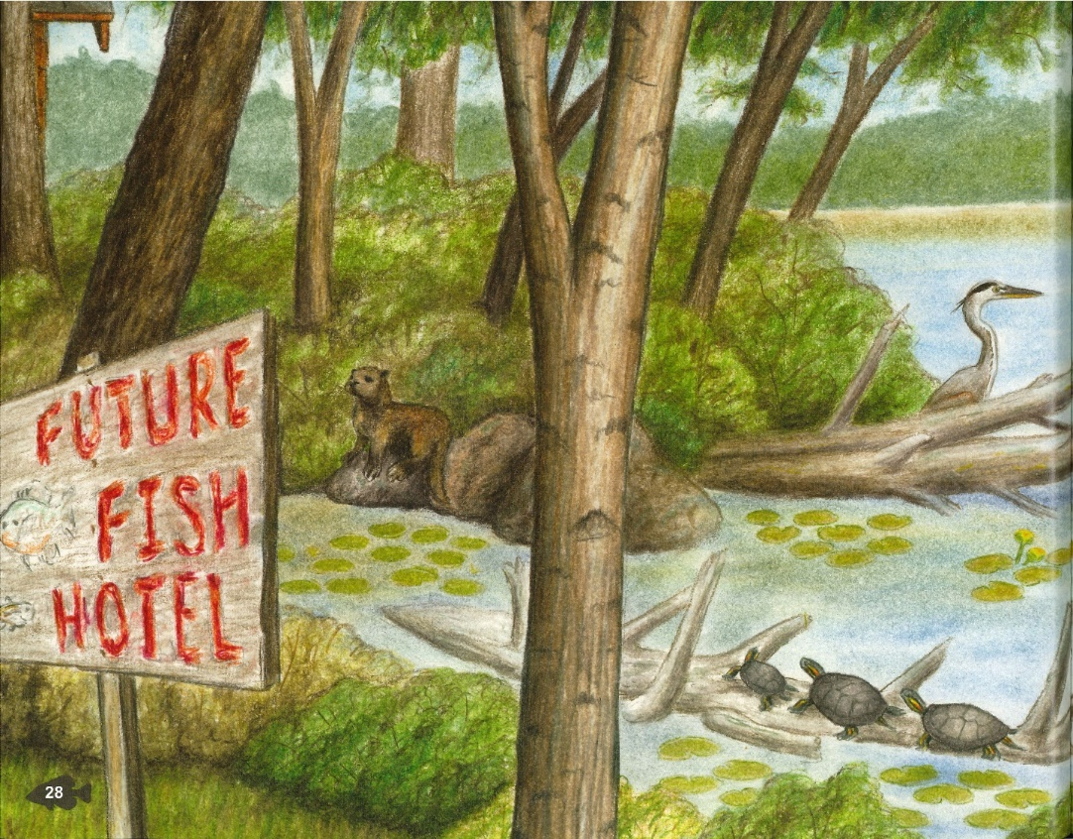
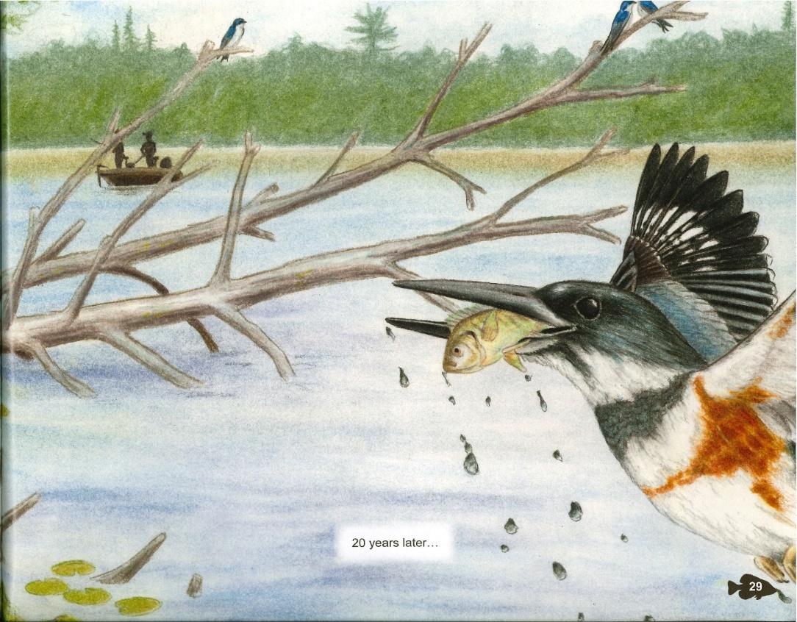
Notes:
This drawing shows the Future Fish Hotel 20 years later after it has fallen in the lake. Fish hotels help more than just fish. The fallen tree also benefits the kingfisher (shown on right with the fish in its mouth), great blue heron (eats fish), otter (eats fish), people who fish (shown in fishing boat), and turtles that bask on the fallen tree to warm up their body temperature.

Slide 6
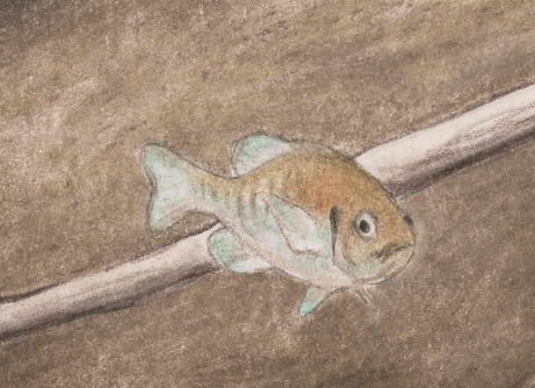
Do you think you could survive as a little fish along these shorelines?

Slide 7
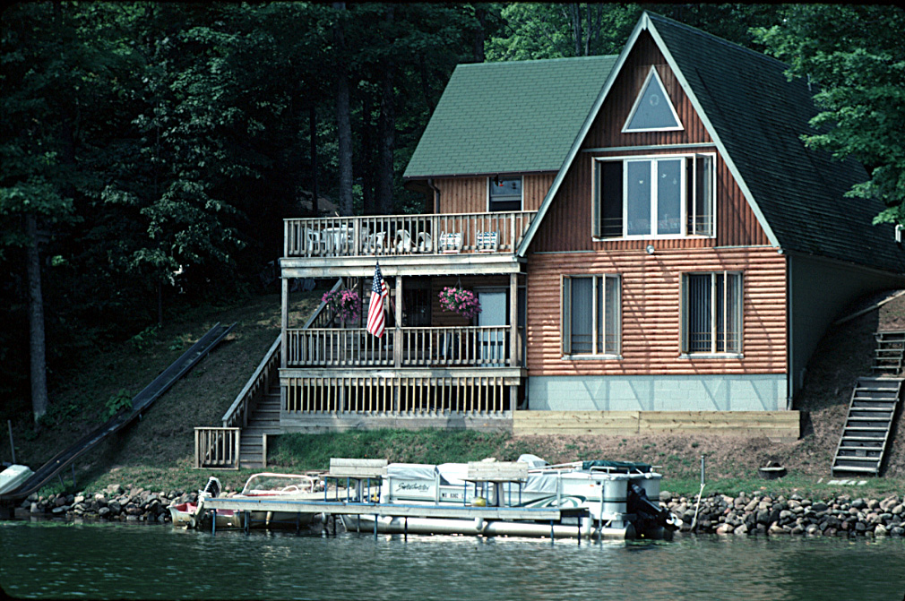
The closer a building is to the water …the more it hurts fish
Could you survive as a fish here?
Notes:
No fish hotels. No trees along the shoreline to become future fish hotels.
Some children are concerned that the water along this shoreline isn’t a good place to live because people live in the house, and they might catch the fish. I point out that people usually don’t fish for or keep little/young fish. In a lake or stream big fish are a more likely predator for a little fish than people are. There may be 500 or 5,000 bigger fish in the lake/river, but probably not more than 8 people in the house.
The rooftop close to the water creates runoff that can carry soil into the water. Soil contains nutrients that cause algae growth and aquatic plant growth. When algae and plants die and sink to the bottom, their decomposition uses up oxygen, which eliminates fish species that live near the bottom because they need cold or cool water. Soil/sediments also cover fish spawning beds resulting in some fish eggs never hatching. No deep-rooted trees/shrubs/native plants along the shoreline to hold soil in place and filter the fecal bacteria and nutrients out of runoff

Slide 8
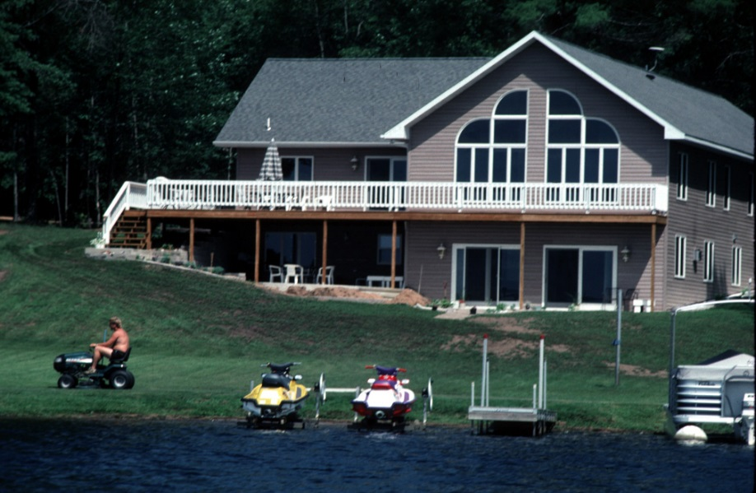
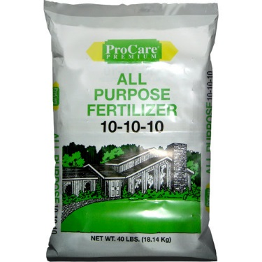
Notes:
No fish hotels. No trees along the shoreline to become future fish hotels.
This house is set further back, which allows the runoff from the roof more of a chance to soak into the ground. Fertilizer (shown in bag on the right) contains nutrients, and when carried into the lake by runoff results in algae growth and aquatic plant growth. When algae and plants die and sink to the bottom, their decomposition uses up oxygen. One pound of phosphorus (the middle number on the
Fertilizer bag) results in up to 500 pounds of algae.
If insecticides are applied to the lawn and are carried into the lake by runoff, they can kill aquatic insects that fish rely on for food. Insecticides are sometimes mixed with fertilizers that are applied to lawns, shrubs, roses, etc.
Scientific studies
Van Dijk TC, Van Staalduinen MA, Van der Sluijs JP. 2013. MacroInvertebrate Decline in Surface Water Polluted with Imidacloprid. PLoS ONE 8(5): e62374. doi:10.1371/journal.pone.0062374.
Chen, X.D., Culbert, E., Hebert, V. and Stark, J.D., 2010. Mixture effects of the nonylphenyl polyethoxylate, R-11 and the insecticide, imidacloprid on population growth rate and other parameters of the crustacean, Ceriodaphnia dubia. Ecotoxicology and environmental safety, 73(2), pp.132-137.

Slide 9
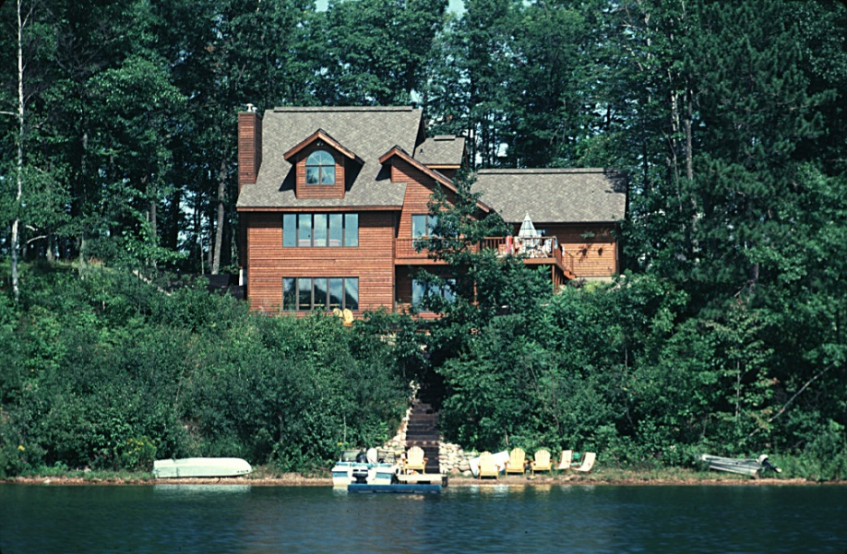
Notes:
No current fish hotels. Lots of trees and shrubs along the shoreline that will eventually die and become fish hotels.
This lot is better for fish than the previous ones because there are many trees and shrubs with deep roots that hold soil in place and allow water and nutrients to soak in so they don’t cause algae blooms or low oxygen. Trees and shrubs also provide some shade for the ground and the water, keeping the water cooler.

Slide 10
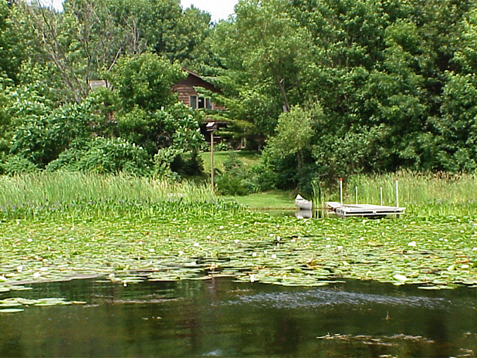
Notes:
No fish hotels that we can see. Lots of trees along the shoreline that will become future fish hotels.
The lily pads and other water plants are similar to fallen trees in the benefits they provide for fish - food and shelter.
Trees on land shade the water and will become future fish hotels. Water plants like lily pads shade the water, like walking through a cool woods in the summer. The lily pads and other water plants provide food for the aquatic insects that fish eat.

Slide 11
Notes:
Fish hotel. Notice there is a house set back from the shoreline with many trees along the shoreline. Good for fish.

Slide 12

Ways to help fish
Keep your shoreline natural. Don’t remove trees or shrubs along the shoreline.
Leave trees that fall in the water. If a tree is in the way move it over, but don’t remove it from the lake.
Plant trees along the shoreline.
Add fallen trees along the shoreline. A DNR permit is required.
Notes:
DNR = Wisconsin Department of Natural Resources.

