Slide 1
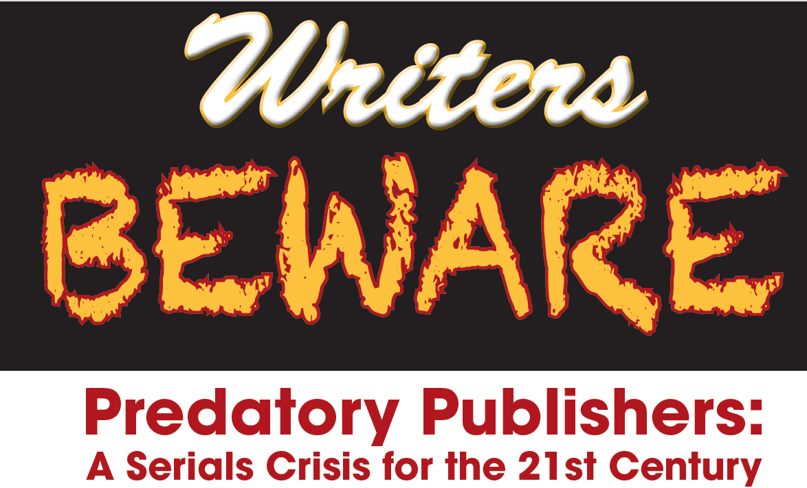
By Jeffrey Beall
University of Colorado Denver

Slide 2
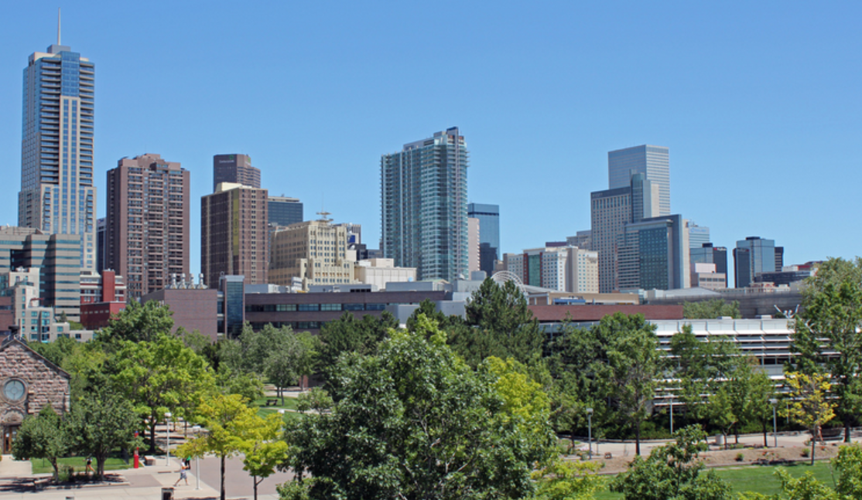
INTRODUCTION
About the speaker
University of Colorado Denver
Auraria Campus
Next year ...

Slide 3
Figi’s

Slide 4
SCHOLARLY PUBLISHING MODELS
Gold open-access model
Freely available
Article-processing charges (APCs)
Subscription model (toll-access, traditional)
Open-Access Movement
Green open-access model
Platinum open-access model
Hybrid model

Slide 5
SERIALS CRISIS
Subscription prices of scholarly journals increased
Libraries began to cancel subscriptions
However
The number of scholarly articles being published increased
New fields led to many new journals
Publishers responded by selling packages of journals to libraries

Slide 6
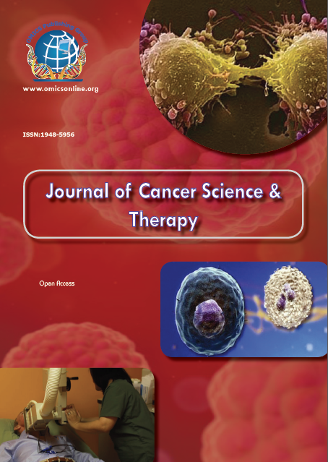
PREDATORY PUBLISHERS
Conflict of interest
Deception
Lack of transparency

Slide 7
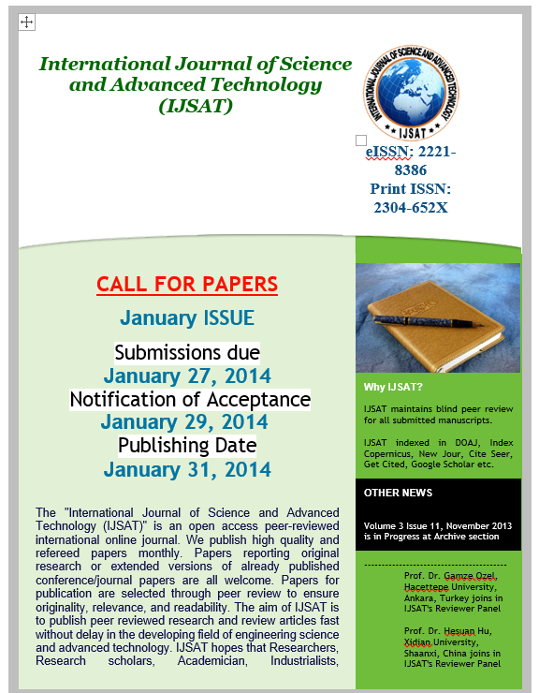
SPAM EMAIL FROM A PREDATORY MEGA-JOURNAL
Notes:
International Journal of Science and Advanced Technology

Slide 8
HISTORY OF PREDATORY PUBLISHERS
Spam email, 2008-2009
Call for paper [sic]
Reviews in The Charleston Advisor
Early lists
New blog in early 2012
Two lists – Questionable publishers, questionable standalone journals
Purpose of lists – help researchers avoid being scammed

Slide 9
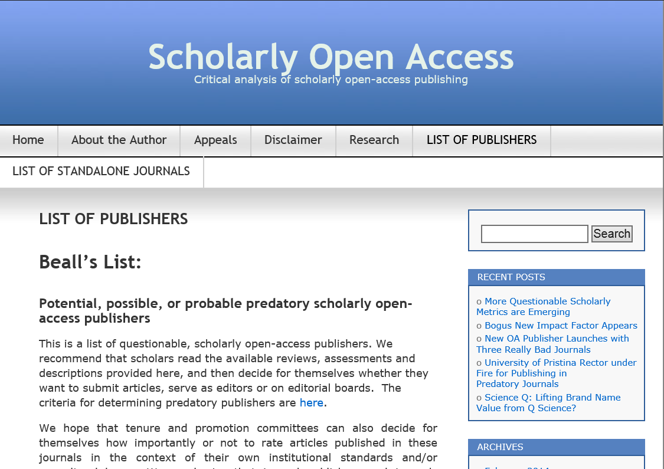
http://scholarlyoa.com

Slide 10
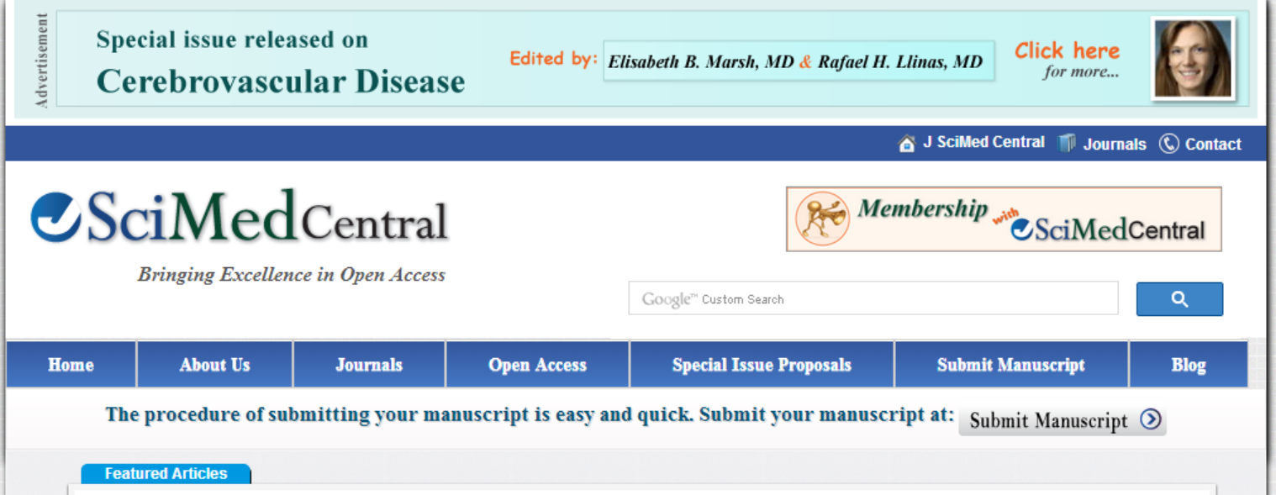
PREDATORY PUBLISHERS – THE FIVE Ws
WHO ARE THE PREDATORY PUBLISHERS ?
Usually small, one-man operations
Operate out of a dwelling

Slide 11
WHAT ARE THE PREDATORY PUBLISHERS ?
Publishers that exploit the gold-open access model for their own profit
Can be corrupt
Customers include people fooled by them
Customers can also be complicit authors

Slide 12
WHERE ARE THE PREDATORY PUBLISHERS ?
South Asia, Nigeria, UK, Ontario, Australia, US
Expatriates in Western countries catering to their home countries
More academic credit for “International” journals
American Journal of _________ .

Slide 13
WHEN DID THE PREDATORY PUBLISHERS APPEAR ?
Gold OA began in early 2000s
Really began to increase in late 2011
New ones appearing all the time
Poisoning scholarly open-access publishing
Low barrier to startup
Hard to differentiate predatory and legitimate journals

Slide 14
HOW WILL THE PREDATORY PUBLISHERS GET YOUR MONEY?
They fool people into thinking they are legitimate
They don’t add value to research like traditional publishers do
They work for the authors, not the readers
Euro-Journals has disappeared as have others
They tell lies (especially about their impact factor)
They spam

Slide 15
CRITERIA FOR DETERMINING PREDATORY PUBLISHERS

Slide 16
PROBLEMS THAT PREDATORY PUBLISHING CAUSES FOR SCIENCE AND SOCIETY
Corruption of the gold open-access model and the staining of open-access in general
Possibly has increased the occurrence of research misconduct
Effect on the press, law, clinical medicine, public policy

Slide 17
PROBLEMS THAT PREDATORY PUBLISHING CAUSES FOR SCIENCE AND SOCIETY (Cont.)
Most predatory publishers don’t know about digital preservation.
Author-centric rather than reader-centric
Gold OA favors hard sciences; may hurt arts, humanities fields
Scam conferences
Model does not work well for some scholarly societies

Slide 18
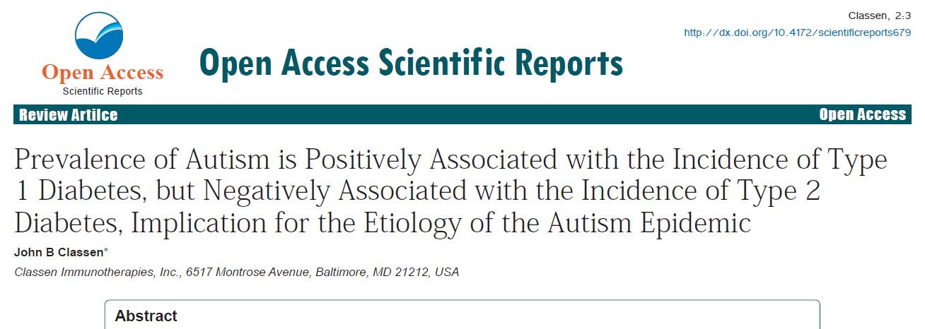
PROBLEMS THAT PREDATORY PUBLISHING CAUSES FOR SCIENCE AND SOCIETY (Cont.)
Spam
Predatory journals threaten demarcation
Publishing in a predatory journal may stain your tenure dossier

Slide 19
OTHER POINTS
Google Scholar does not screen for quality
The validation function of traditional journals
The public’s inability to distinguish pseudo-science and authentic science
Promoting OA without warning about predatory publishers

Slide 20
OTHER POINTS (cont.)
Have you cited any predatory journals?
Emergence of bogus metrics

Slide 21
OTHER POINTS (cont.)
How do we stop predatory publishers?
Are larger publishers better able to add value to scholarship?
Legal threats against me
Hijacked journals

Slide 22
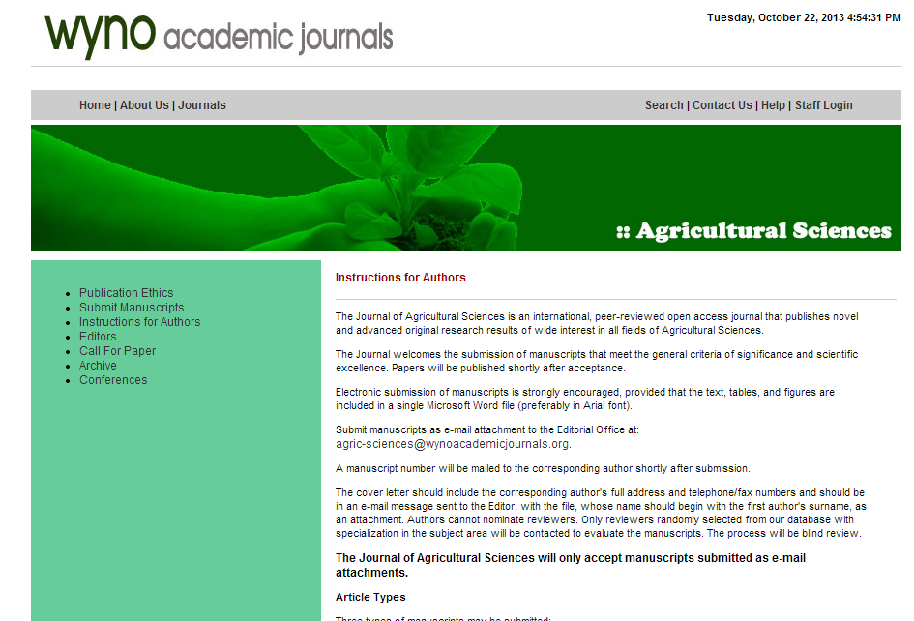

Slide 23
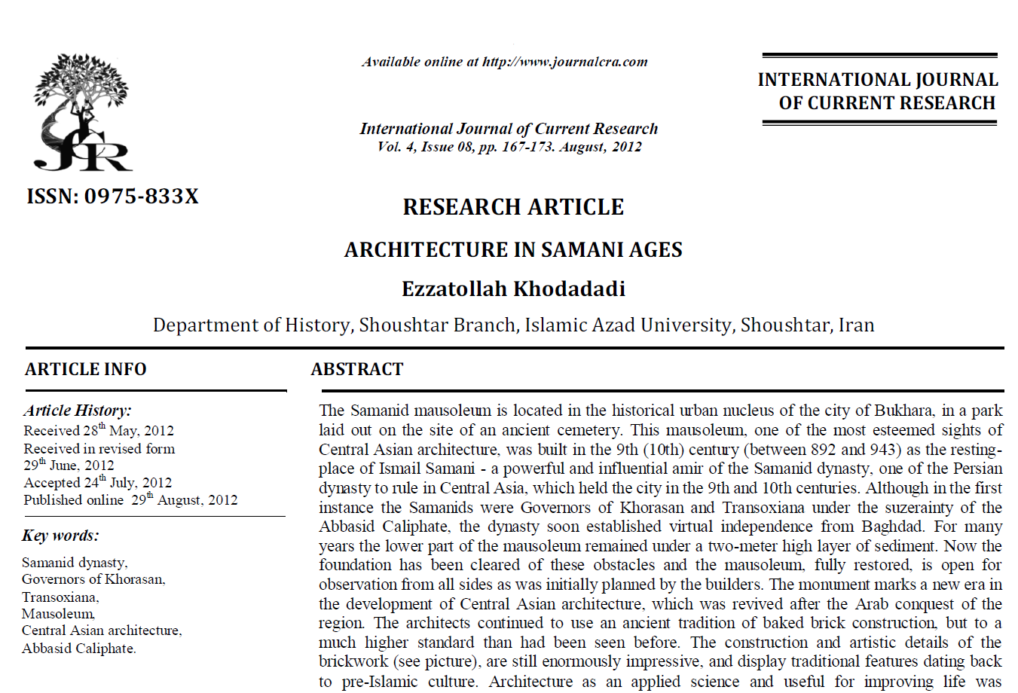

Slide 24
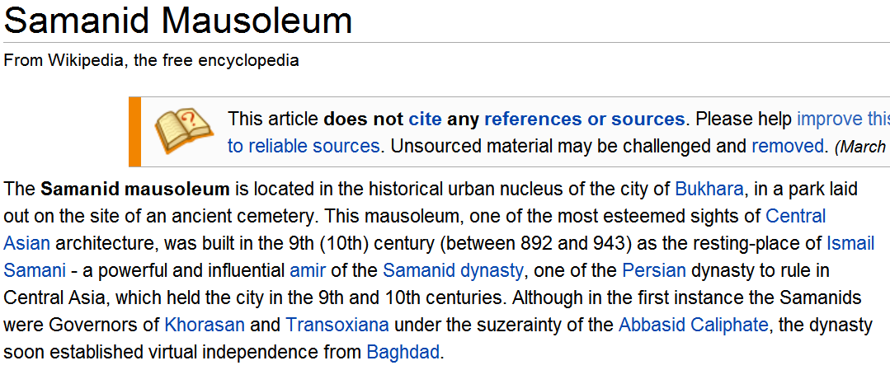

Slide 25
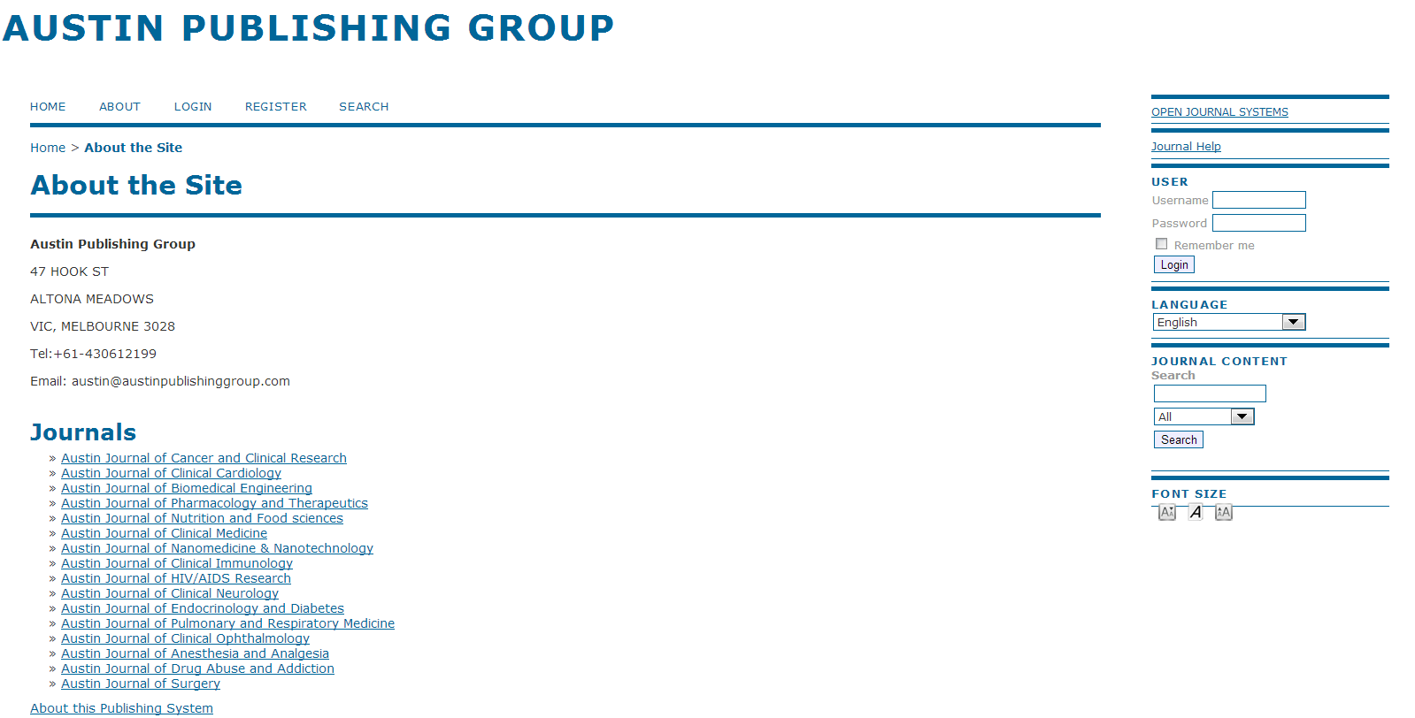

Slide 26
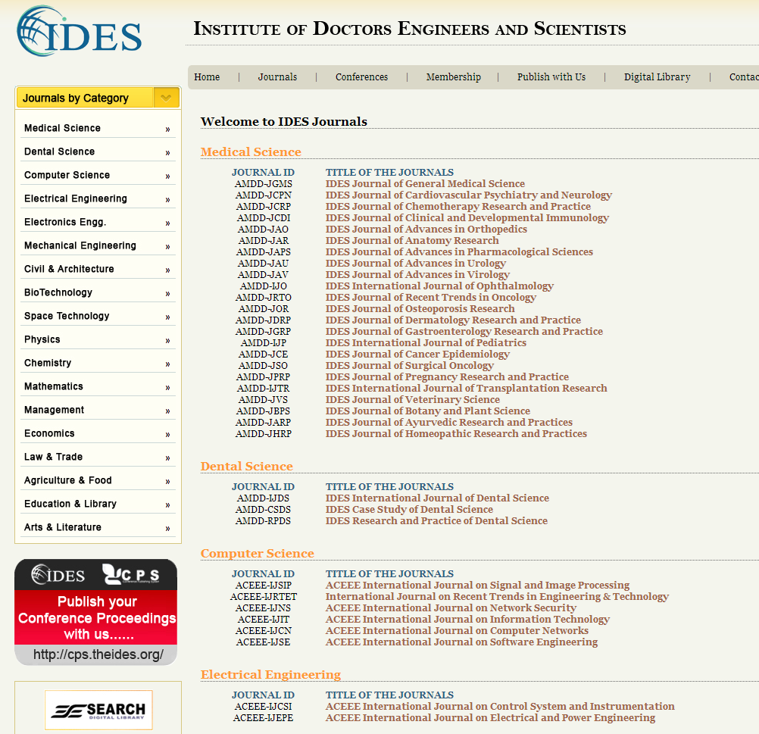
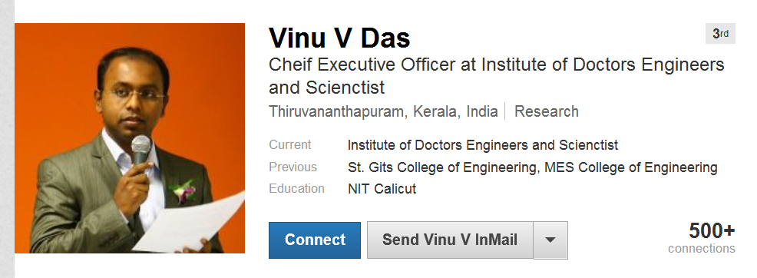

Slide 27
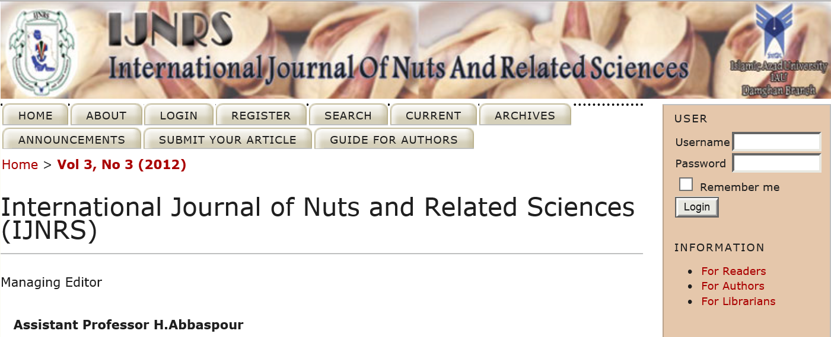

Slide 28
Thanks !
Jeffrey Beall
jeffrey.beall@ucdenver.edu
http://scholarlyoa.com

