Slide 1
Flood Plain Permitting
This Power Point is a collection of real life examples of requests submitted to the Jefferson County Planning and Zoning Department. Jefferson County uses DNR approved model ordinance. Please use current DNR floodplain model ordinance for reference.
Please answer each scenario as you were issuing a permit.
If you need more information, please write down what information is needed to complete the permit. If you have enough information, write out your process for issuance or denial of the permit with your supporting explanation and/or information. In addition, you can cite DNR floodplain model Ordinance to support your answers.

Slide 2
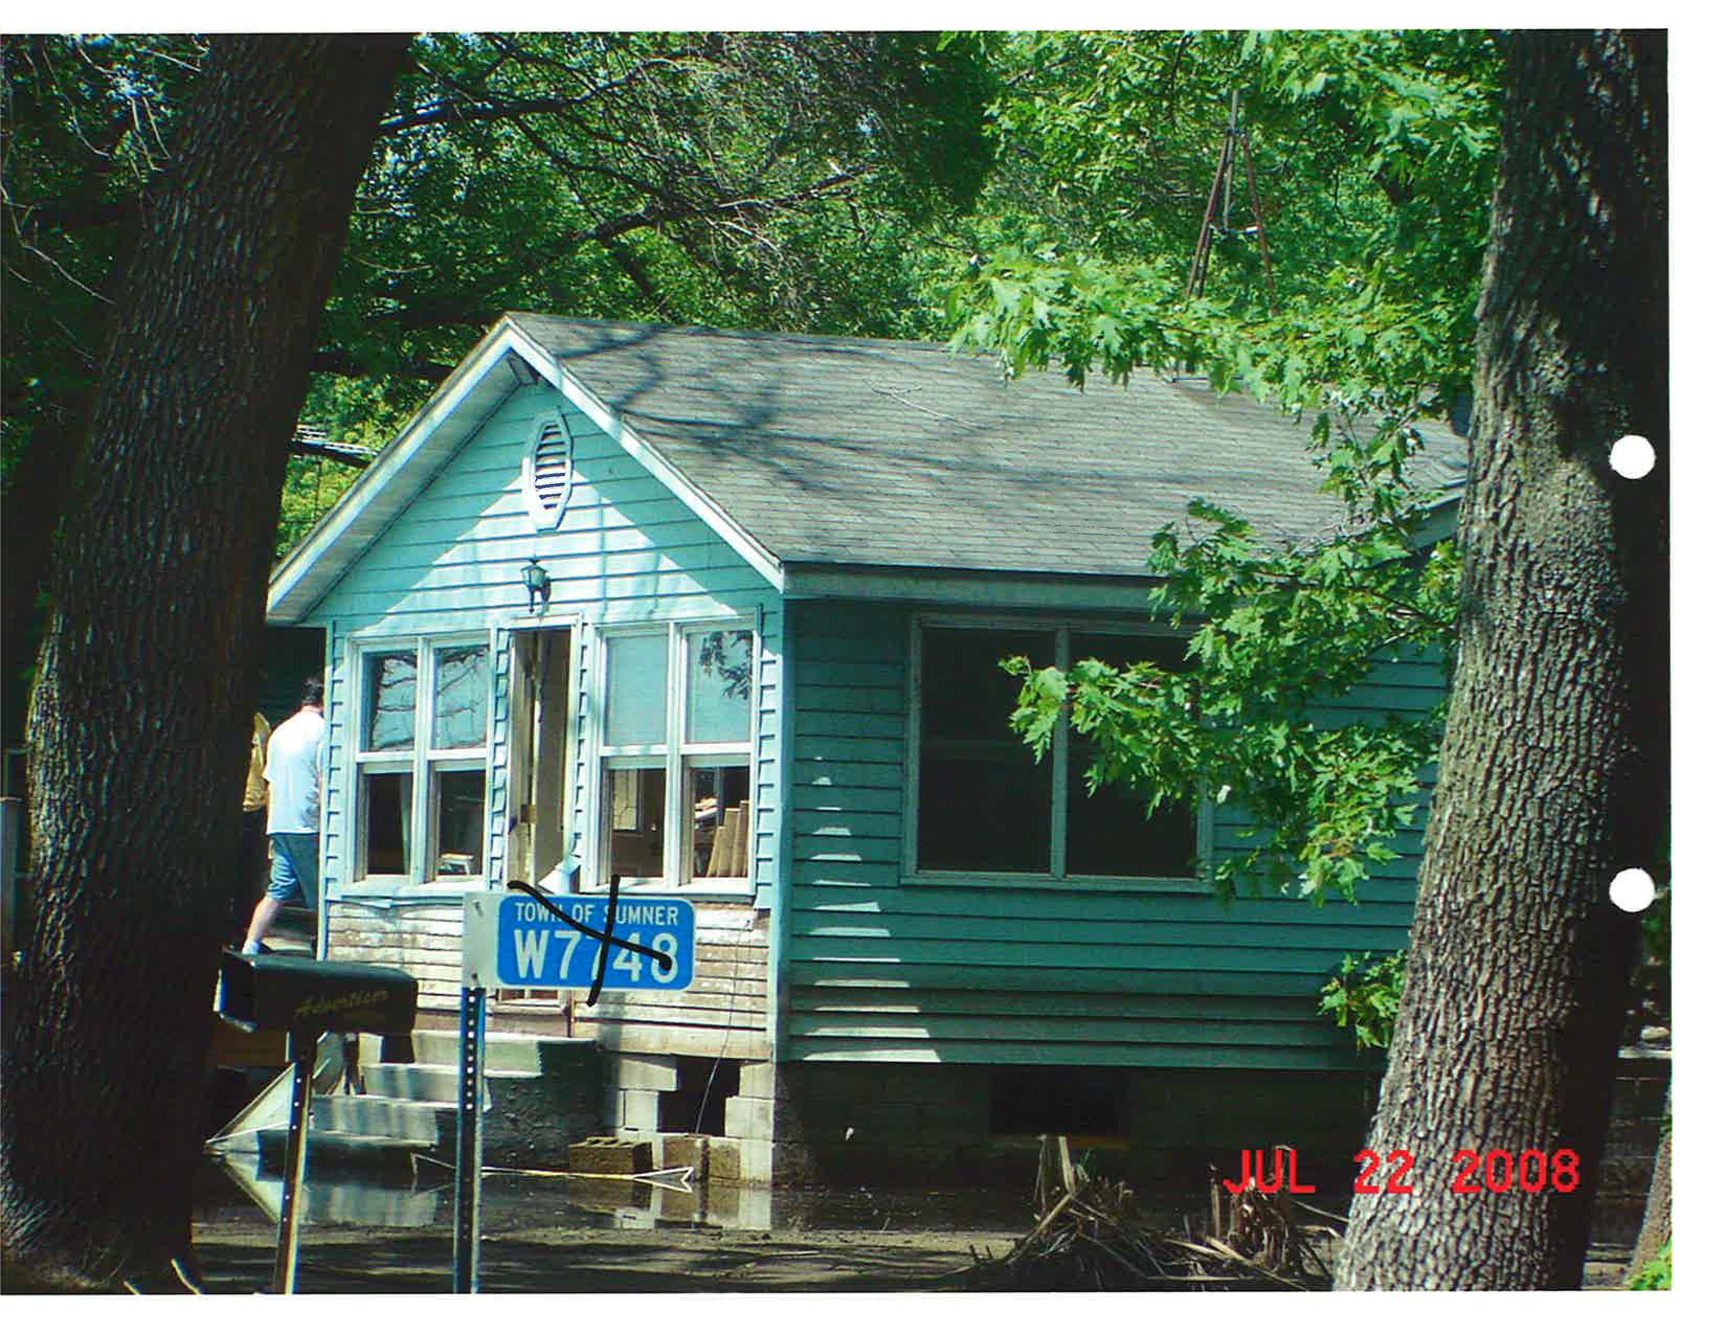
PERMIT 1 !

Slide 3
Permitting Scenario 1
In 2008, this property in the Town of Koshkonong on Lamp Rd sustained flood damage. RFE for Lake Koshkonong is 784.2. The property owners are coming in for a flood damage repair permit. 13 inches of water was over the first floor. The property does not have dry land access.
Explain the process for issuing a flood damage repair permit. What types of items are included in a flood damage repair permit?
What information would you need from the owner to issue this permit?
Can you issue a permit for this property? Explain your answer.
If you can’t issue a permit, what would the owners have to do to make this structure compliant?

Slide 4
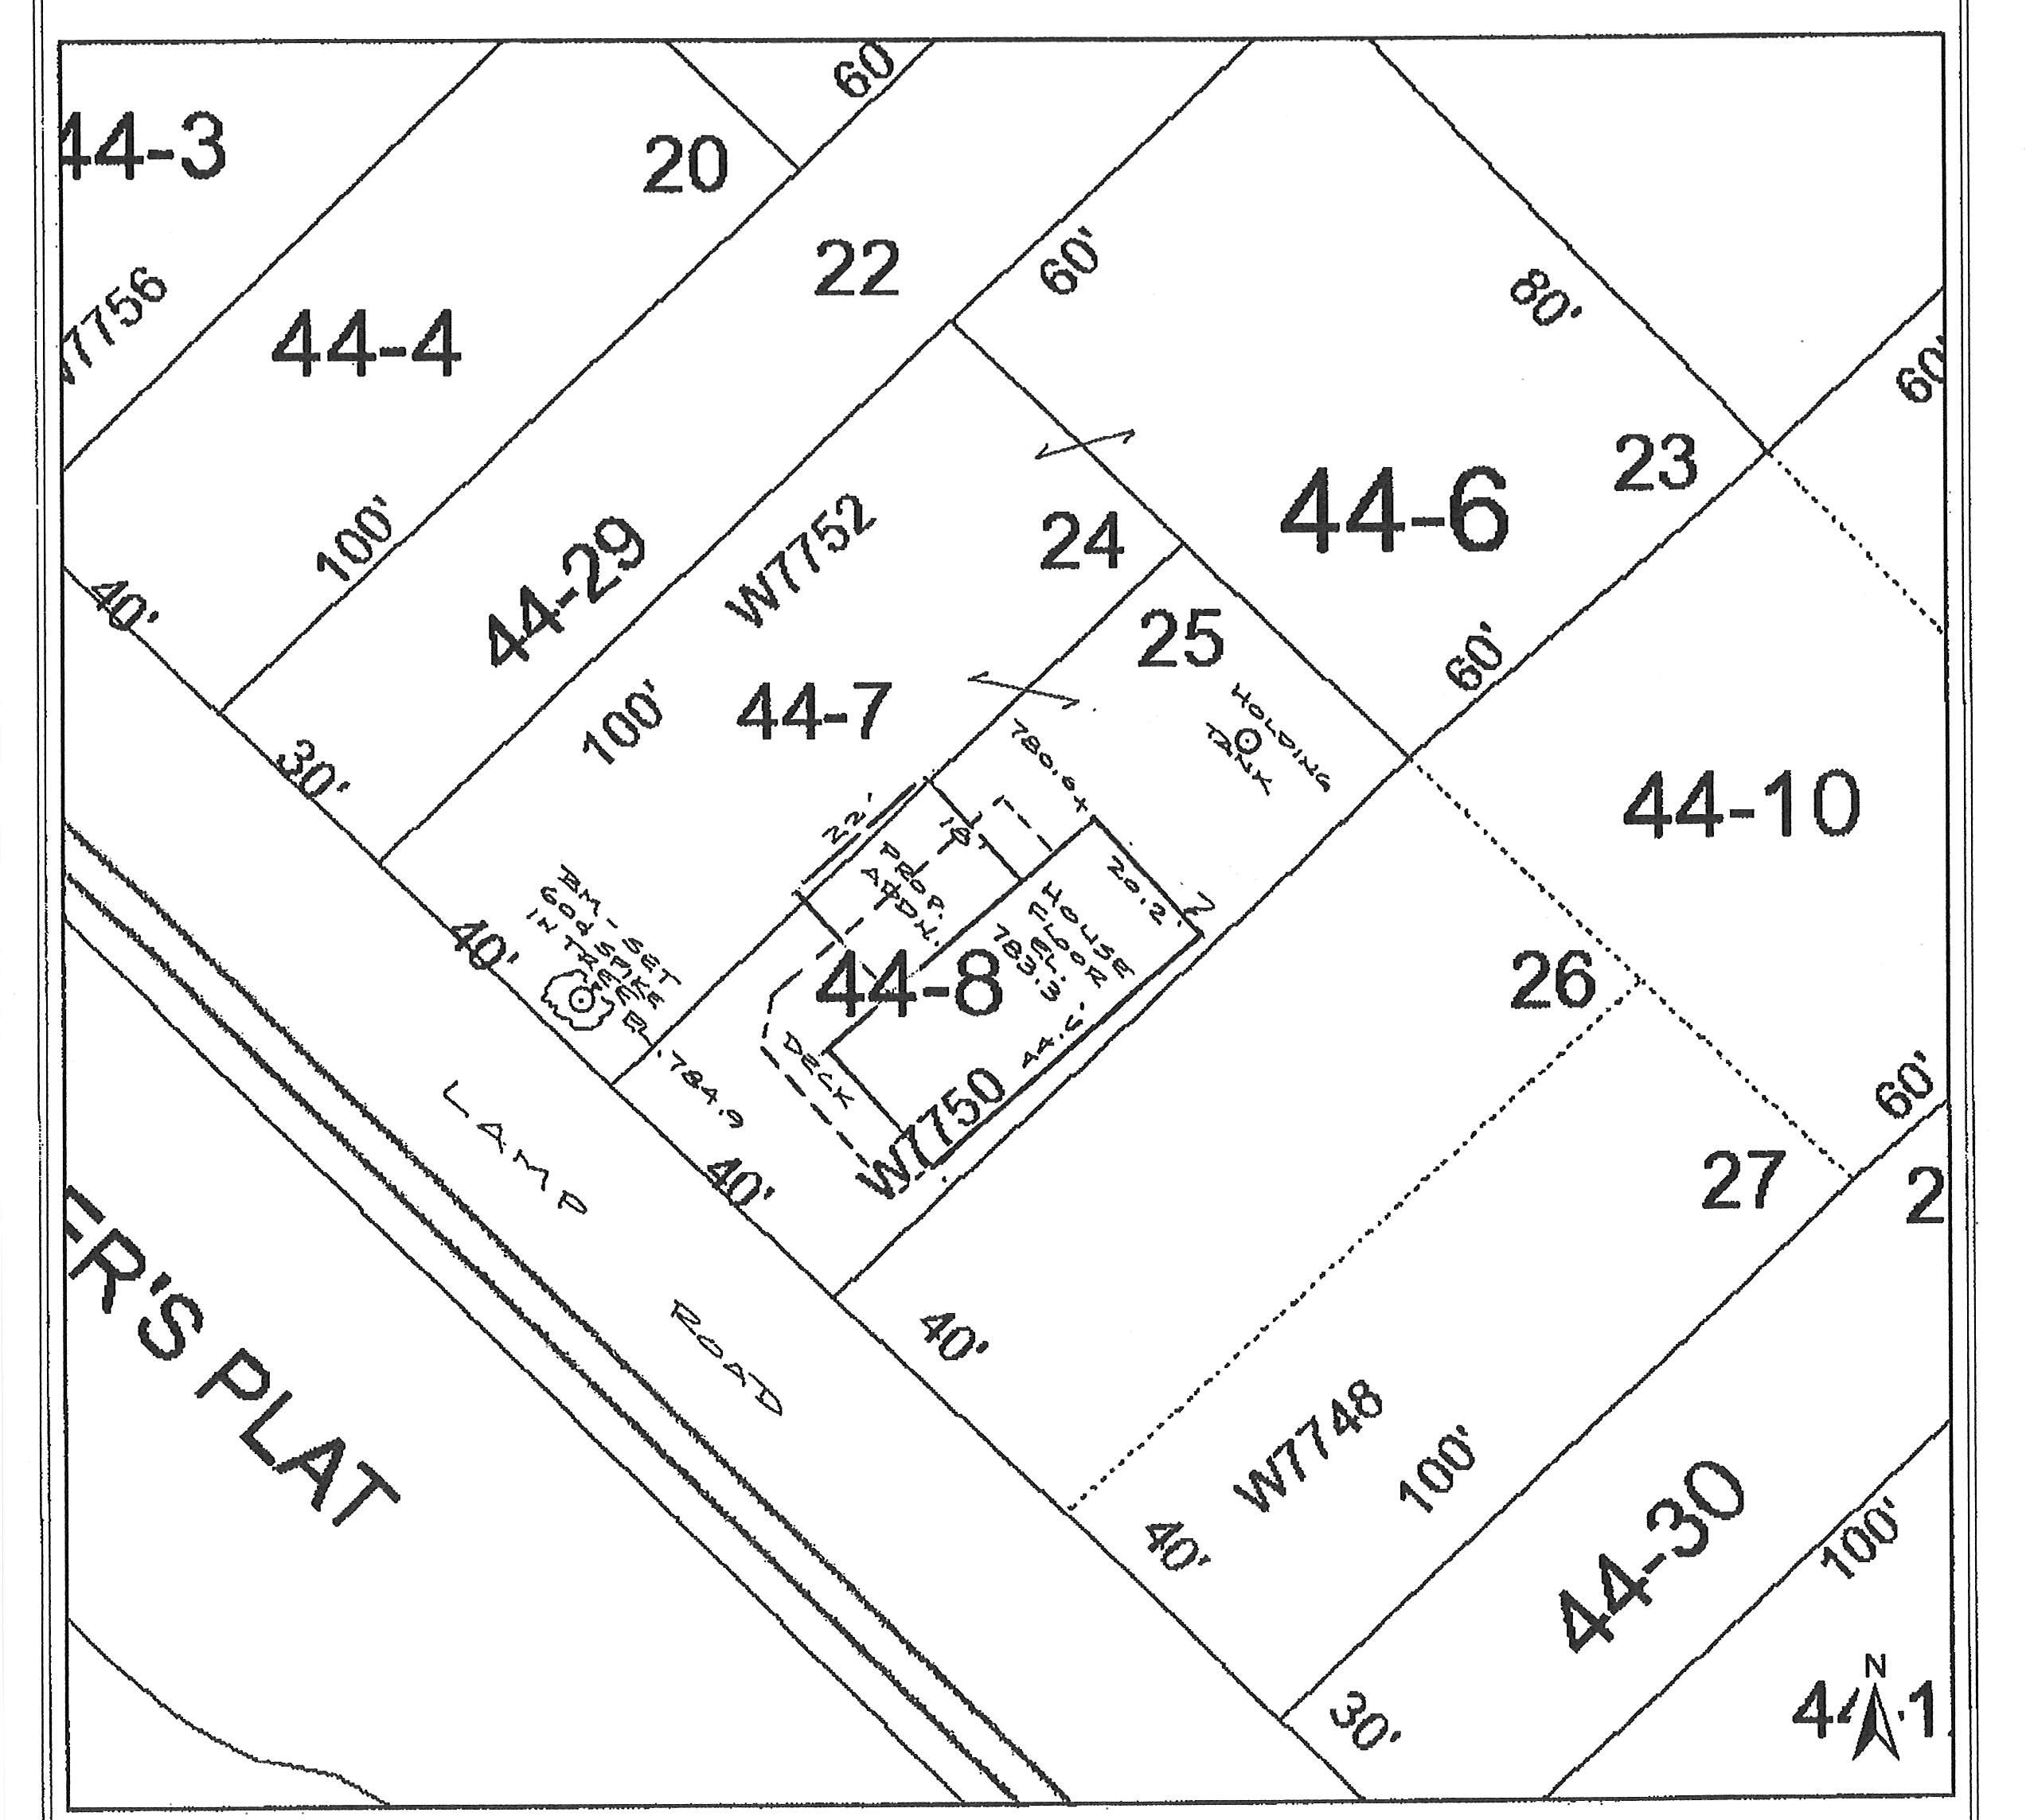
Permitting Scenario 2
Same property in 2014, the owners would now like to add an addition onto the structure.

Slide 5
Permitting Scenario 2
What information do you need in order to issue this permit?
Can you issue a permit? Explain your answer.

Slide 6
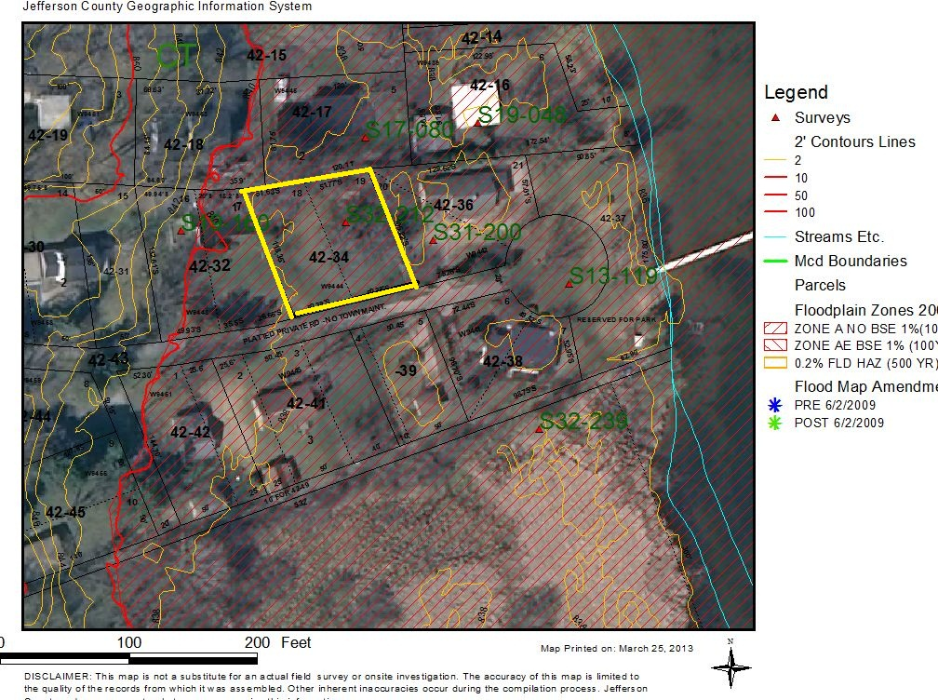
Permitting Scenario 3
Owners want to build a new home on this lot in the floodplain. Is the proposed home in FP?
BFE 837.99 FEMA Mapped BFE 840
838 Elevation Contour
Notes:
First, the FEMA map shows the land in the floodplain. In this case, the bfe is 837.99 but the BFE was mapped at 840. If you look at the contour lines, 838 is on the lot. We recommended to this landowner to get a survey of the lot with the floodplain delineated before planning this project not only for the location of the floodplain but dryland access. This is flood fringe.

Slide 7
Permitting Scenario 3
What information would you need to determine if the property is in the floodplain?
If this property is in the floodplain, what information would you need before you considered issuing a permit?
Can you issue a permit for a new home on this lot? Explain your answer.
If you could issue a permit for this property, what information would you need to issue a new home permit in the floodplain?

Slide 8
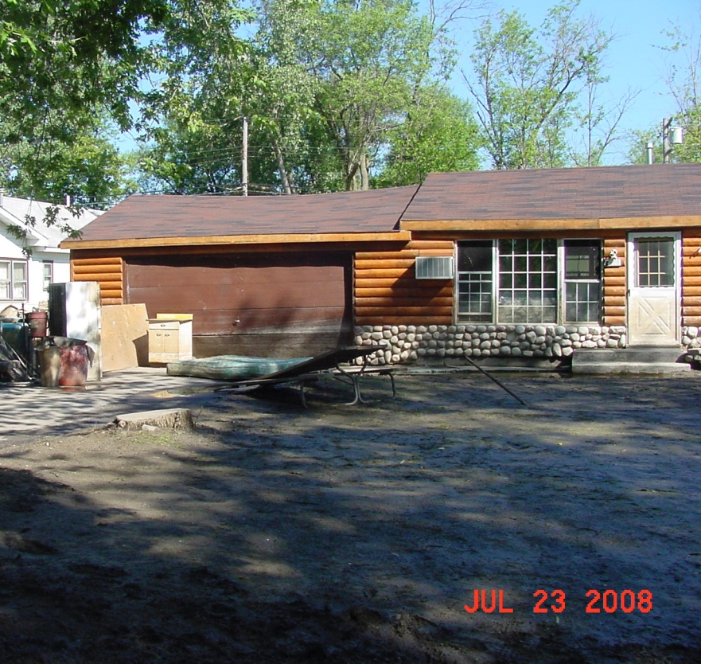
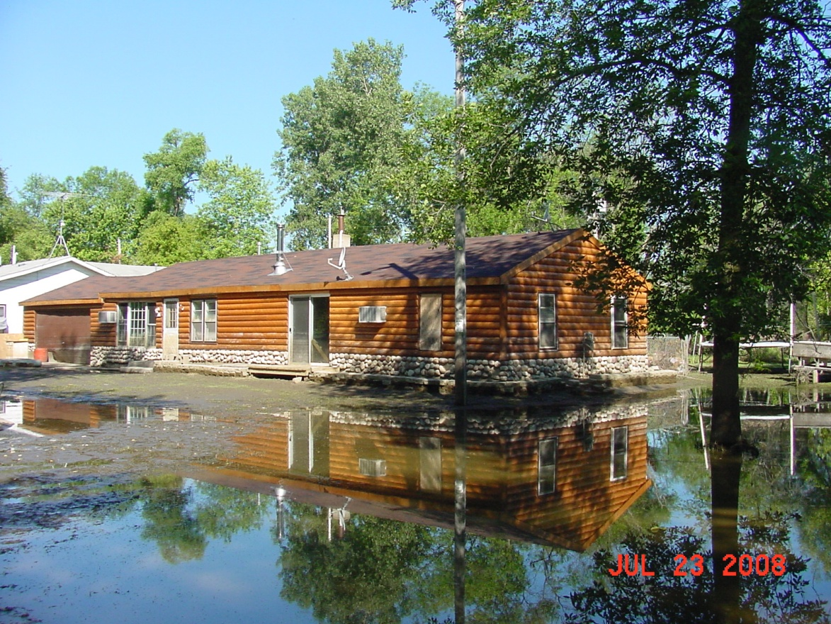
Permitting Scenario 4
Owners on Blackhawk Island Rd. want to raise an existing home in the floodway. This area does not have dry land access.
Again, for permitting purposes, what information do you need?

Slide 9
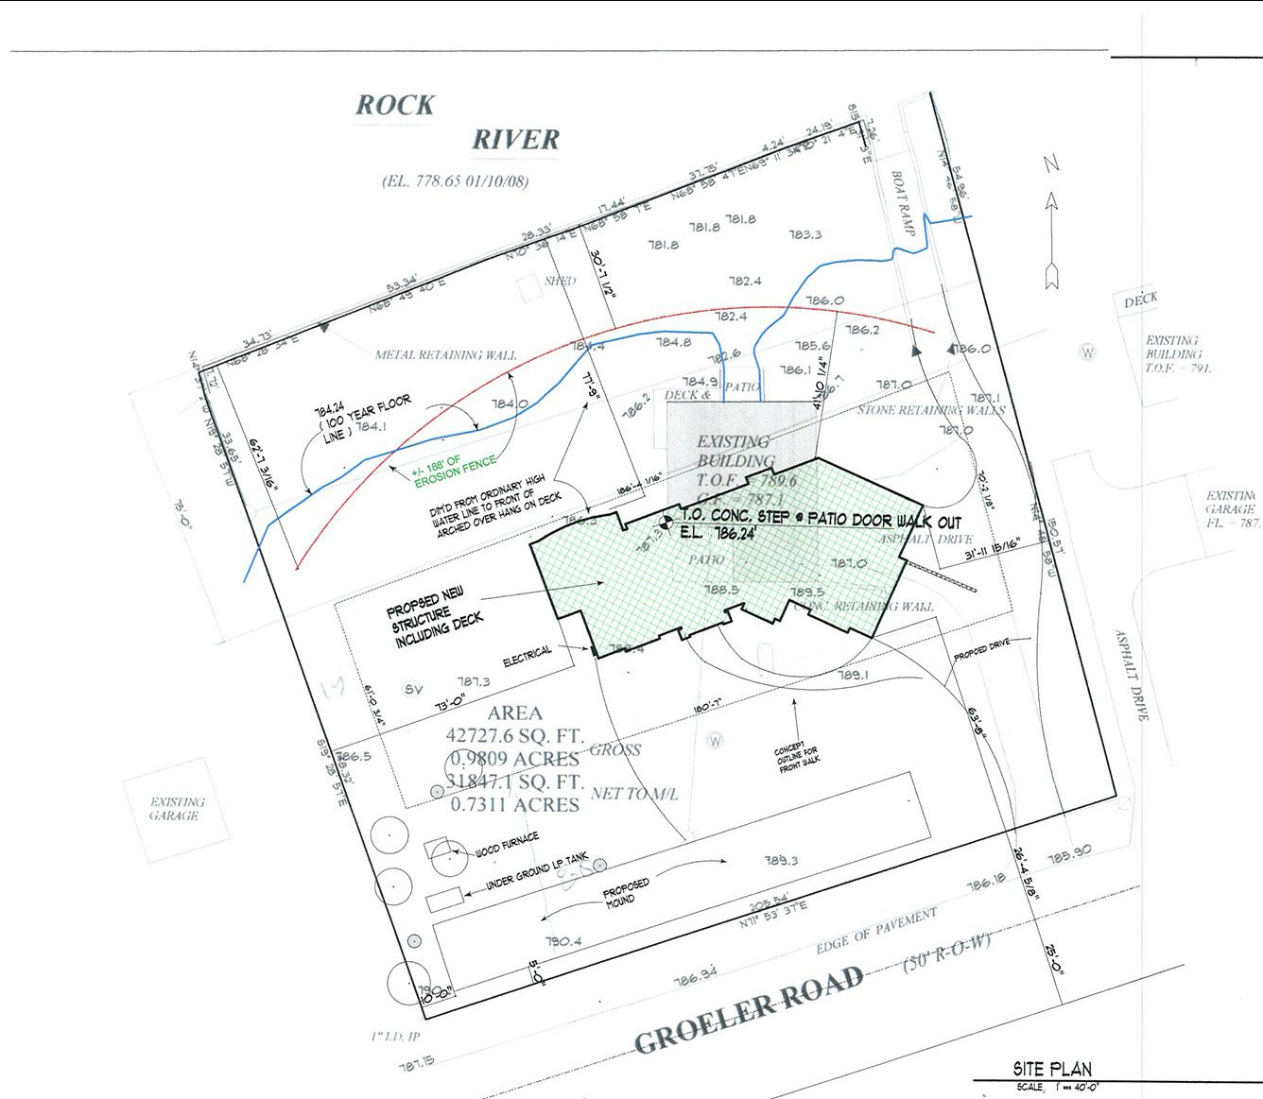
Permitting Scenario 5
Owners wants to raze the existing house and construct a new residence. Blue line is the floodplain, existing home is in the gray, new proposed home is the green. What is required?
Notes:
Blue line is the floodplain, existing home is in the gary, new proposed home is the green. What is required?
Trick question: Old home was in the floodplain because the exposed basement touched it. New home is proposed outside of floodplain. No floodplain requirements.

Slide 10
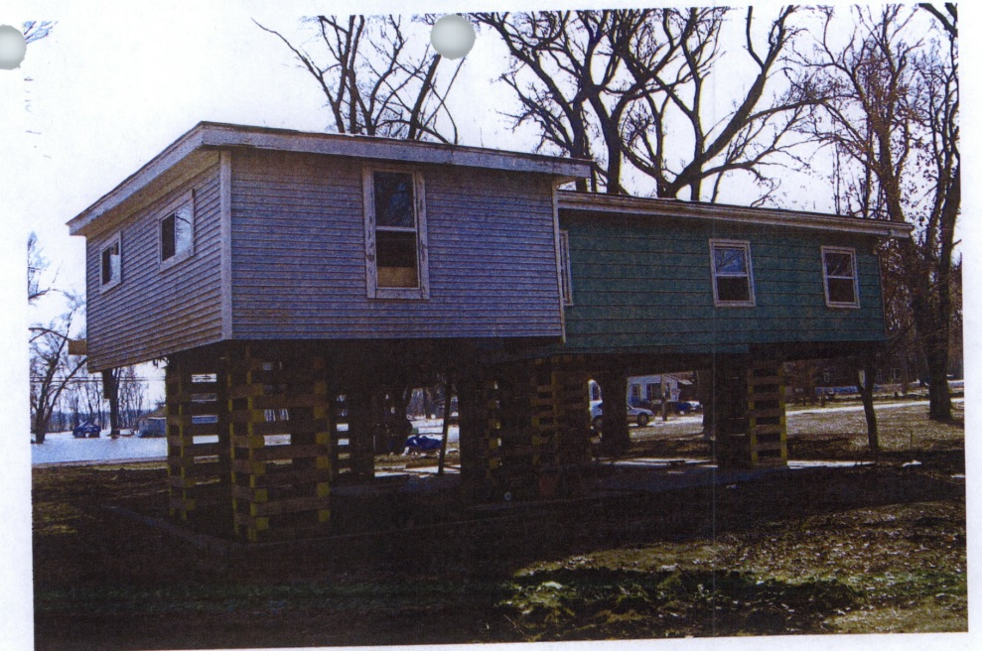
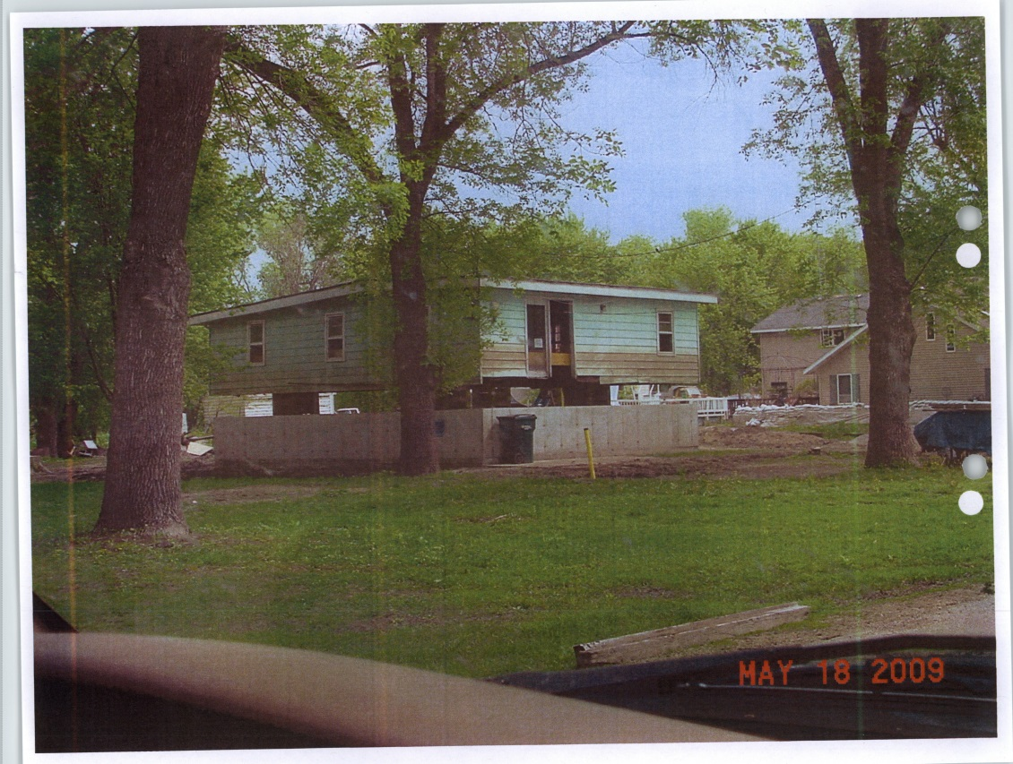
Permitting Scenario 6
Landowner received a permit to raise this structure and add an garage addition. Structure is the floodway of the Rock River with no dry land access.

Slide 11
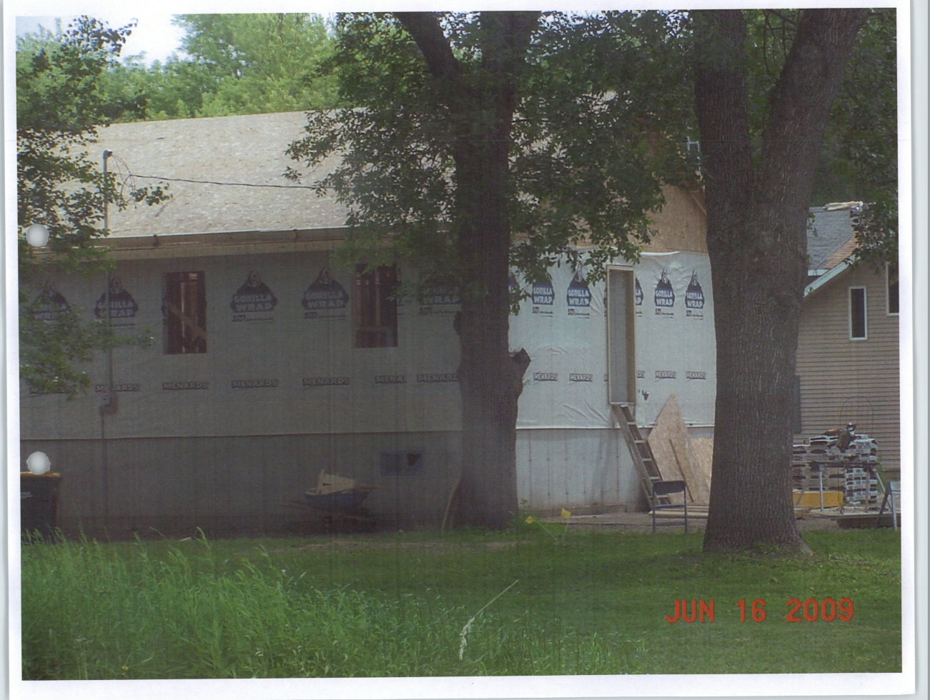
Permitting Scenario 6
Our department received a complaint that the owner was rebuilding the structure.

Slide 12
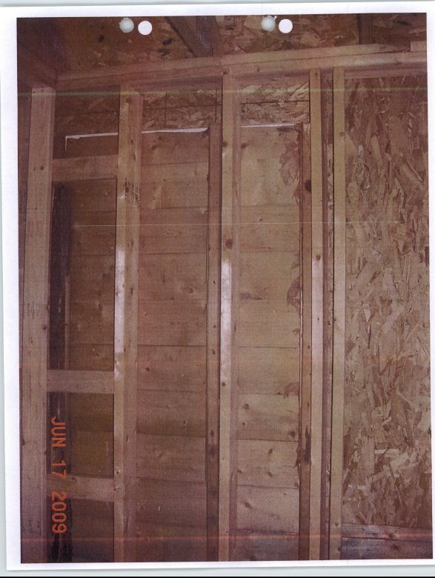
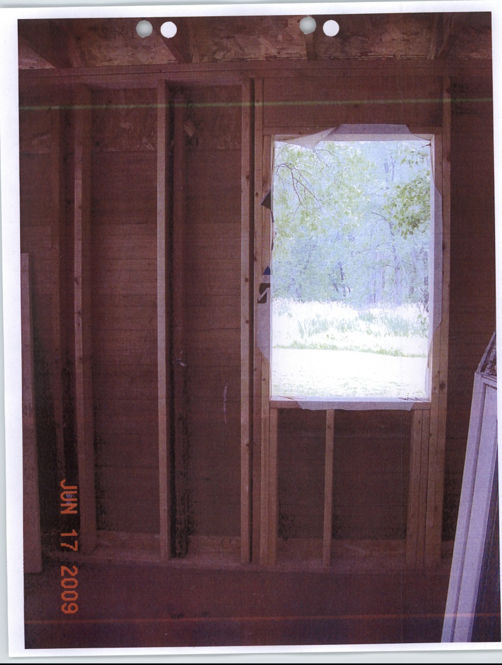
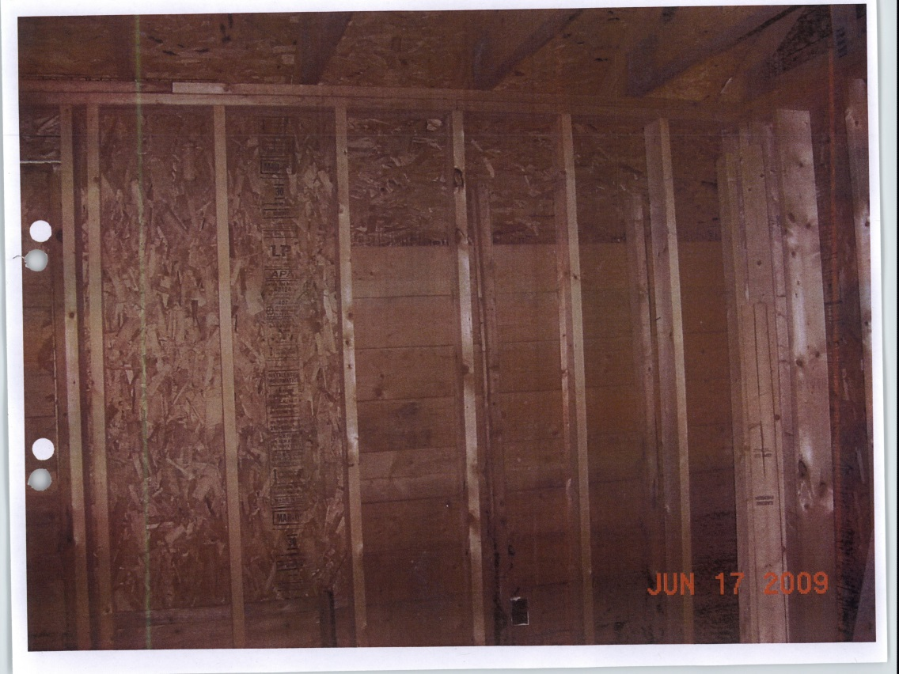
Permitting Scenario 6
Our department contacted the owner for an interior inspection.
Photo’s of interior inspection.
Photo’s of main section of the structure

Slide 13
Permitting Scenario 6
Is this a violation of the original permit issued for raising the structure and garage addition?
If it is a violation, can you issue a permit for the additional work?
If you can issue a permit, what additional information do you need?
If you can’t issue a permit, what would be required to rectify the violation?
Please explain all answers.

Slide 14
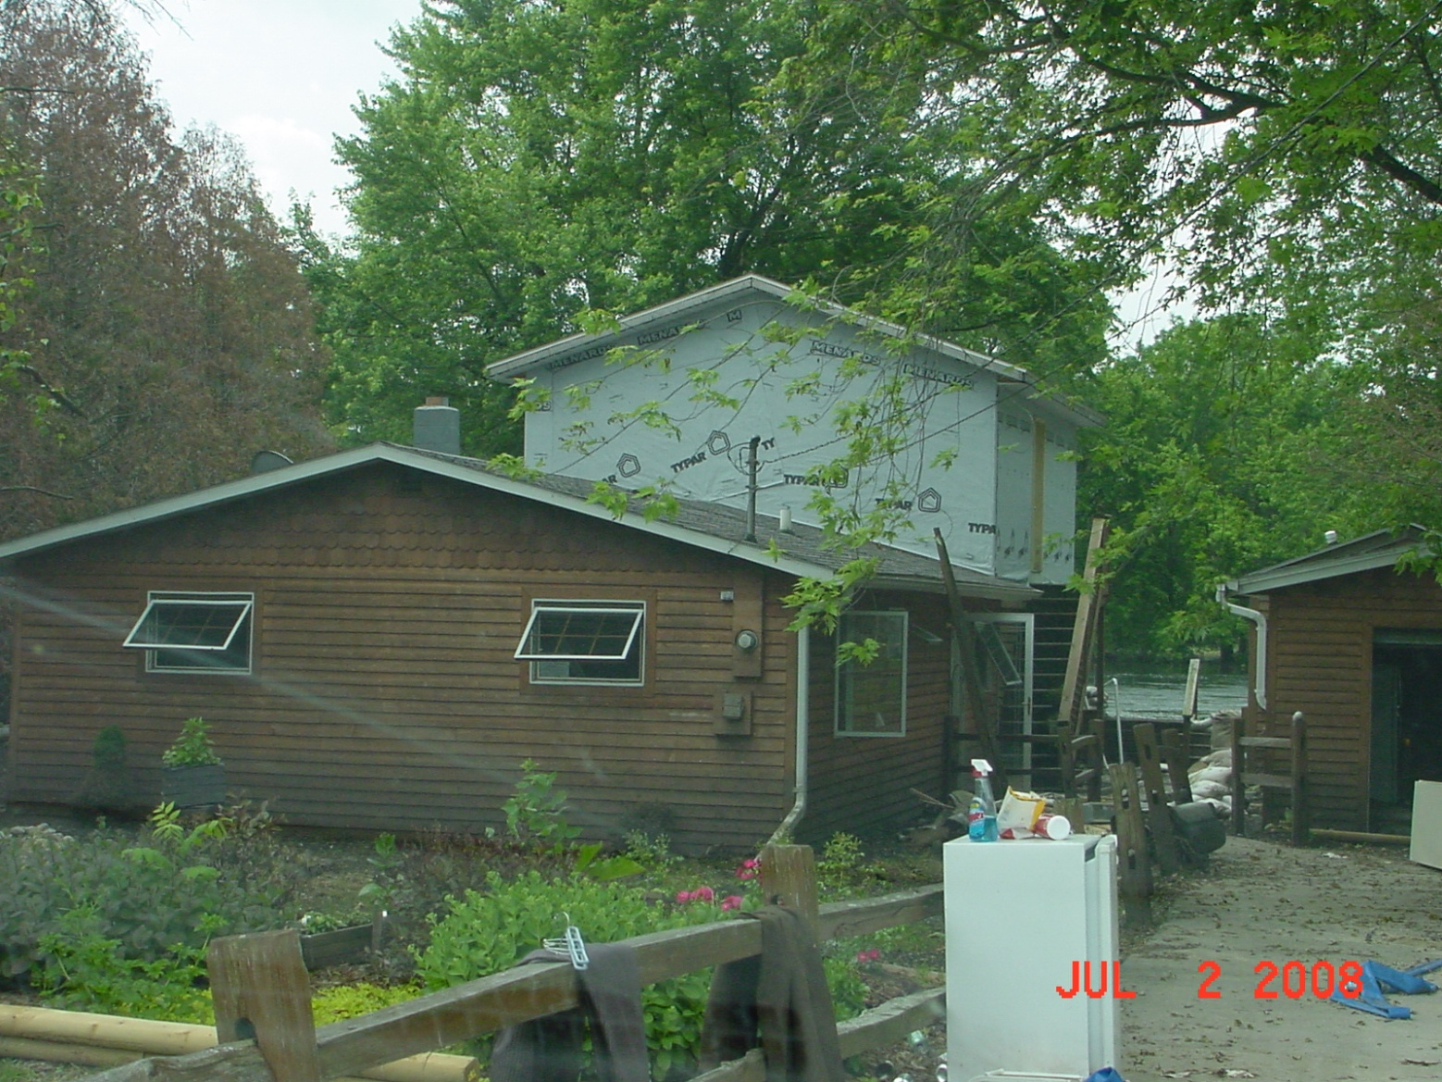
Permitting Scenario Number 7
Owner would like to build a 2nd story addition on this structure that is located in the Floodway but there is dry land access is available.
Notes:
Just have to make sure it is less than 50%. This was permitted before the flood and then flood came after.

Slide 15
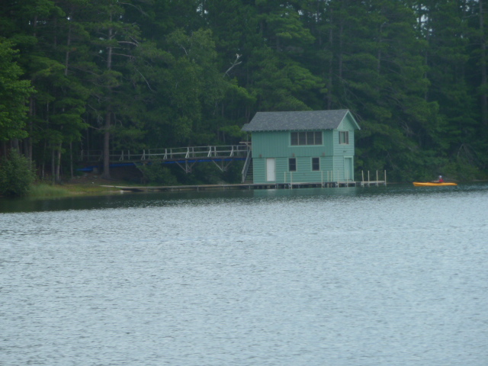
Permitting Scenario 8
Are Floodplain Permits required?

